Slide 1
NHMF – Conference 2017
Building Our Future
Paul Wenham
Southern Housing Group

Slide 3
Southern Housing Group – Who are we?
In 1901, a charitable trust was set up to provide housing for the working poor in London. The first properties were completed in 1910 on Liverpool Road, Islington in London and, over the years, many more homes have been built throughout London and the South East of England.
In 2001 the Trust changed its name to Southern Housing Group to reflect the changing nature and scope of the organisation. In October 2010 a single charitable housing association, Southern Housing Group Ltd, was formed from the amalgamation of Southern Housing Group Ltd, James Butcher Housing Association Ltd and South Wight Housing Association Ltd.

Slide 4
Southern Housing Group – Past
We currently operate across 54 boroughs
We operate in five regions
We own and manage approximately 30,000 homes in the South East
Group turnover £213M (2015/16)
We spend in the region of:
£25M per annum on repairs
£5M per annum planned works
£4M per annum on cyclical works
£20M per annum on major works

Slide 5
Southern Housing Group

Slide 6
Southern Housing Group – Our performance 2014/15………
Overall Resident Satisfaction 75%
Satisfaction with repairs 91%
Complaints (received) 569
75% Repairs
14% Staff Conduct
4% Estate Services
4% Tenancy Management
2% Other

Slide 7
Southern Housing Group – Our performance 2014/15………
Time taken to resolve complaints – (Average) 58 days
Repair Complaints – Top three categories:
Incomplete repairs 26%
Repair delays 41%
Missed appointment 20%
Void loss 1.2%
Lettings (Average) 44 days
Gas compliance 99.97%

Slide 8
Why change?
We are doing ok but…………….

Slide 9
Context
Efficiency and value for money
Rising customer expectations
Personalised and insightful services
Why?
Retained social commitment that is complemented by commercial business opportunities
We do well BUT could do so much better
Modern services that offer choice and ease of access
Consistency in core services derived from a set but flexible operating model
Notes:
Why do we need to do it?
Customer are more demanding when interacting and transacting with those who either provide services to them.
All sectors are striving for efficiency and providing excellent customer service is a key area most companies – including us – can improve on.
We do well but we could be great. Your feedback has told us we excel in some areas, but could do much better in others.
Staff feedback about performance and capability through Glad, Sad, Mad and work with The Clearing is less positive than GST’s.
Excellent customer service is a key part of our corporate strategy
But we need to enable you and the business to provide excellent customer service, so we need to transform and modernise our services. That’s what the Building our Future programme is all about.
Everyone who works here wants to make a positive impact on the lives of our customers and to continue to do this we need to:
Improve access for our customers, giving them the choice of how they interact and transact with the Group.
Empower you to make positive decisions and find solutions to enhance the customer experience.
Understand who our customers are and how they want to be contacted and served.
Use our Corporate Strategy and social objectives to drive our business and provide services in the most efficient, but ultimately customer-focused, way.
Enable you to have a more flexible and mobile approach to meeting our customers' needs that is backed up with online and off-line access into the organisation – a 'virtual' Southern Housing Group wherever you are.
Political pressures
A lot of changes are coming, especially from the Government
We started Building our Future programme before these changes announced, our recognition that we need to change sets the foundations for us to thrive.
Pressures like Right to Buy, the 1% rent reduction and benefit caps, we need to maximise our ability to be efficient and focus our business on the customer.
This isn’t about cutting costs. It’s about making sure we provide our customers with an amazing experience.
To do that, we need to make the best use of our resources.
Because we’re a not for profit, any money we save through the Building our Future programme gets reinvested back into the business to either build the homes that are so badly needed or to improve our services.
Other industry changes
Many competitors considering mergers
Our financial strength and stability makes us resilient and will allow us to remain independent – we’re not merging with anyone.
We open to acquisition, but this means other organisation works to the Southern Housing Group way.

Slide 10
Key Drivers
Flexible Service that is customer focussed
Improved Standards
Consistency good service that is flexible, dynamic and creates an excellent customer experience
Better access to senior staff and improved staff empowerment
Improved operating costs
Clear ownership and responsibility
No role/function duplication
Known and understood operating model

Slide 11
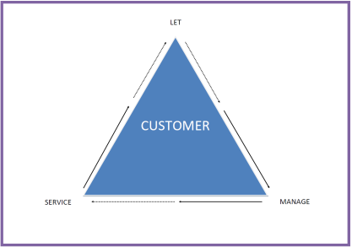
Ownership and Responsibility
Clear Ownership and Responsibility
Customer Services Directorate

Slide 12
Project Structure
Strategic Change Board – Sponsor, Project Leads, Programme Support Team, Communication Support
Group Projects
Technology: Technological enablement and integration via digital/mobile, IT Infrastructure, internet, intranet and telephony
Services and Processes: Simplification and modernisation of services and processes enabling staff to excel at customer service
Resources and Service Structure: Making it easy to do business with
Data and reporting: Data cleansing, storage and use – single view of the customer

Slide 13
Project Structure
Group Projects ….continued
Communication: Simple access to information that enables and enhances the impact and clarity of service offer to customers
Performance Management: Performance manage at all levels with dashboard reporting providing common and consistent management
Third Party Management: Ensuring our contractors are “on-boarded” with transformation and systems/processes
People and Organisational Development: Translating customer excellence – a common language and culture, a balance of people and technical skills with staff who are fluent in a multi-channel communication environment

Slide 14
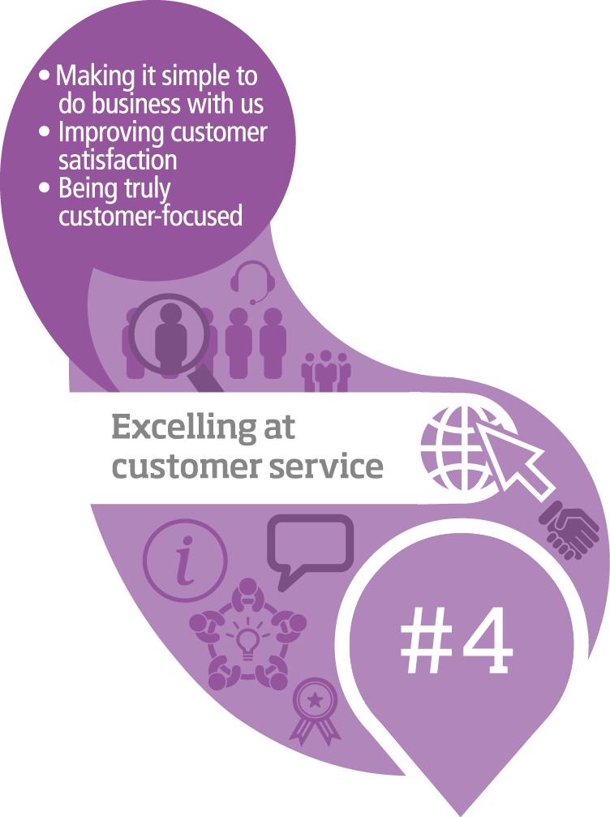
Project principles -
Excelling at customer service
Digital by design
Self serve option, paperless interactions
Encouraging channel shift where possible
Simple and effective customer experience, easy to do business with
Customer driven organisation, using customer insight as a key method to deliver services and products
Flexible, value driven services that meet the needs of our customers and communities
Notes:
If we think about modernising our services and giving customer’s the choice and ease of access we need to consider all channels.
***EXERCISE*** - think of examples of excellent and poor customer service that you’ve experienced
Then, pull up the principles:
If we then compare the principles of the project against #4 “Excelling at customer service”, we can see many similarities.
All of us want to make a positive impact on the lives of our customers and to continue to do this we need to:
More accessibility for customers, flexible and mobile approach for meeting customer needs
Understand who our customers are and how they want to be contacted and served
Give customers choice of how they interact and transact with the Group

Slide 15
About Building our Future
Cannot be done in isolation (Group wide transformation)
Openness and honesty
Group Board buy in
Track record of projects – some good, some poor – some not finished!!
A project isn't a solution it’s the beginning of a journey…..
How does the Resident bit work?

Slide 16
About Building our Future
Project structure – buy in from each department
Resource project – Project support, backfill posts…
Business as usual wherever possible! The day job must continue but Group awareness and prioritise performance areas
Project teams – new people and not “my” team…Group volunteers. Different job levels and specialisms. If you do what you’ve always done…

Slide 17
About Building our Future
Project teams have to gel. They need to get to know each other (workshops)
Specific responsibilities for teams with clear deadlines
Be aware – some like to talk, consider (which is good upto a point..)
Delivery is better!

Slide 18
About Building our Future
Third Party Management
Understand what it means
Don’t over complicate – our business is already complicated!
An opportunity to step back. Consider what works well and why, volume, value of work/relationships.
What do others do?

Slide 19
About Building our Future
Third Party Management
What do others think within your own organisation?
Reduce complicated systems – perhaps you already have a good process…you don’t follow!
System thinking is good but don’t let it cloud common sense!
Link in and modify BAU if possible – small steps big outcomes
Don’t lose sight of what you're trying to achieve!

Slide 20
Third Party Management
The process – Phase 1
Workshop
Terms of reference
Data – costs/experience/
Interviews
Workshops
External & Internal providers
Findings
Outcomes
Phase 2

Slide 21
Third Party Management
Moving Forward

Slide 22
Its all about the customer!
https://www.youtube.com/watch?v=E83PSa-QHOo
Notes:
Faulty towers video, lighten the mood
We don’t want to be faulty towers….
2. ASK Who are the customers & supplier's in third-party management? flip chart call outs.

Slide 23
Third Party management work stream What's its purpose?
Create a purpose statement
Each group present back to team
Team vote on best statement
Team flip chart what should be done with statement
A purpose statement is a sentence which summarises something specific and its reason for existing.
Notes:
Break team into sub groups (without announcing)
Ashley O`Garro, Colin Thomas, Mattio Righetti / Mohit Jain, Elizabeth Williams / Stuart Clark, Sue Green, Kay Messam / Dawn Doherty, Paul Cotton
2. Hand out High level Scopes
3. Each sub group to write a purpose statement for the work stream on Flip Chart
4. Each Sub Group to Present to one another – choose favourite
5. What shall we do with this statement? Thrash out ideas & share, agree, get owners. – Flip Chart

Slide 24
3rd Party How is it defined?
Notes:
Break team into sub groups (without announcing)
Ashley O`Garro, Colin Thomas, Mattio Righetti / Paul Cotton, Elizabeth Williams / Stuart Clark, Sue Green, Kay Messam / Mohit Jain Dawn Doherty
2. Each sub group to write a definition of a third party on Flip Chart
4. Each Sub Group to Present to one another – choose favourite
5. What shall we do with this definition? Thrash out ideas & share, agree, get owners. – Flip Chart

Slide 25
Third Party Management
Strategy
Review Operations
Performance & Direction
Standardisation & procurement
Accommodation
Ashley O`Garro
Matteo Righetti
Colin Thomas
Mohit Jain
Elizabeth Williams
Stuart Clark
Sue Green
Kay Messam
Paul Cotton
Dawn Doherty
Purpose
Notes:
Always have the purpose of the 3rd Party Management work stream objective in mind.
The scope has been split into bite size chunks and defined.
Team members are assigned to each of the scope areas and set clear objectives which will deliver outputs.
Over time, the collaborative outputs of the teams work will create a new strategy on which Third Party Management will sit.

Slide 26
Introduction to Sub Groups
Notes:
Hand out Scope & Deliverables to Groups
Groups to read, produce a purpose statement, present back to other groups, feedback initial thoughts and sound any challenges

Slide 27
High level ‘To do lists’
Today
Add coffee to mug
D
Add hot water
Get mug
Walk to tap
Boil kettle
Turn on tap
Fill up kettle
Get coffee
Get spoon
Spoon coffee into mug
Pour in hot water
Stir
D
Notes:
Sub groups to follow methodology, make high level plans and call out for CSI support they think they need. Detailed plans will be collated over next 4 weeks to be presented to PW for sign off.
Sub groups to present back their high level plans to project team and highlight any CSI support they think they need.
Project Methodology templates - needed

Slide 28
Standard project administration
Notes:
Group write standard project administration needs on post its on wall
Group breaks for a cuppa WS groups views
After cuppa WS presents back views & team members take ownership of resourcing standard methods
Project plans
Risks & Issues
Quality Checking
Meetings
Communications / reports / newsletters
Control protocols
Roles and responsibilities

Slide 29
Third Party Management – What does this mean?
Purpose Statement:
“Enable our staff and service providers to work together seamlessly and consistently to exceed our customer`s expectations”
Definition Statement:
“Anyone external to the Group who provides service to our customers”

Slide 30
Third Party Management

Slide 31
Third Party Management – Phase 1
Data & Research:
Social Value Today – Housemark
Social Impact of Housing Providers – HACT
Communities Count – Orbit
Good Practice Contract Management Framework – National Audit Office
Understanding Contract Management – Modern Gov
G15 Questionnaire & Survey

Slide 32
Third Party Management – Phase 1
Data & Research contd:
SHG Staff interviewed (Cross section)
Presentations and working Groups with external providers:
Fastflow Group (Social Value delivery methods)
Chas Berger (Working with SHG as a client)
Breyer Group (Working with SHG as a client)

Slide 33
Third Party Management – Phase 1
Data & Research contd:
Third party supplier matrix – SHG suppliers, work value, contract arrangements
Third party management arrangements across SHG
Group procurement & G15 procurement bodies

Slide 34
Third Party Management

Slide 35
Third Party Management

Slide 36
Third Party Management

Slide 37
Third Party Management
Achievements – New structure, agile working, new patches/regions, re-procurements….repairs, gas, major works, repairs strategy, VFM, staffing structures, remove reliance upon Consultants, new opportunities, additional staff, flexible work, new office environment………….

Slide 41
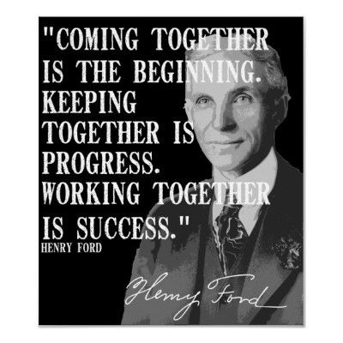
Working together
Listen
Act
Engage
Support
Enable
Notes:
Support and deliver a flexible service offer that is customer focused across all customer touch points and areas of the business
This is a new and different approach to how we respond to the ever changing needs of the customer and the outside world e.g. regulatory and government changes
It is also to enable us to work in a consistent, joined up and flexible way regardless of the area of the business we are in
The work runs across the whole of the end to end customer journey e.g., form the time a customer is trying to find a home, all the time the live in their home, to the time they move out or move on regardless of tenure type (covers all tenures)
Listen – to each other and the customer
Act – do and deliver
Support – each other and the customer
Enable – by doing your job well it enables others to do theirs
Engage – get involved and be part of the future

Slide 42
Stay updated and involved
Notes:
Lots of ways to keep up to date
And still opportunity to get involved.

Slide 43
Any questions?
Paul.wenham@shgroup.org.uk
buildingour.future@shgroup.org.uk

