Slide 1
Workshop 2e:
How can technology support stock condition surveys?
Speaker: Richard James (Solon), Andrew Tolley (Solon), Mark Pickance (Director for Upshott UK Ltd), Chaired by: David Jarvis (King Street Housing) Room: Dorset Room

Slide 2
Solon’s Experience in Using a UAV
Introduction to Solon
Why we chose UAV (drone) technology
What is a UAV
Some examples of drone surveys
Benefits & cost savings achieved
Limitations & other considerations
Legal requirements
Setup & running costs
Further uses

Slide 3
Introduction to Solon
Established in 1974 Solon is a Registered Provider based in Bristol
Owns 1300 affordable homes mainly in Bristol & South Gloucestershire
Large number of inner city pre 1900 street properties

Slide 4
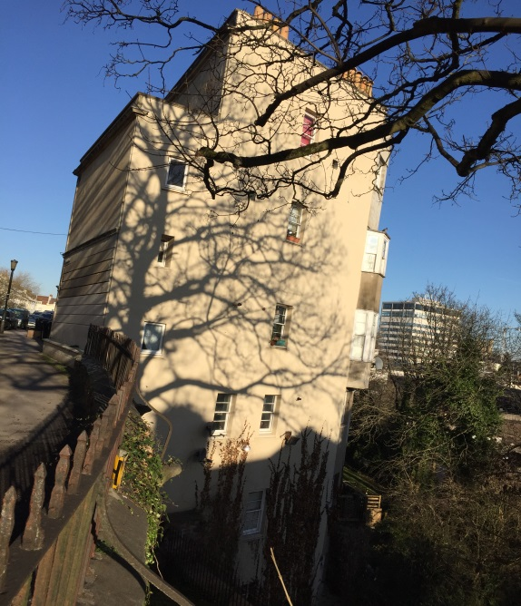
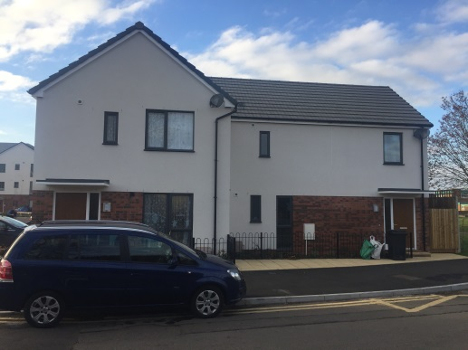
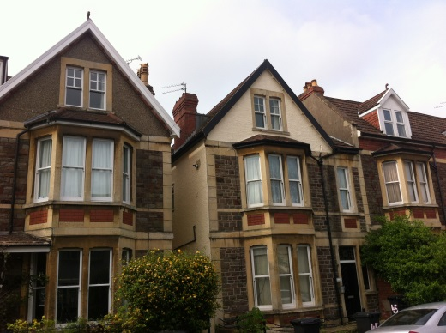
Introduction to Solon
Typical Solon Properties

Slide 5
Why we chose UAV (drone) technology
Stock includes a high proportion of properties with difficult to access areas
Found we were spending a lot on scaffold for inspection purposes
Scaffold staying up on properties for a prolonged period of time resulting in customer dissatisfaction and additional cost
Roof defects taking time to explore and rectify
Scaffold causing disturbance and risk to staff, customers and the public
A drone offered a quick and cheaper way of inspecting difficult to access areas

Slide 6
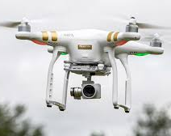
So What is a UAV – in brief..
Unmanned Aerial Vehicle (UAV)
Remotely controlled
Quadcopter configuration
Stable flight
Electronic (battery) powered

Slide 7
The control system
Controller and tablet

Slide 8
Case Studies

Slide 9
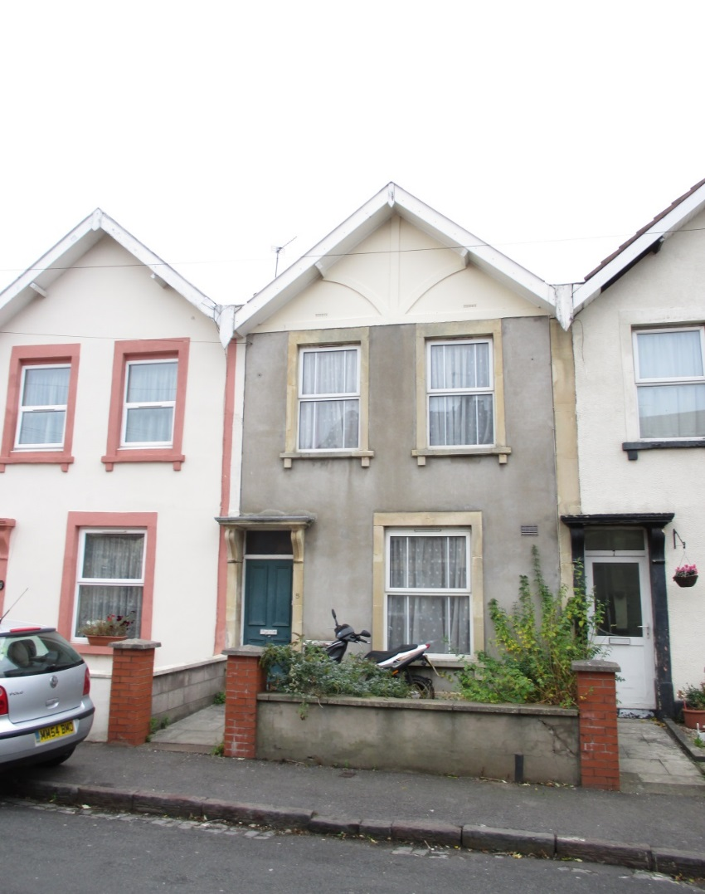
Case Study 1

Slide 10
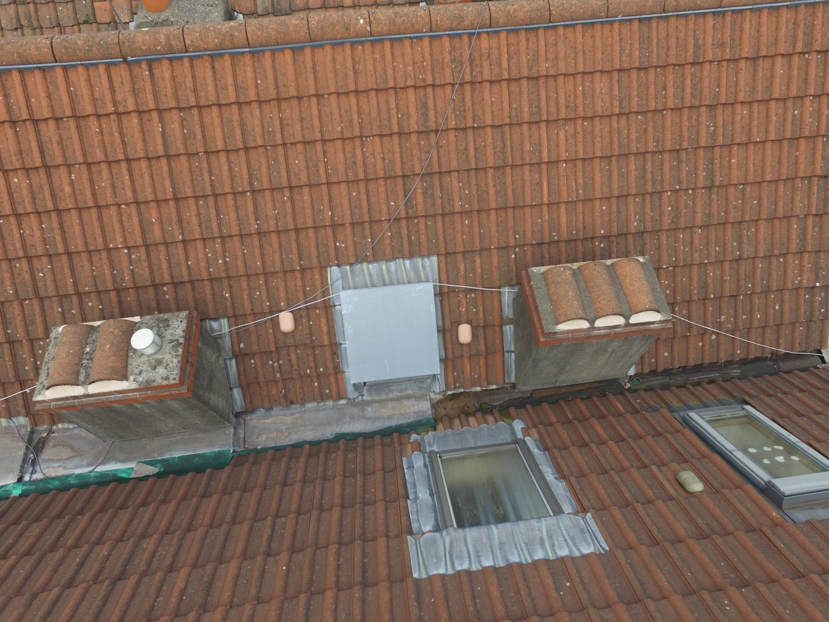
Blocked ventilation

Slide 11
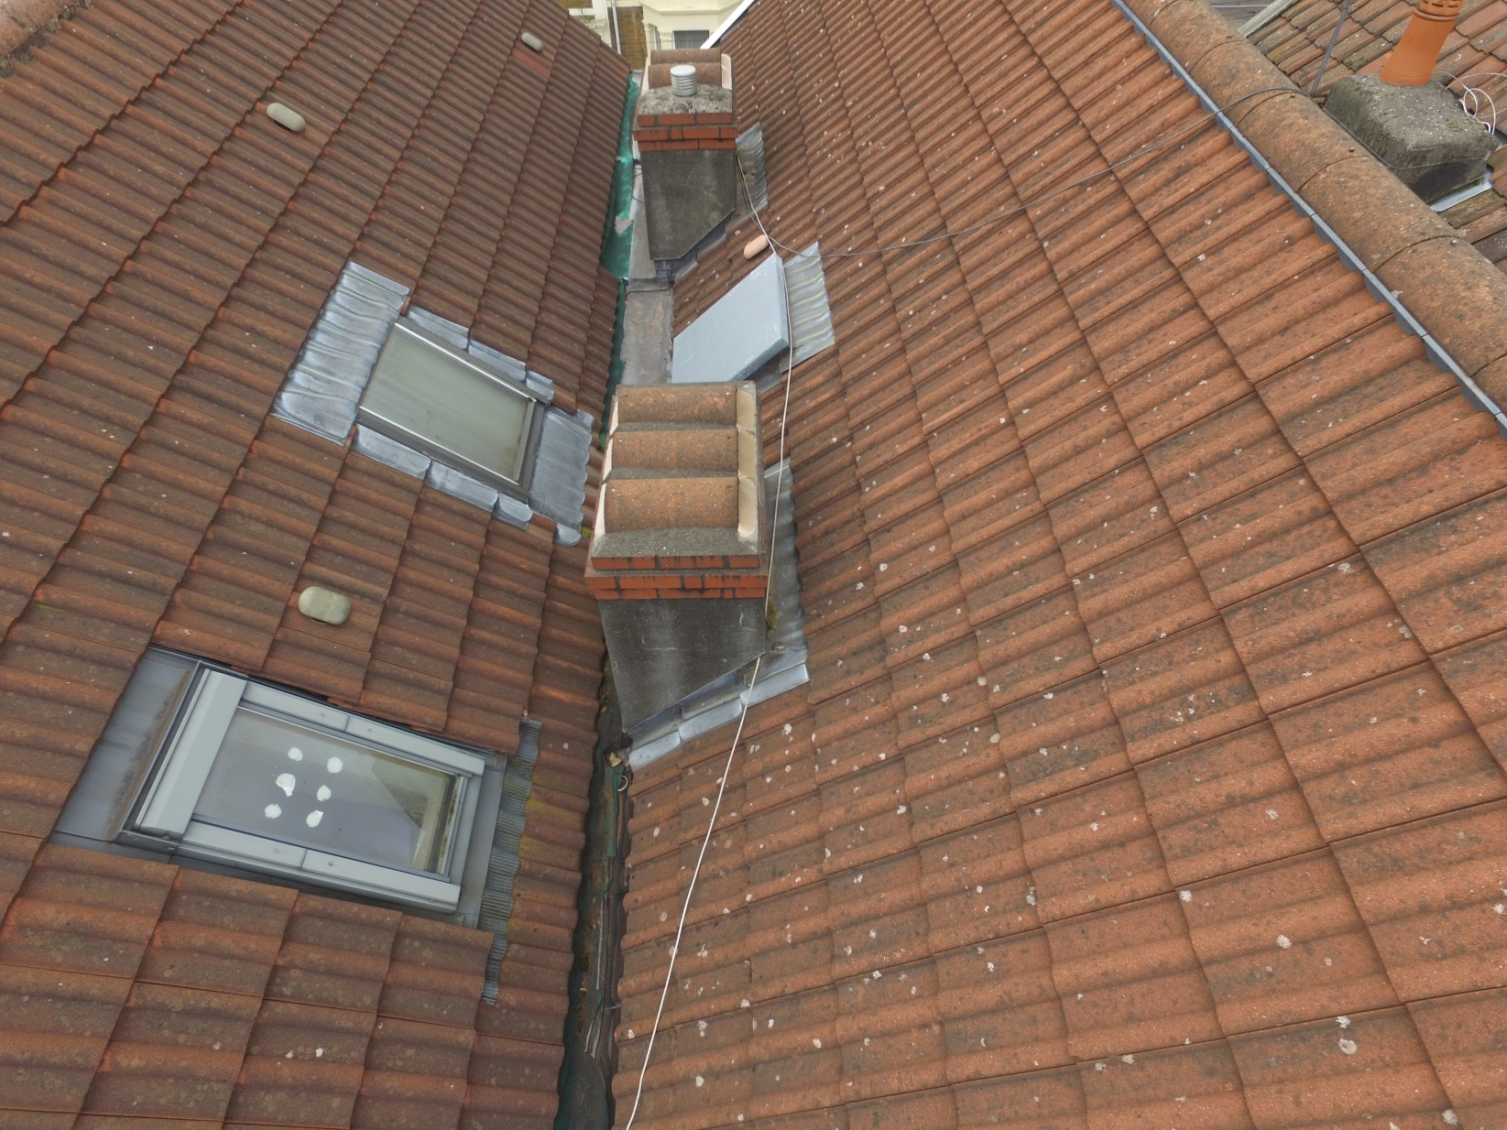

Slide 12
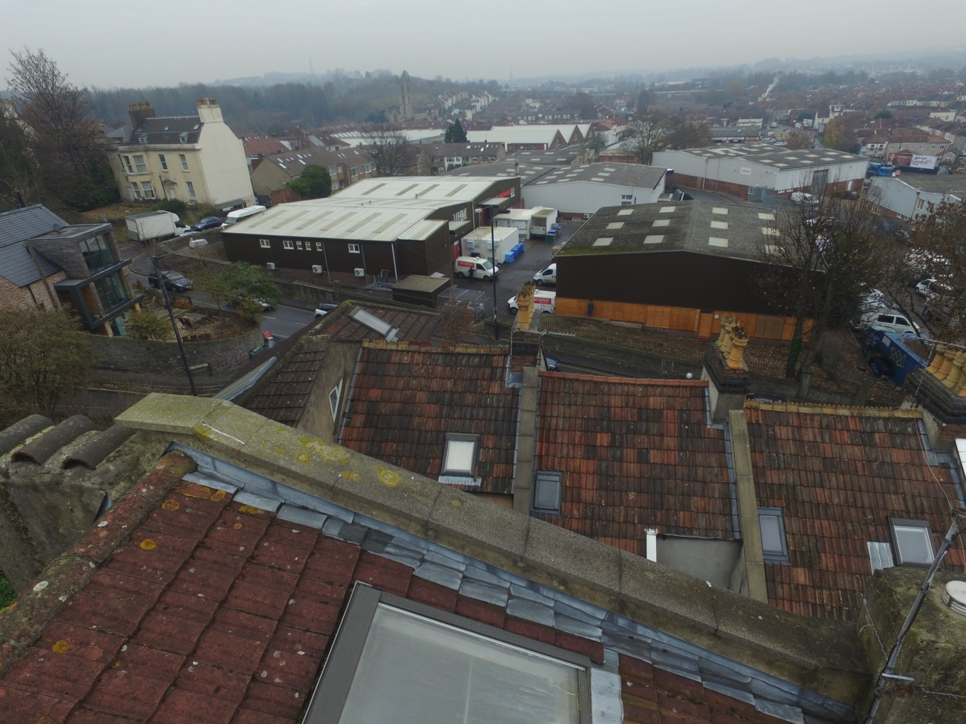
Case Study 2
Check roof condition following reports of damp within the property

Slide 13
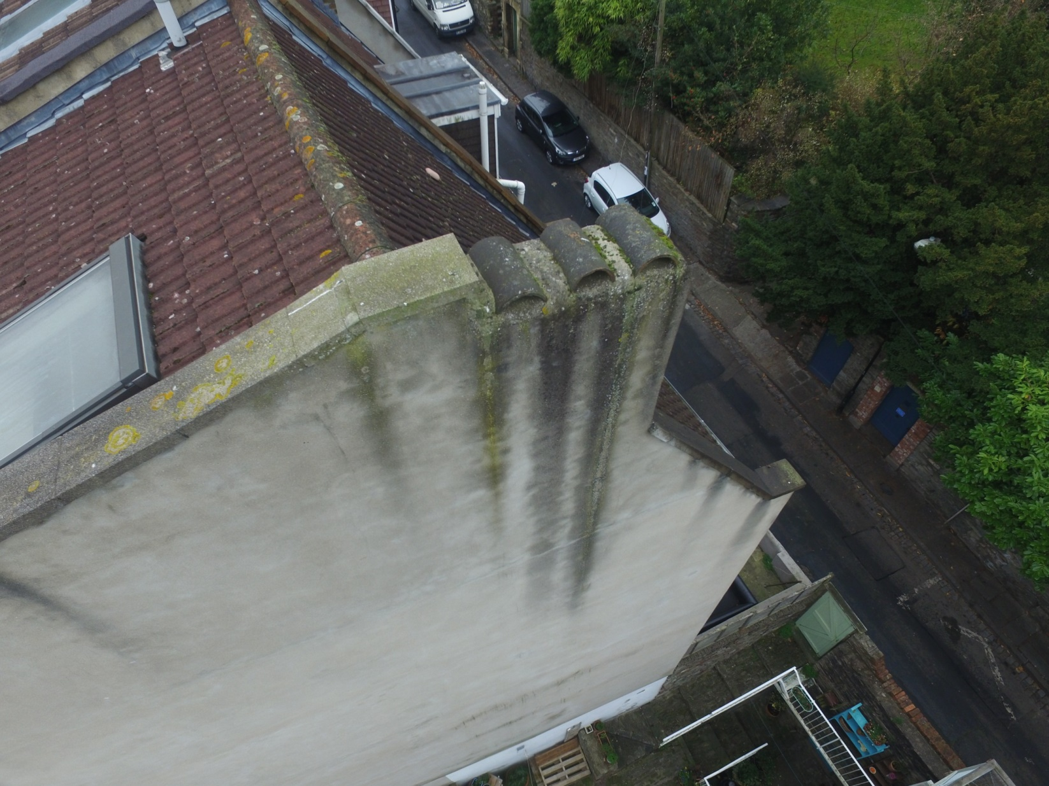

Slide 14
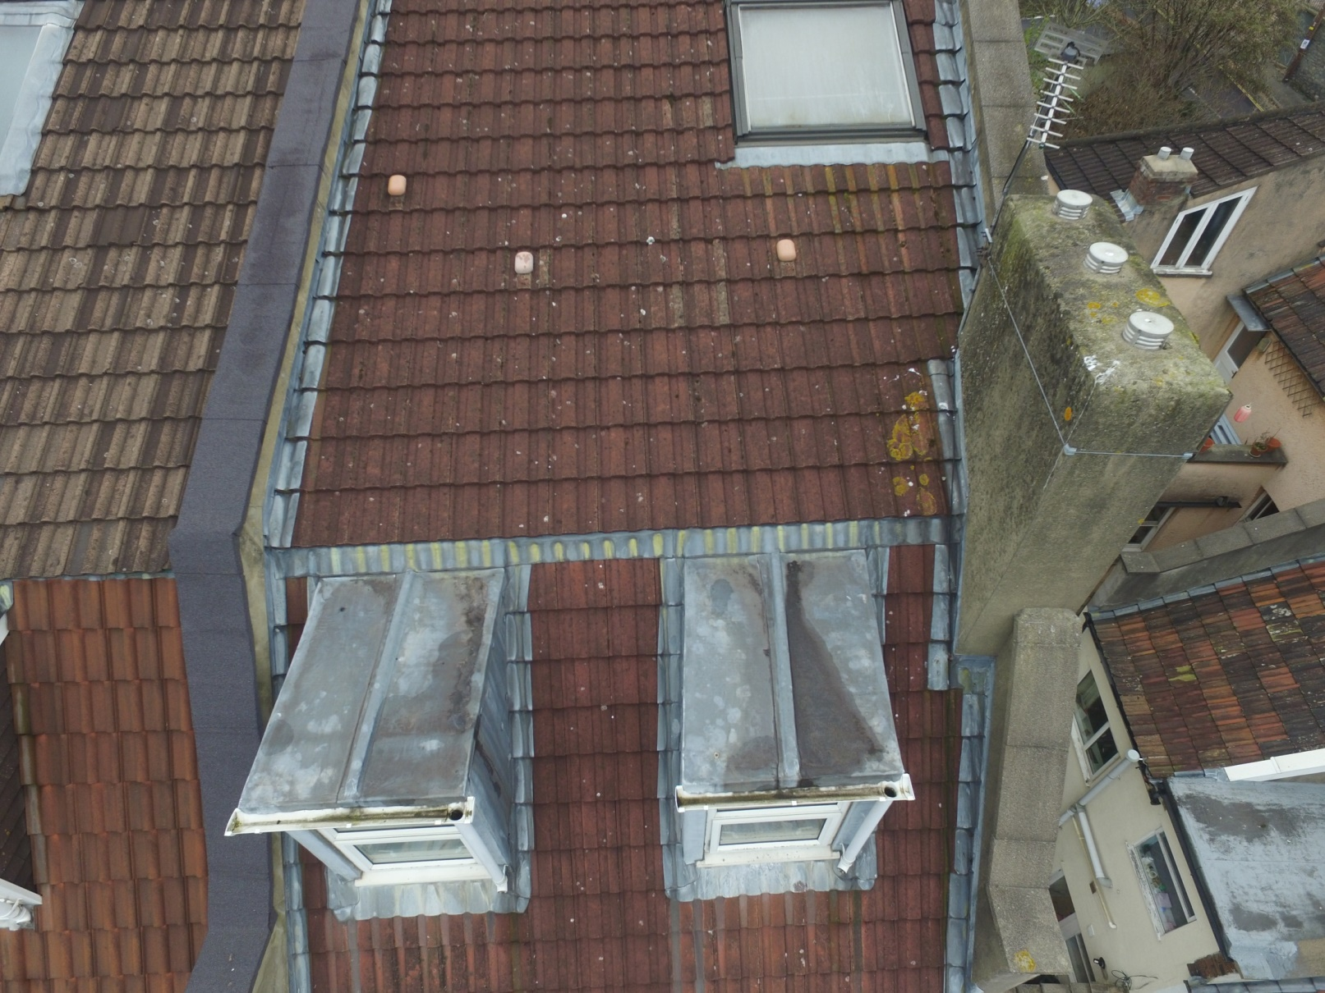

Slide 15
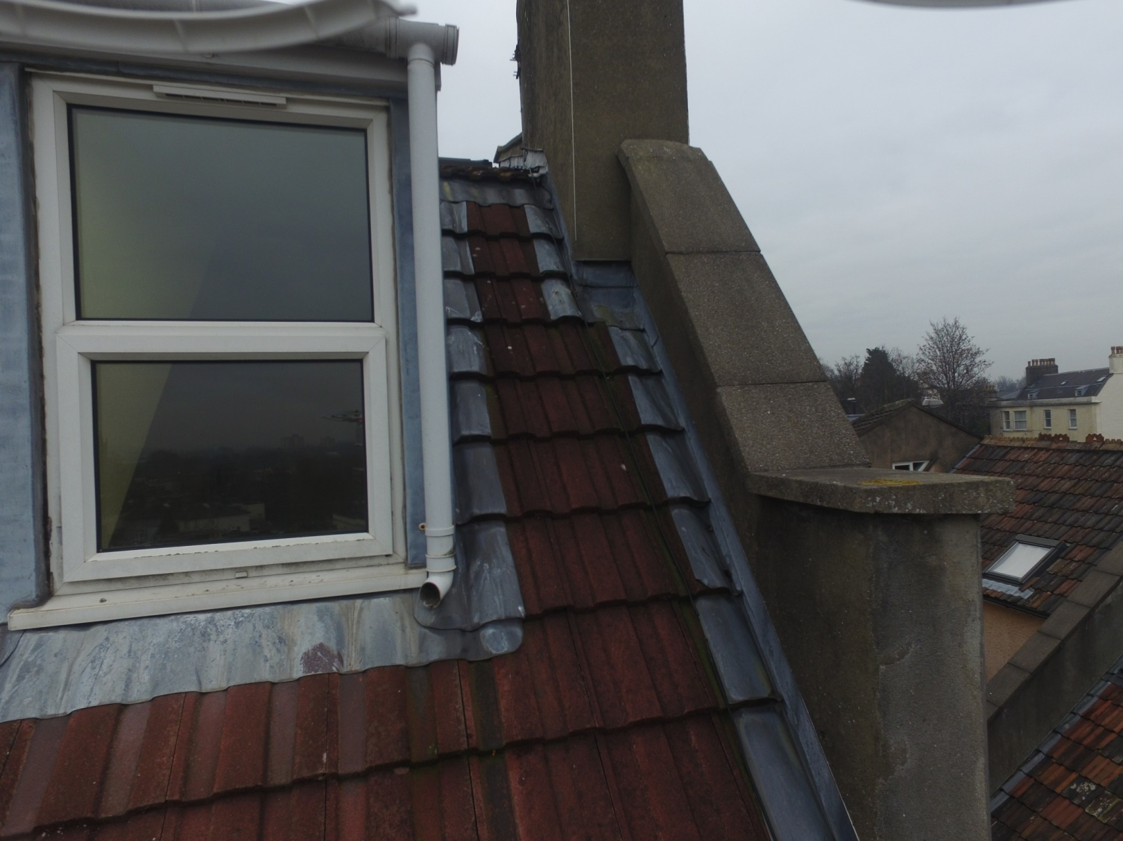

Slide 16
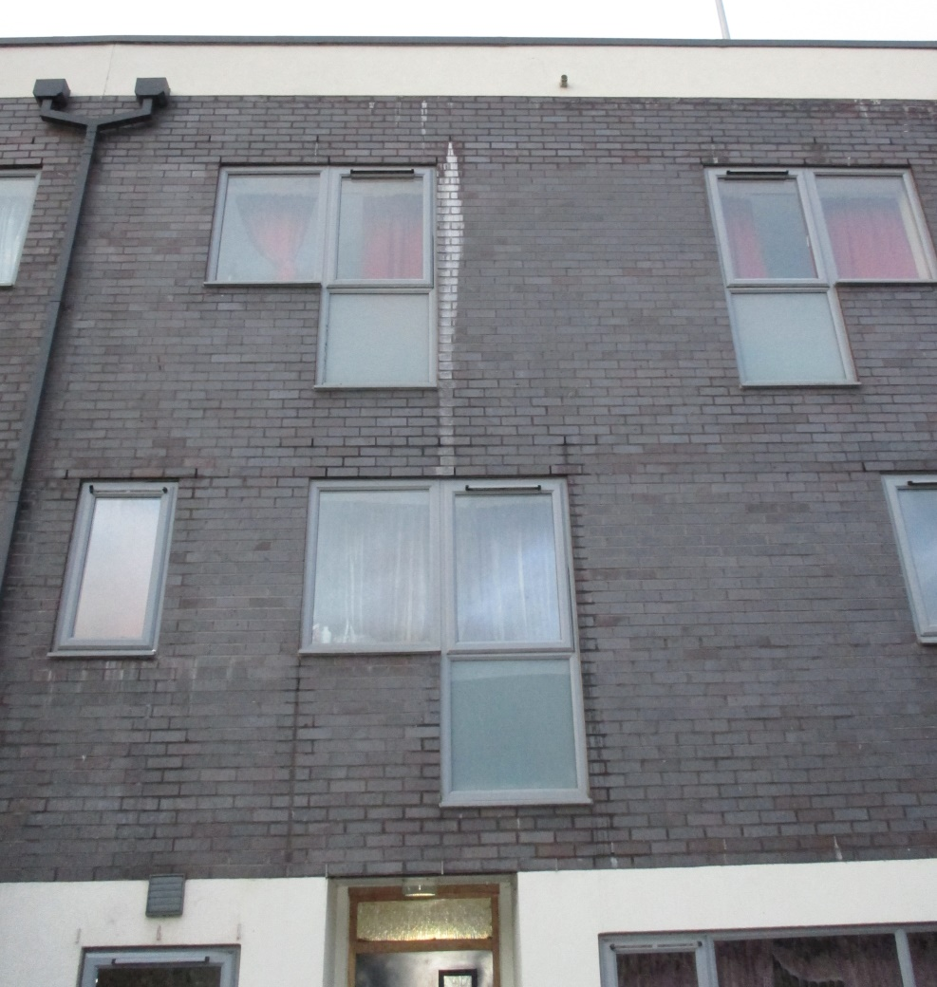
Case Study 3

Slide 17
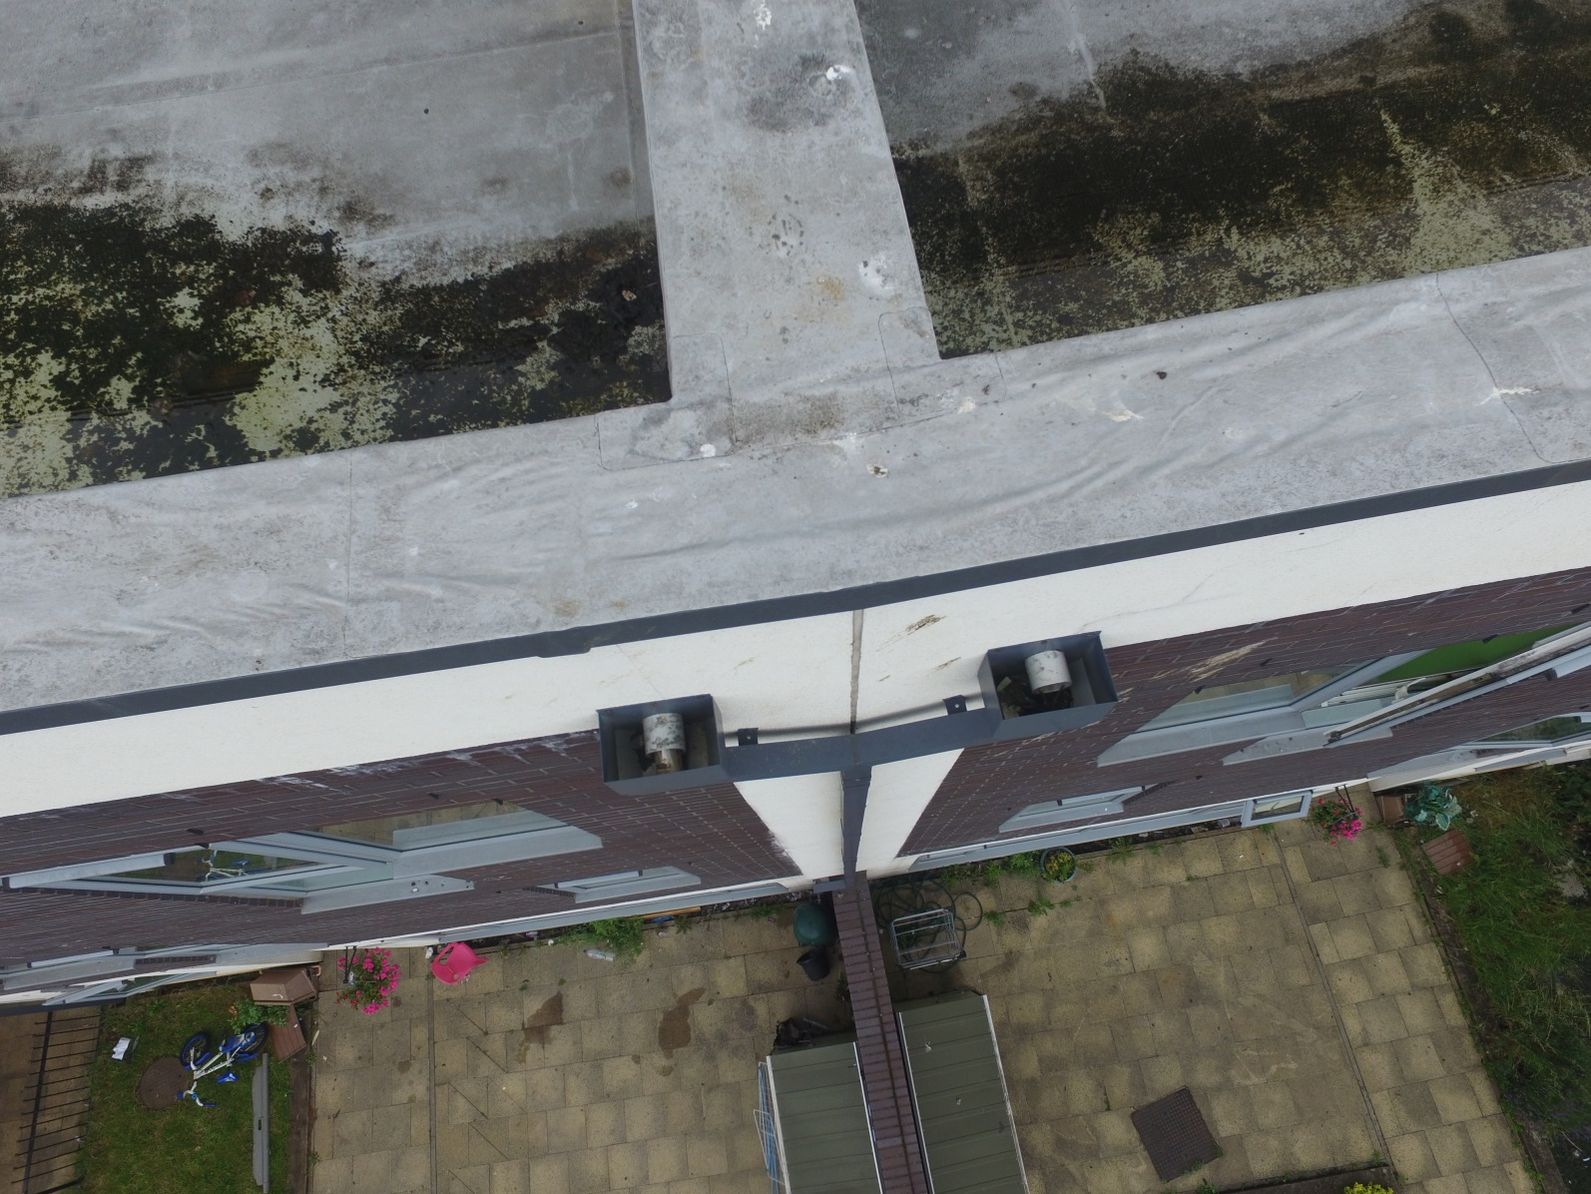
Inspection of roof to determine cause of damp within properties

Slide 18
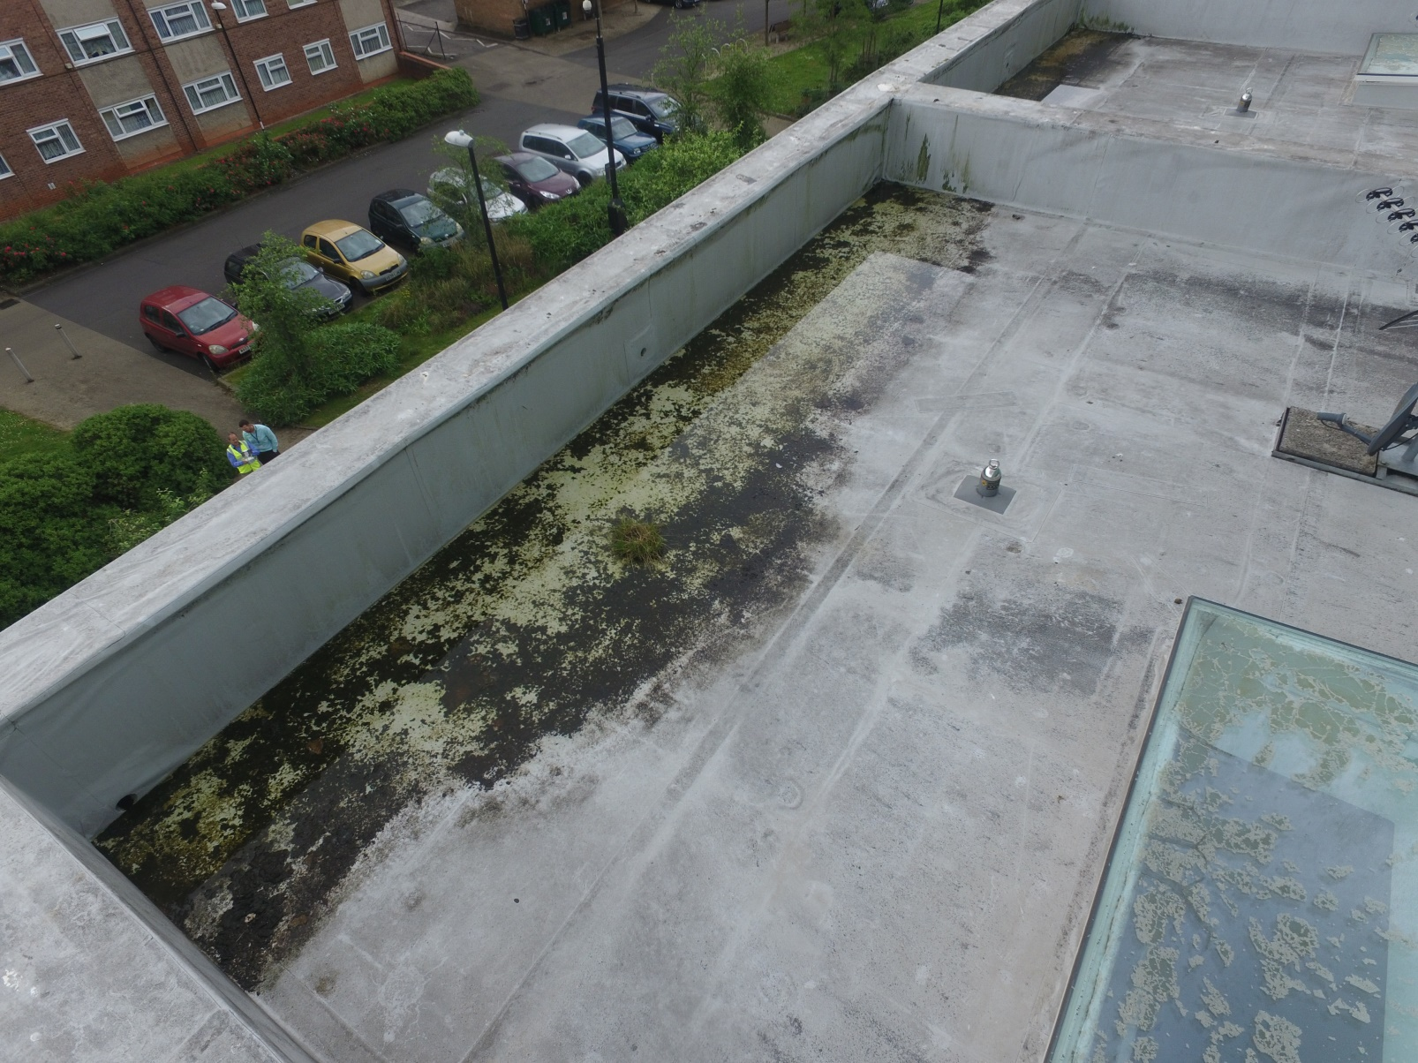

Slide 19
Benefits & Cost Savings
Benefits Achieved
Speeds up the inspection process for roof related work.
Improved safety for surveyors and tenants
Reduced complaints associated with scaffolding
Significant savings on scaffold costs

Slide 20
Benefits & Cost Savings
Cost Savings
To date in 16/17 we have saved Approx. £11,000 over 21 roof inspections (less set up costs).
Hope to save £12-15K annually
Against these savings must be factored the annual costs:
Annual CAA renewal fee - £112
Drone Insurance premium £550 (could be reduced with less cover/ different insurer)
Savings will vary with different stock profiles

Slide 21
Limitations & Other considerations
Weather dependency for drone operations
Control interference
Unsuitable sites
Training / licencing process, time and costs
Evolving Civil Aviation Authority (CAA) regulation / compliance

Slide 22
Legal Requirements
Restrictions
You must not fly a drone:
Over or within 150 meters of a ‘congested area’
Over or within an open air assembly of more than 1000 persons
within 50 metres of any vessel, vehicle, person or structure which is not under the control of the person in charge of the aircraft.
Higher than 400 feet above you or 500 metres horizontally from you

Slide 23
Legal Requirements
The CAA governs the use of UAVs in the UK
Permission from CAA is required to operate a UAV in ‘congested areas’ and within 50m of a structure or property.
The aircraft must be operated in accordance with your CAA permission and your (approved) operations manual
The aircraft must remain within visual line of sight during flight (VLOS) of the pilot

Slide 24
Legal Requirements
Requirements for CAA permission for commercial operation
UAV Pilot qualification
Theory (similar in content to private pilots licence + Drone specific)
Practical (flight test)
Operations Manual – working document (for approval by CAA)
Suitable insurance cover for intended work
Payment of fee to CAA for issue of Permission for Commercial Operation)
Mobilisation - Expect it to take 6 to 9 months from decision to fully operational

Slide 25
Setup & Running Costs
Our costs were:
Drone purchase - £1100
Tablet purchase (ipad mini) - £300
Pilot training x 2 – circa £1500
Insurance (annual premium) - £550
CAA permission application fee - £112
Bits and pieces - £300
Total – circa £3800

Slide 26
Further Uses
Plan to start using on the cyclical maintenance programmes to get a better understanding of repairs required to improve the control of budget, scope of work and delivery timescales.

