Slide 1
Active asset management to unlock financial capacity
Chloe McLaren Webb
National Housing Federation

Slide 2
Contents
Why active asset management
Where are we now
Opportunities to unlock financial capacity
Recommendations
Discussion

Slide 3
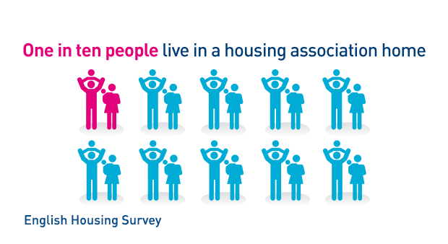
The housing association sector
Notes:
Our members provide two and a half million homes for more than five million people

Slide 4
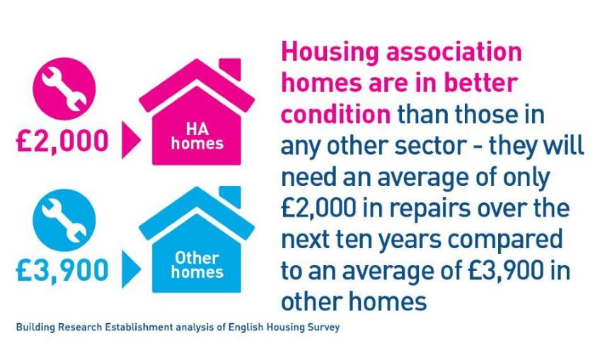
Notes:
These are homes are of good quality:
Housing association homes are in a better state of repair than local authority and private rented homes, and broadly similar to owner-occupied homes.
The HA stock has a higher proportion of homes requiring no repairs expenditure (38%) compared to PRS (29%)
The average cost to undertake the more comprehensive repairs likely to be required over the next 10 years is £2,000 per dwelling. The investment estimated to be necessary in PRS is around double this – over £4,300

Slide 5
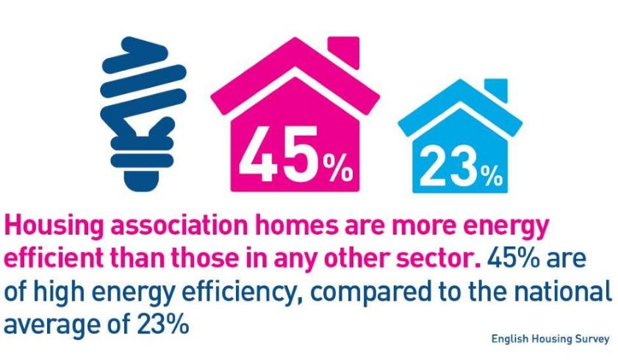
Notes:
Housing association homes are much more energy efficient than homes in other sectors
45% of homes are rated EPC A-C
The average energy efficiency rating in HA stock is 66.2 SAP points compared to 58.8 in PRS.
(SAP rating is a rating out of 100 - the higher the SAP rating, the lower the fuel costs and the lower the associated emissions of carbon dioxide.)

Slide 6
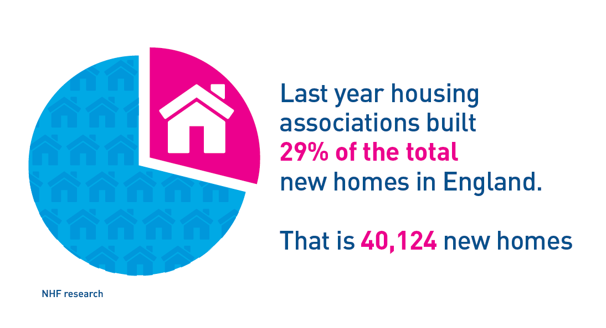
Notes:
As well as providing good quality homes, as a sector we build a significant proportion of new homes.
Last year housing associations built around 40,000 new homes
We want to build more - Ambition to Deliver: by 2035 the sector ambition is to be building 120,000 new homes per year

Slide 7
Why active asset management?
…all of which can only be delivered by maximising the performance and value of the existing stock
Active asset management enables housing associations to maximise delivery of their business objectives. It enables them to understand the contribution that their property and land makes to their business objectives and take action to increase that contribution, which in turn drives up the value of their activities.
- Savills, 2015
Notes:
…all of which can only be delivered by maximising the performance and value of the existing stock
The existing stock is the foundation the sector is built on and active and strategic management of those assets is essential for a successful business.
The changing policy and funding context has had a significant impact on housing association finance.
Reduced grant levels mean that housing associations increasingly make use of private finance and their own capital base to finance the development of new homes which means they are increasingly reliant on rental incomes and the sale of new homes to fund future development.
At the same time housing associations have gained greater freedoms to manage their own assets and use this to leverage new funding.
A strategic approach to understanding and managing the performance of the existing asset base is essential if associations are to secure long term sustainable rental income, and unlock latent financial capacity in order to increase development activity.

Slide 8
Where are we now?
Knowledge and good practice around AAM increasing
Are the right structures, skills and systems in place?
Better alignment of asset management and development strategies needed
Opportunities to reduce expenditure?
Opportunities to increase borrowing?
Notes:
Associations’ knowledge of the financial and social performance of their stock is increasing, and it is now common practice amongst many associations to actively respond to information about poor performance.
Across the sector as a whole, though, the use of targeted actions to improve overall performance, and to support development output, would still be considered best practice.
As asset management practices and priorities change, do we have the right structures, skills and systems in place to support new ways of working.
Alignment of asset management and development strategies is still not strong, so opportunities for one activity to proactively contribute to the other may be being missed, and occasions where one discipline hinders the other continue to occur.
Active and day to day asset management are not necessarily well aligned. Asset management practice still follows the twin track of 30 year business plans but 3-5 year investment programmes, and this can hinder good long term decision making.
Margin is a good indicator of operational efficiency (though certainly not the only one) and there is currently a wide spread of margin performance across the sector. Clearly there are lots of things that impact operating costs – location, provider type etc. And there are external constraints that limit some associations’ ability to improve margins. But, this spread suggests that there must be potential for associations to move performance closer to the current upper quartile.
Some associations have underutilised financial capacity that could be unlocked through additional asset backed borrowing

Slide 9
Opportunities to unlock capacity through AAM
Increasing asset backed borrowing
  Identify or acquire unencumbered assets that can be brought into charge
  Create headroom over existing debt
  Attitudes to debt and risk appetite to support more borrowing
  Review and renegotiate existing loan security and existing loan agreements to identify and enable use of latent capacity.
Notes:
If we look first at the financial side:
READ OUT SLIDE
Each association will be in a different position. However it’s clear that associations need to put efforts to increase capacity front and centre across the whole organisation - these options cover strategies for treasury management, business performance, asset management, governance, and business growth. They are not simply a ‘back office’ or process matter.

Slide 10
Opportunities to unlock capacity through AAM
Performance
  5% saving on both management & maintenance equates to 12% increase in NPVs
  Focus on reducing expenditure but effort can also go into maximising income
Tenure change
  Modest change of tenure can have a significant financial impact
  Practical limitations
Disposals
  eliminating costs of poorly performing property
  just 0.3% of all stock in 2015-16
Notes:
And in terms of the assets themselves:
Disposals - disposing of stock can remove poorly improving stock from the portfolio, help concentrate resources, or free up funds for reinvestment.
However, sale of properties can clearly reduce income as well as reducing expenditure, so it will be important to understand the impact of increased numbers of disposals.
The proportion of properties being sold in the sector each year is still very small – just 0.3% of all stock in 2015-16.
Will the changes to the consents regime have an impact on this? What are the risks attached to that?
Performance – Savills modelling shows a saving of 5% on both management & maintenance and capital expenditure can increase average NPVs by 12%.
Many associations are looking for management & maintenance savings as a result of the rent cut. Associations have reported to the HCA a planned 16% cut in major repairs expenditure over the four year period of the rent cut.
Again, are there risks in this? We’ve seen a lot recently in the press about quality of homes and service.
Tenure change - Savills modelling suggests that a modest change of tenure of rental properties in ownership can have a significant financial impact.
Though there are clear limitations to this – not least around your social purpose. Also loan terms often require a % of social rent, you need to consider market needs and market rents in different regions

Slide 11
Recommendations for housing associations
Understand the range of tools available
Put efforts to increase capacity front and centre across the whole organisation
Develop active asset management strategies and practices to drive down costs and release receipts for reinvestment
Treasury Management strategies to optimise borrowings and release their full capacity
Notes:
Recommendations for housing associations
It is very difficult to prescribe the ideal approach to take in any given situation because circumstances of organisations and geography are varied and complex.
Associations need to understand the range of tools available and be in a position to assess the opportunities and limitations relating to their use.
-what is you process for stock appraisal and decision making, what are the strategic parameters, what are the other considerations as well as thinking about NPVs
This is really all about:
Putting efforts to increase capacity front and centre across the whole organisation
Developing active asset management strategies and practices to drive down costs and release receipts for reinvestment.
Pursuing active Treasury Management strategies, supported by strong governance, to maximise their borrowings and release their full capacity.

Slide 12
Discussion
An accurate reflection?
How does this relate to everyday asset management?
What support do landlords need?
Notes:
Does this reflect your experiences? What are you doing to address these challenges?
Do you think the disposals regime will have an impact on what you do?
Is there anything that we (or others) can do to help associations do this more/more easily?

