Slide 1
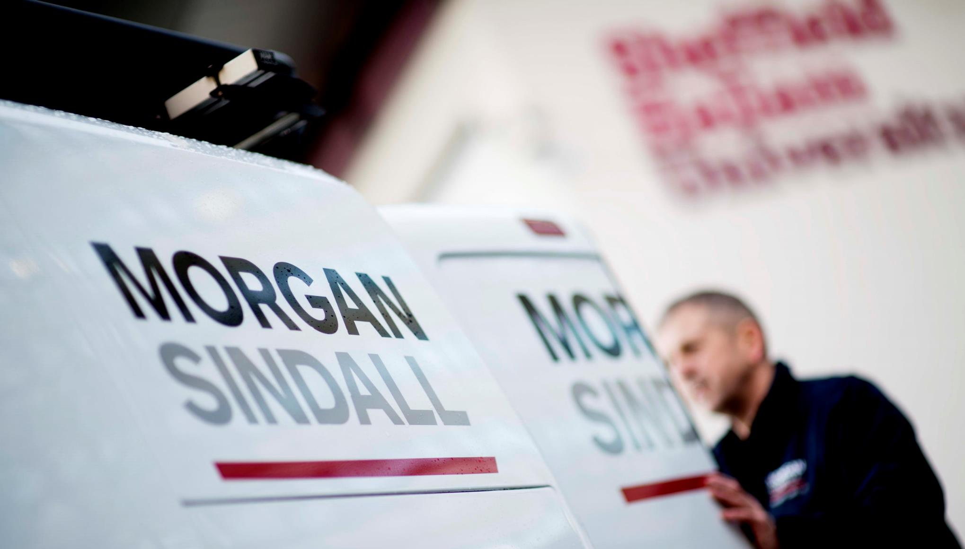
East Asset Management Group
Amy Ross – Gateway Manager
Peter Long – Property Repairs Service Manager
Notes:
Introductions, who I am and what my role covers
Pete and his role
A brief outline of what will be covered in the presentation

Slide 2



The Contract
Strategic Asset Management Contract
Repairs, Gas, Planned Maintenance, Voids
Go live 1st July 2016
Co-locating at Barleylands
Established repairs contact centre
Notes:
Pete to set the scene of procuring the contract, mobilisation and why Morgan Sindall
Holistic approach to maintenance
Targeting preventative repairs through ‘Property Services’
Working with BBC to use Planned and Responsive budgets more efficiently

Slide 3













Social Value Commitments
BasWorx
Apprenticeships
Skills Training
Employment Opportunities
Engaging with schools
Supporting unemployed residents
Resident training
Supply Chain
Notes:
Brief overview of commitments – you all have a copy of the progress spreadsheet in front of you which details each of the commitments in the contract and our progress against them to date.
Details if required:
BasWorx – Social enterprise, which acts as a subcontractor and work place training academy to deliver works to Morgan Sindall and Basildon Council. Initially starting with the cyclical decorations.
Apprenticeships – Commitments to 18 apprentices in the first year, and then a further 6 every year
Skills training – Work experience opportunities for residents and Sector based work academy programmes
Employment Opportunities - A minimum of two "employment opportunities" (not to be apprenticeships) for each £1 million of the Contract Value for unemployed residents
Schools - Engagement of six schools in year one; two primary schools and four secondary schools
Supporting unemployed residents - Work with a proportion of disadvantaged benefit claimants
Resident training – trades DIY training days
Supply chain – 1 meet the buyer event per year. Evidence how much social value is being delivered.
As you can see over the last few months we have been building our connections and partnerships in the local area to create a network to support the delivery of the social value commitments in the contract.
I’m going to run through our progress and key achievements to date followed by our targets and plans for 2017.

Slide 4
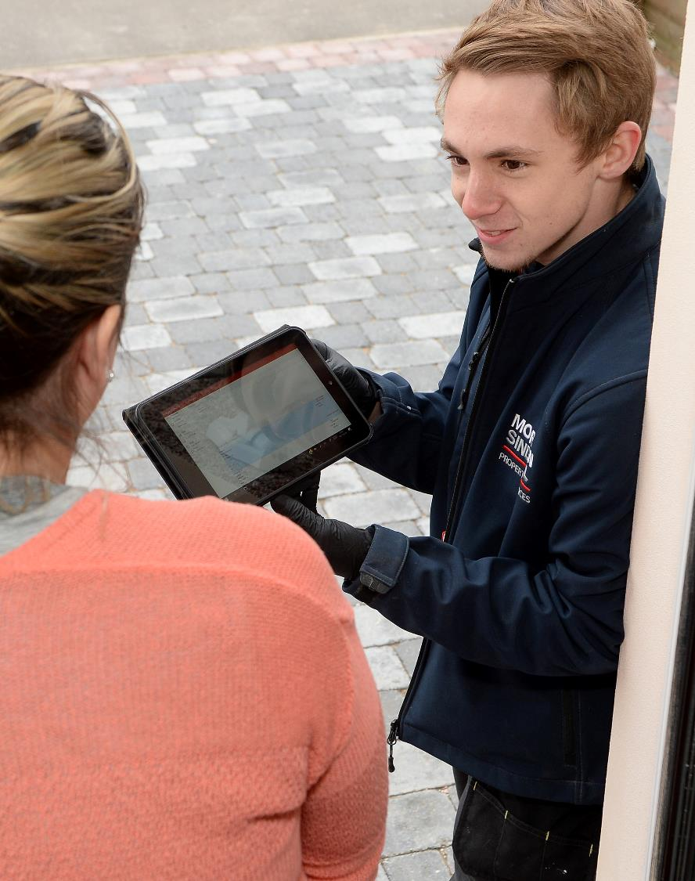
Apprenticeships
The apprenticeship levy – employers pay 0.5% of pay bill, through PAYE on pay bill in excess of £3m
Introduction of the levy has changed employers approach to apprenticeships:
- Apprenticeships are for all ages
- Employer led Standards, move from existing
Frameworks to deliver skills which are more closely
tailored to employer requirements

Slide 5
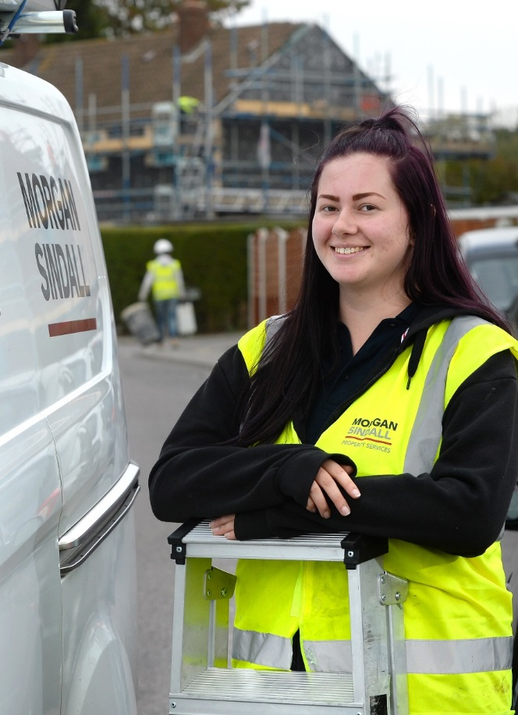
Our Apprentices
Our apprenticeship programme is about:
Inspiring the next generation
Identifying talent and investing in learning
Setting out a clear career path for progression for future leaders
How we attract apprentices:
Our BasWorx Work to Learn programme
Work with local schools as STEM ambassadors to encourage
young people to consider careers in the industry
Progression from work experience placements to apprenticeships
Referrals from local provisions

Slide 6

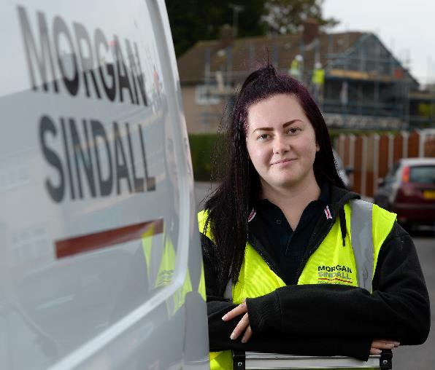
Our Apprentices
Chloe – Maintenance Operations Apprentice
Chloe is our rising star she is very soon due to complete her Level 2 apprenticeship, she is the only girl in her class at college and is regularly the top performer. She has recently received excellent feedback from our operatives about her plastering skills.
Chloe submitted a proposal to the management team to support our handyperson service in the sheltered schemes which we have strongly encouraged.
From September she will progress on to the L3 Plumbing apprenticeship and hopes to go on to become a Supervisor.
Notes:
This is one of our apprentices Chloe, she is very close to completing her L2 Construction Maintenance Operations Apprenticeship and wants to progress onto L2/3 Plumbing. She is a great ambassador for encouraging women into the industry. She started out as a hairdresser but didn’t enjoy it and decided to retrain.
We have Callum who completed 2 weeks of college work experience with us, he impressed the team and asked to stay on doing work experience two days per week around his multi trade college course. We have now given him a part time paid role with view to progress him on to a L2 plastering apprenticeship in September
We recently recruited Charlie our business admin apprentice, he is only 16 but has settled very well into the team and even helps induct new starters into our call centre team at Basildon
Emma, our gas admin manager is completing a team leading apprenticeship as part of upskilling her to provide her with a better management toolkit to assist her in her role and to help her progression with a formal qualification.

Slide 7
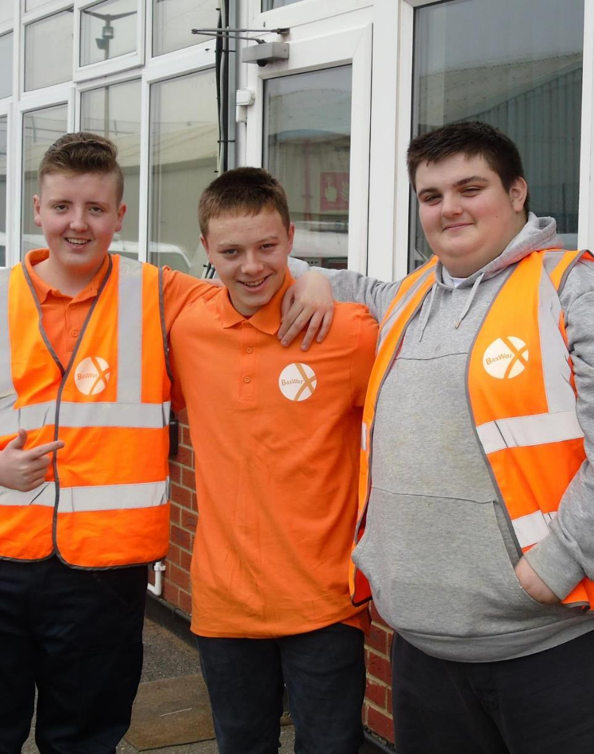

BasWorx
A Basildon based Social Enterprise delivering cyclical
decoration works to Basildon Council properties as a subcontractor to Morgan Sindall Property Services.
Creating work experience, apprenticeship, and employment opportunities for Basildon residents through a structured work based training and upskilling programme.
The focus is on bridging the gap between leaving school and progressing onto an apprenticeship, and supporting unemployed residents into work.
The BasWorx work to learn programme consists of two routes. The traineeship route and the work academy route.
Notes:
BasWorx is geared around the planned work programme particularly the cyclical decorations. I spent the first few months structuring the BasWorx programme and what that was going to look like, and felt it was important to run a pilot cohort to test the model rather than wait for the planned work to start. Not only does this let us know whether the model is suitable, it allows us to make any amendments or changes to the programme before we launch. But also provides us with some success stories to help promote and publicize BasWorx going forward.
We started our pilot cohort of BasWorx of the 17th October, with 4 trainees who were referred to us through our local network. We decided to keep it low key and not formally advertise the opportunities at this stage so as not to over subscribe it. As you can see we had a good number of referrals and the feedback from the NEET team is that there is a definite demand and requirement for BasWorx in the borough.
BasWorx is based on a traineeship route, so the first week the Lightbulb provide employability skills and skills for confidence training, followed by 4 days per week with Morgan Sindall out with our engineers, and 1 day per week studying customer service qualification and up-skilling in functional skills maths and English. At the end of the 8 weeks we will interview, assess the entry to an apprenticeship and progress onto paid traineeship programme leading through to the start of the apprenticehip.
We have also delivered a H&S L1 course which provides the knowledge to sit the CSCS tests which we are booking the trainees on to now.

Slide 8

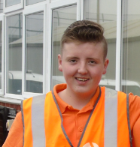
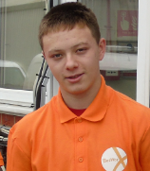
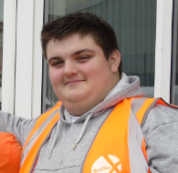
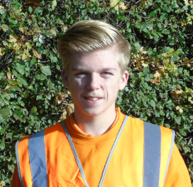
BasWorx | Traineeship
Liam
Conner
Kyle
Mitchell
16 year old, Basildon resident.
Liam values the opportunity to learn
the trades and prove himself with
an employer.
Progressed onto a paid position and we continue to support his Functional Skills in Maths and English to help him progress onto an apprenticeship. He recently passed his CSCS test first time.
16 year old, Canvey Island resident. He particularly enjoyed plumbing.
Kyle completed the 8 week programme and found a paid kitchen fitting opportunity close to home.
17 year old, Basildon resident, has always enjoyed working with his hands.
Connor completed the 8 week programme and found a paid ground work opportunity.
16 year old, Basildon resident.
He is a polite, well mannered
and a conscientious hard worker.
Progressed onto a paid position
and we continue to support his Functional skills to progress on
to an apprenticeship. He recently passed his Level 1 Maths.

Slide 9
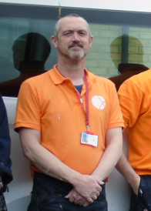
BasWorx | Work Academy
“
It’s been really good for my confidence and self worth, even my partner has noticed
a big change in me. It wasn’t good for me being stuck indoors applying for jobs for
4 hours a day.
Chris
”
I’ve really enjoyed the comradery, the programme has brought people together from different aspects of life.
“
Chris now 46, has been a Basildon resident since he was 26. Worked as a Warehouse Manager for over 20 years, but was unfortunately made redundant in August 2016. This is the first time he has found himself unemployed and he was job hunting for 9 months before BasWorx. He had applied for 353 jobs with only one of these progressing to interview stage.
Chris has a family including a partner and 4 children to support between the ages of 4 and 13.
Chris walks everywhere to save money including an hour walk to site every day which shows his commitment and motivation.
”
I’m starting from nothing, no one can survive on £101 a fortnight this is the lowest I’ll ever be now.
I like a challenge and want to see what I can achieve. Hopefully there will be the opportunity to make use of my management skills here too.
“
It’s good to find a training
course like this which provides genuine opportunities for people and builds confidence.
”
“
”

Slide 10
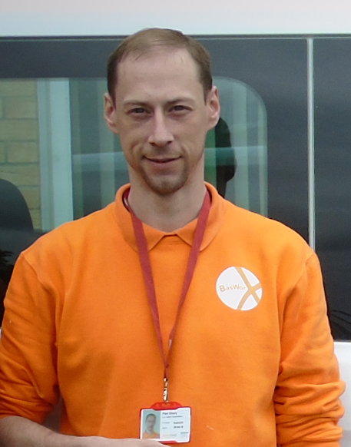
BasWorx | Work Academy
I’m dyslexic so I struggle with the classroom side, but I really enjoy the practical side working with my hands get getting the job done.
“
Paul
”
Paul, aged 33 is living with his family in Basildon, and is currently supporting 2 young children.
He has been unemployed since February after the groundwork he was completing through an agency dried up. He has been unemployed on and off and is frustrated with inconsistent agency roles.
He already has his CSCS card and is used to site work. He had done a range of construction work in the past and was attracted to the BasWorx programme because of the opportunity to prove himself and potentially progress with a large reputable employer.
Paul is very quiet and focused, he is technically very good and as the programme progresses is building his confidence
It’s been a great laugh working with
the team, I’ve learned quite a bit from the teachers and supervisors including some handy tips. Some of the stuff
I knew but it was a good refresher.
“
”
I don’t want to go back to
agency work, they would always promise you the next job was lined up but there would always be long gaps in between.
“
”

Slide 11
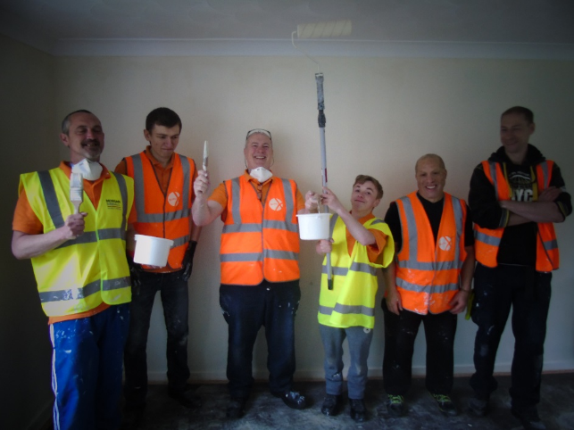
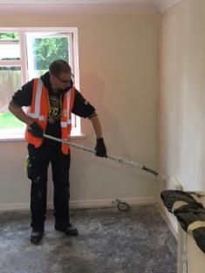
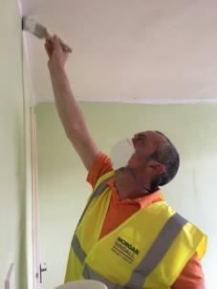
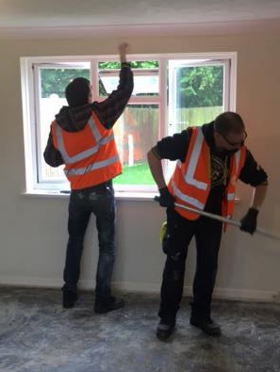
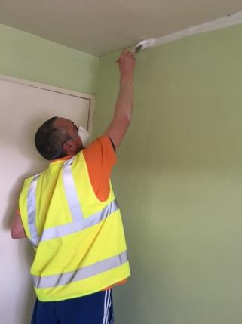
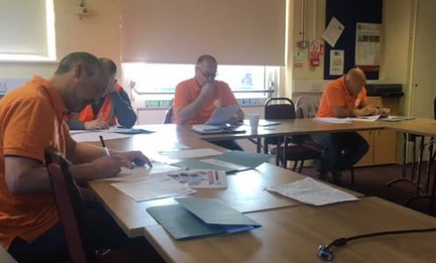
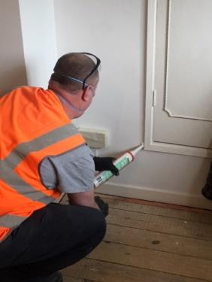
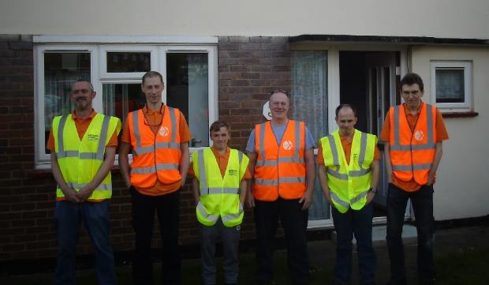
BasWorx Training

Slide 12

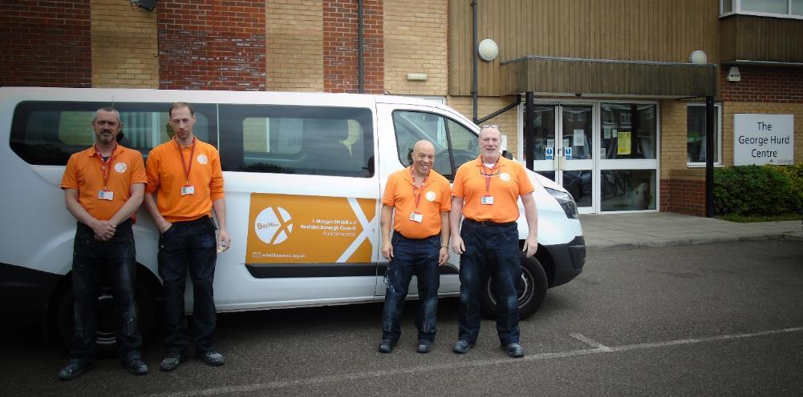
BasWorx
Outcomes
Level 1 Qualification in Construction
Level 1 H&S in a Construction Environment
CSCS Test
Painting and Decorating training
Employability skills
6-8 weeks work experience to boost CV
Guaranteed Interview scheme
Maths and English support (traineeship route only)
Borough Benefits
Leave a sustainable legacy
Upskilling residents through training
Creating employment opportunities
Promoting opportunities available in the construction industry

Slide 13
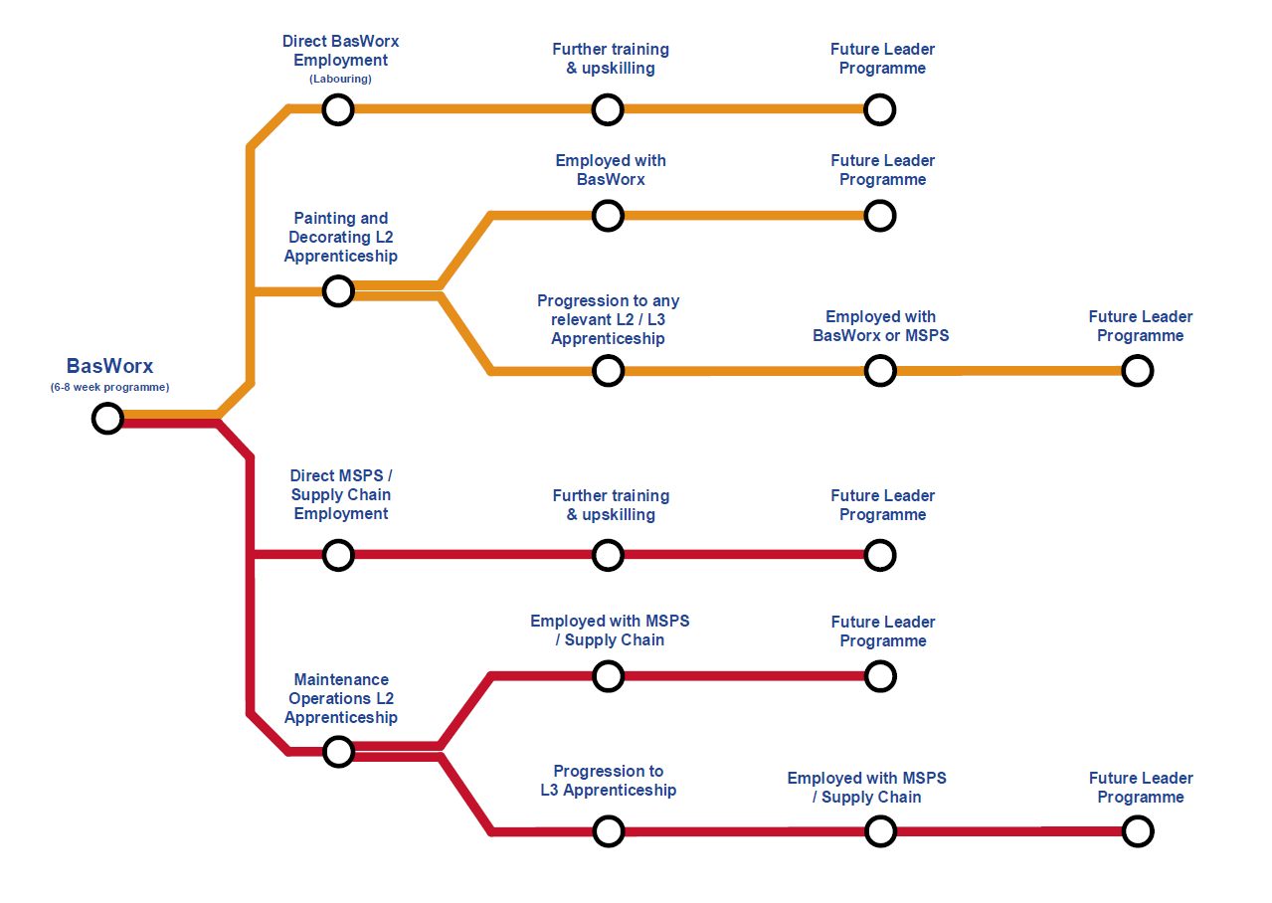
Progression Route

Slide 14
Learnings
Importance of finding and working closely with an experienced training provider
Timings and smooth progression from classroom to site and work experience is essential to ensure good engagement
Good information about outcomes and structure from day one so trainees understand what the benefits and opportunities are
It needs to be an enjoyable and meaningful experience. Feedback is that there are
a lot of courses out there that don’t lead to anything specific or do not produce relevant
qualifications to progress
Working with candidates of all ages is a rewarding experience, impacting a whole family in some cases rather than just an individual.
Look at what other provisions are already out there and ensure what you are offering is filling
a gap in the market and is what people NEED rather than what you WANT to offer

Slide 15

What next…
Continue to complete legal requirements to establish Social Enterprise
Grow BasWorx as a subcontractor in it’s own right
Expand offering beyond painting and decorating to additional work streams
Formally advertise BasWorx and promote opportunities locally,
online and through social media
Those who complete the BasWorx programme to progress where possible on to apprenticeship / employment opportunities with BasWorx, MSPS or supply chain
Work with schools to engage school leavers to the traineeship route
Work with provisions within the borough to support referrals
Direct promotional activity to encourage better uptake by women

Slide 16
Social Value Achievements
BasWorx traineeship pilot cohort of 4 trainees successfully progressed 2 into paid employment with MSPS with view to progress to apprenticeships
BasWorx work academy pilot cohort of 8 trainees, 4 have shown good commitment and we will be looking to provide opportunities as the interview stage
Established good partnerships with Job Centre Plus to work academy referrals, formed a good relationship with training provider to deliver tailored skills to fit our BasWorx - Work to Learn programme
Morgan Sindall work experience offering has identified Callum as a talented multi-trader and plasterer now in paid employment with view to progress to plastering apprenticeship
Morgan Sindall Property Services creating apprenticeship opportunities for school leavers in terms of Customer Service, Business Admin and Construction Maintenance Operations (CMO)
Morgan Sindall Property Services’ first apprentice on the Basildon contract Chloe due to complete Level 2 CMO next month, and we will support further progression on to Level 3 plumbing

Slide 17
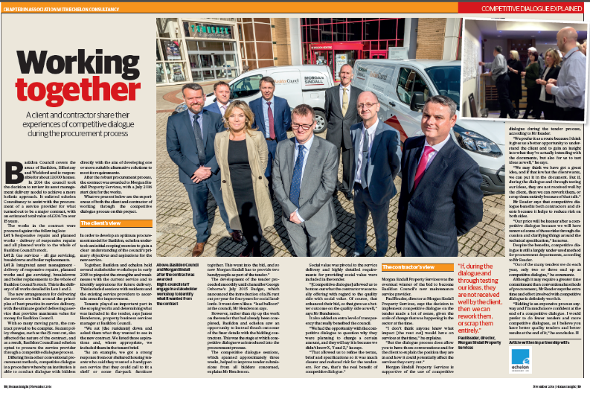
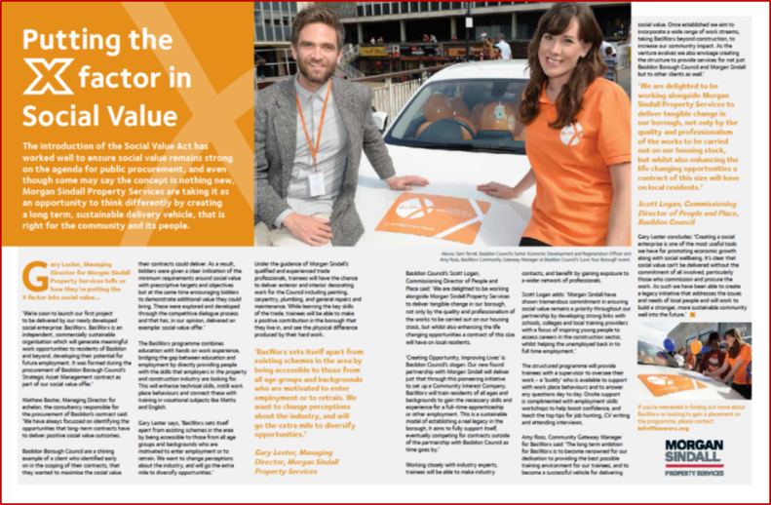
Basildon Council View & Summary

Slide 18
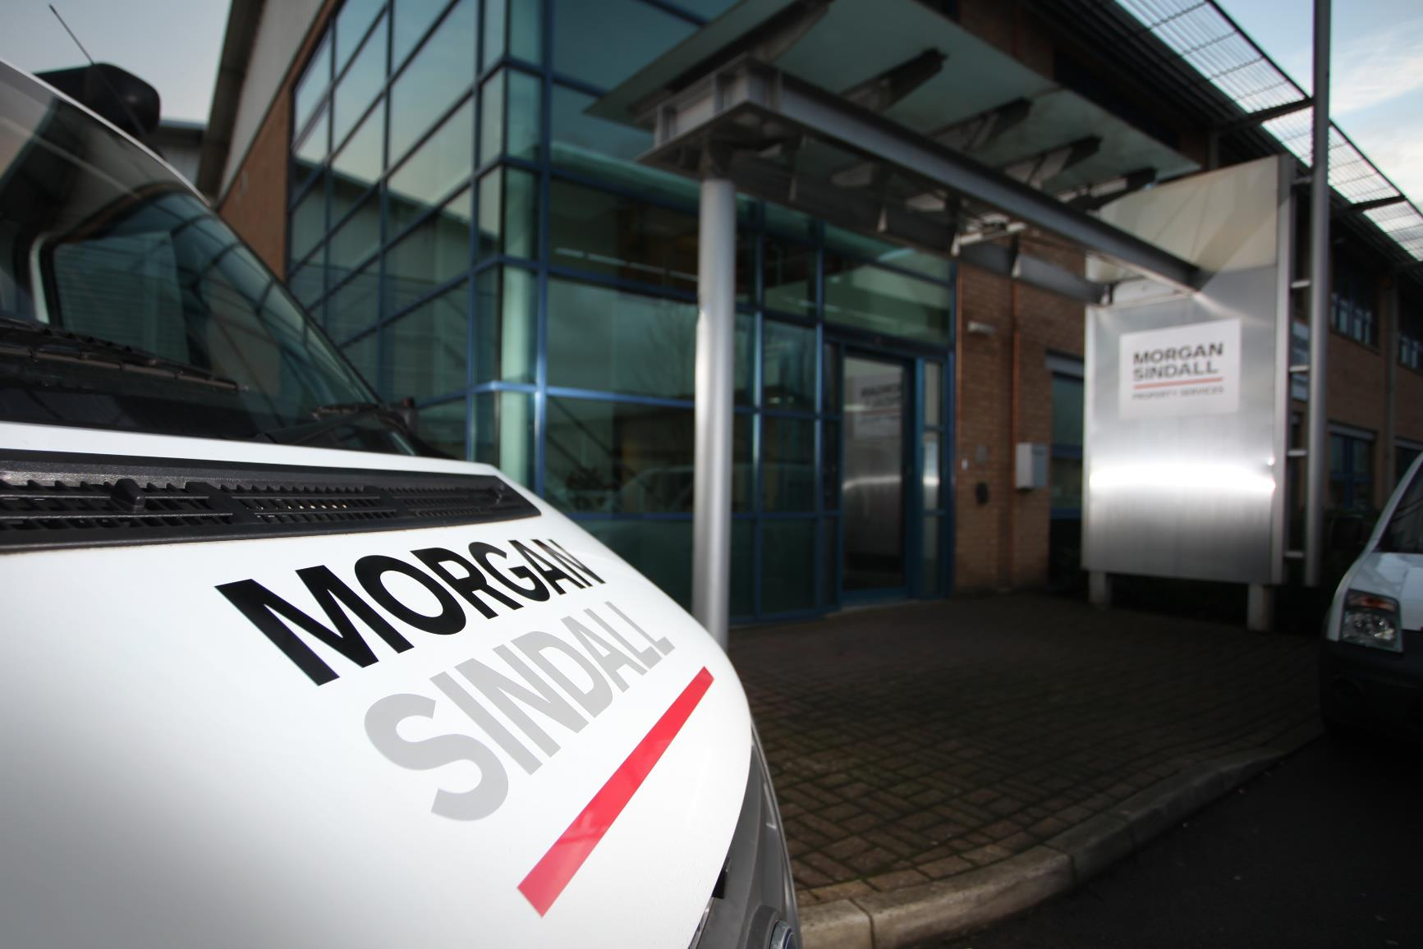
Thank you
Any Questions?
Thank You
Questions
v

