Slide 1
Workshop 1c:
Achieving the sweet spot of delivering a successful repairs and maintenance service
Speaker: Rob Bryan (Vantage Business Solutions),
Chaired by: David Miller (Rand Associates)
Room: Arden Room

Slide 2

Achieving the sweet spot of delivering a successful R&M service
Rob Bryan,
Operations Director
@RobBryanVantage
www.yourvantage.co.uk
© Vantage Business Solutions

Slide 3
Agenda
1. The Big Picture
2. DLO Ingredients for Success
3. Tips for Maximising External Contracts
4. Comparing Performance
5. Q & A
© Vantage Business Solutions

Slide 4
The Big Picture
© Vantage Business Solutions

Slide 5

Hitting the sweet spot
© Vantage Business Solutions

Slide 6

Changing conditions
INCREASED CEO/FD FOCUS
HCA SPOTLIGHT
MERGERS & TRANSFORMATIONS
RENT REDUCTIONS

Slide 7

Getting clarity and gaining confidence

Slide 8

The big picture – top 150 expenditure (FY 15/16)
© Vantage Business Solutions
Source: Vantage Global Accounts Plus database

Slide 9
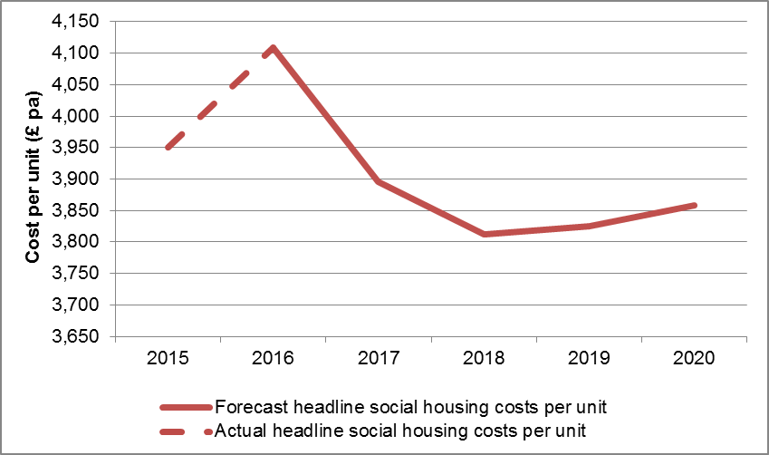
What the HCA are saying…
Delivering objectives in the face of projected 11% reduction in costs per unit
Source: HCA presentation at Vantage workshop
© Vantage Business Solutions

Slide 10
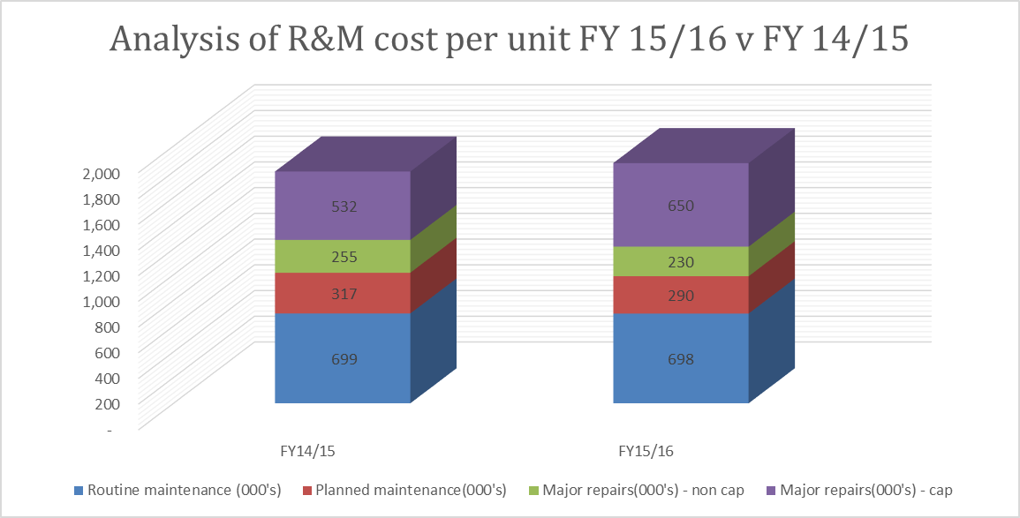
Is financial performance improving?
£1,802
£1,868
Source: Vantage Global Accounts Plus database
© Vantage Business Solutions

Slide 11
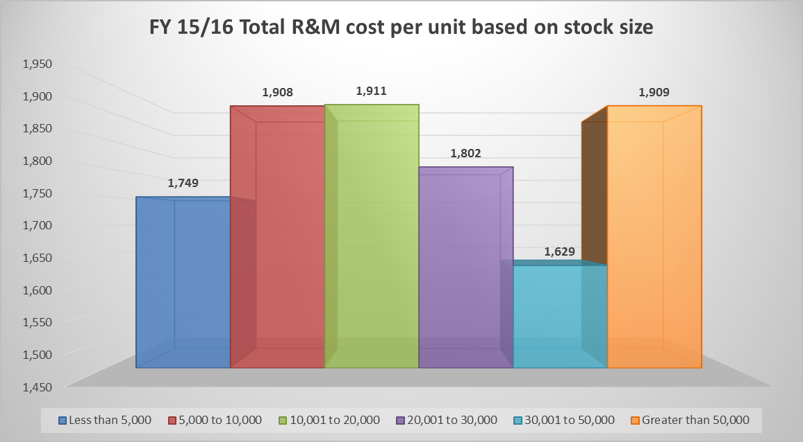
Does size matter – total R&M CPU?
Source: Vantage Global Accounts Plus database
© Vantage Business Solutions

Slide 12
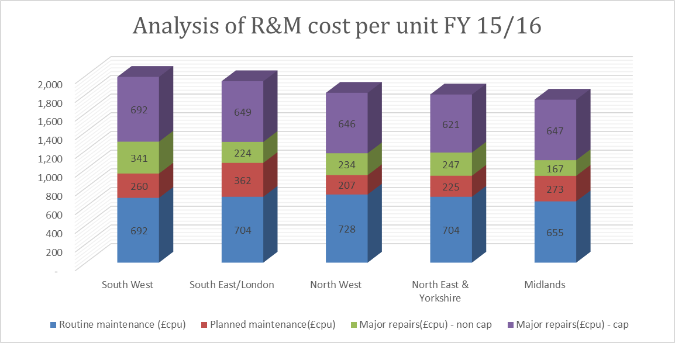
Is London more expensive?
Source: Vantage Global Accounts Plus database
© Vantage Business Solutions

Slide 13
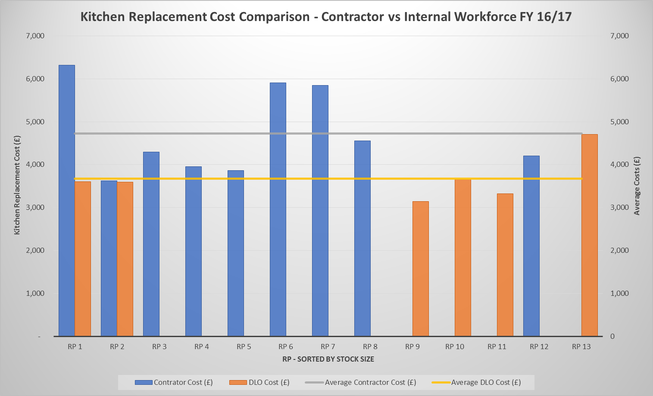
Does the delivery model guarantee success?
Source: Vantage Planned Maintenance Study
© Vantage Business Solutions

Slide 14
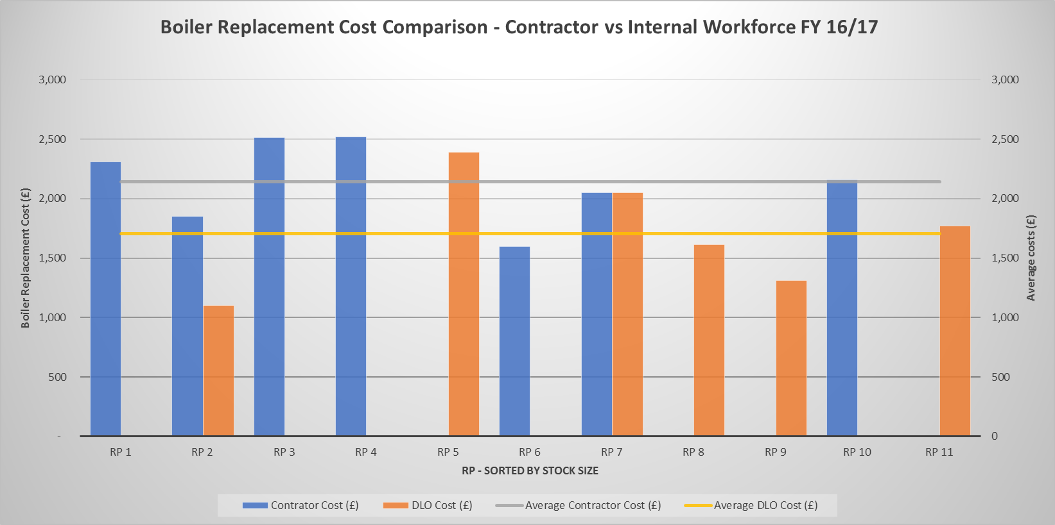
Does the delivery model guarantee success?
Source: Vantage Planned Maintenance Study
© Vantage Business Solutions

Slide 15
Other key findings
Materials prices for larger organisations (through both contractor or DLO models) are often no better
There is no evidence from our studies that length of contract consistently gives a lower average cost per unit
Supply chain integration between client and contractor is improving but still falls way short of that in leading private sector industries
Mergers are potentially making things worse, at least in the short term; many lack experience in large scale integration

Slide 16

The biggest sweet spot factor?

Slide 17
Finding your sweet spot – what are you aiming for?
Our role
VFM Definition that we use…
“The relentless pursuit of the elimination of waste from every process with the ultimate goal of providing what the Customer wants or needs (quality, delivery and service) at the lowest possible cost.”

Slide 18
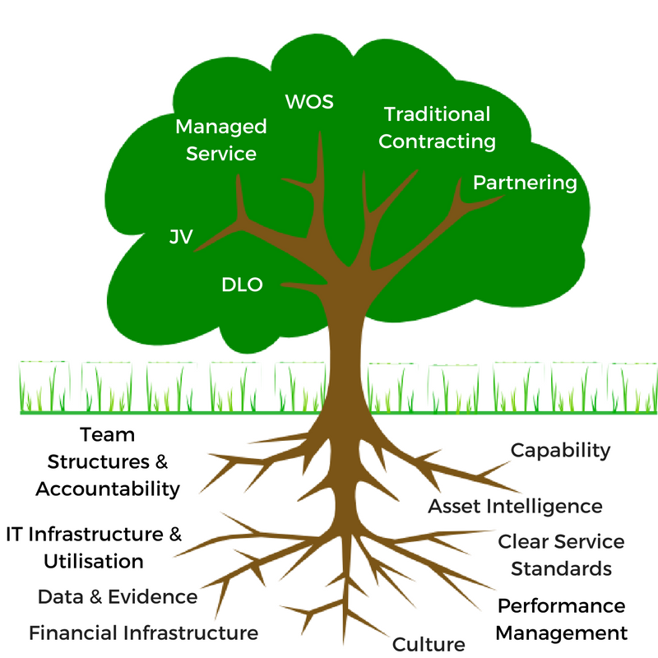
Procurement or transformation?
Focus is often on procurement of the delivery model
Deeper change management may be required
© Vantage Business Solutions

Slide 19

Customer and asset demand
In order to optimise any delivery model:
Understand existing demand data – Responsive, Voids, Cyclical and Planned
Find opportunities to Smooth demand where appropriate
Manage controllable demand down
Use demand data to underpin Organisational Resources (Both DLO and/or Contractors)
© Vantage Business Solutions

Slide 20
DLO Ingredients for Success
© Vantage Business Solutions

Slide 21
DLO ingredients - get the strategy right
Ensure there is a clear strategy set by the business
  Set out how success of the DLO will be judged beyond one year
  Ensure that that the DLO is doing the right things in the right areas
  If there is a strategy for growth, be clear what that is
Ensure that the DLO has the right level of Senior Sponsorship
  Do the Executive team all ‘buy-in’ to your DLO?
  Does someone on the EMT understand internal maintenance delivery
Ensure that there are a clear set of specifications and service level agreements (engaging with external customers)
© Vantage Business Solutions

Slide 22
DLO ingredients – get clear accountability
Strategic reporting - decision making on overall R&M models
Management reporting – decision making on DLO workstream performance
Operational reporting – DLO day to day decision making at a trade/operative level
Assets
DLO
© Vantage Business Solutions

Slide 23
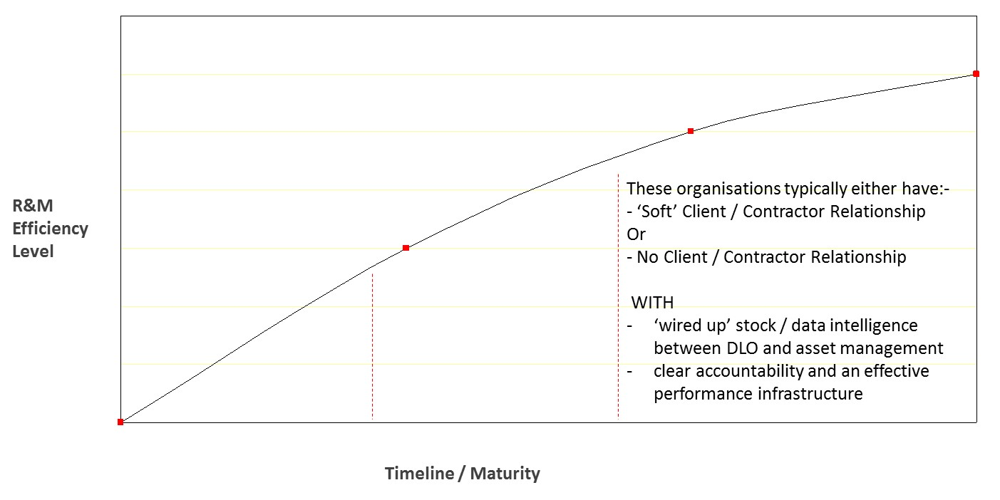
DLO ingredients – get the structure right
High performers
© Vantage Business Solutions

Slide 24
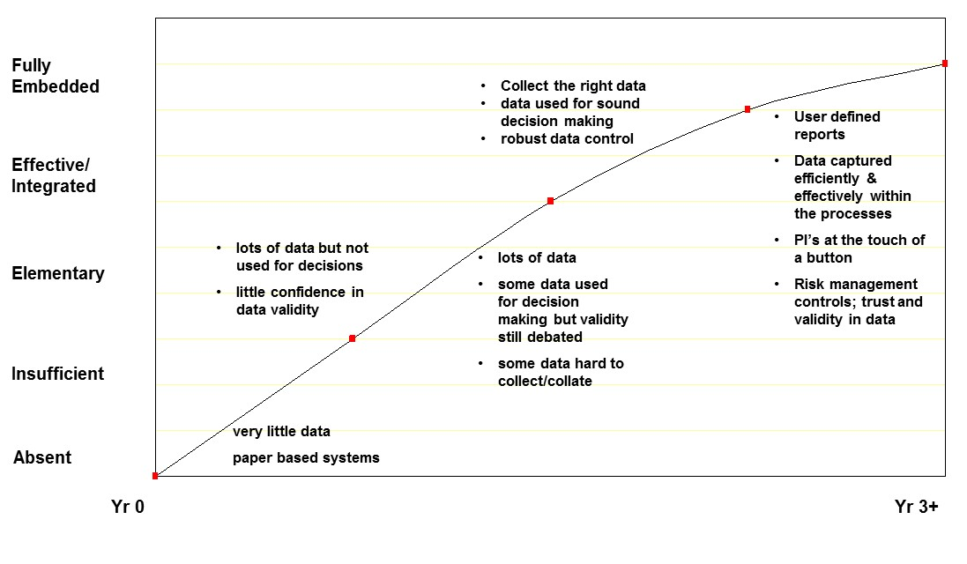
DLO ingredients – use data for decision making
The Housing Sector average
High performers
© Vantage Business Solutions

Slide 25


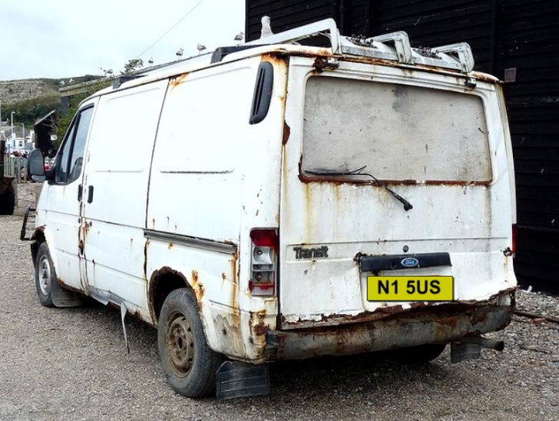

DLO ingredients – model of no excuses
© Vantage Business Solutions

Slide 26

DLO ingredients – develop your staff

Slide 27

DLO ingredients – get out the glue
Example – Responsive Repairs value chain
© Vantage Business Solutions

Slide 28
Tips for Maximising External Contracts
© Vantage Business Solutions

Slide 29
External partners – go beyond traditional procurement
Options & Business case
Includes supply chain review (e.g. single source supply v multi)
Procurement feasibility
How are we most likely to achieve that value?
Procurement process
Compliancy process
Mobilisation
Review & challenge of specification (beyond the status quo)
Establish what good value looks like (service & target costs)
Plan should be part of wider operational plan
What type of contract is likely to meet our needs?
Due to capacity, often organisations start here!
What type of procurement route do we take?
What tools can we use? e.g. competitive dialogue
Appraise delivery model options
Critical phase
© Vantage Business Solutions

Slide 30



External partners – model of no excuses
© Vantage Business Solutions

Slide 31
External partners - drive the contract initiatives
If your contract allows for innovation e.g. new technology, take the lead (you are the client)
If your contract allows for on-going efficiency and VFM improvement, take the lead (you are the client)
If your contract does not work for you, don’t give up
Ask yourself if the contract is becoming more important than the customer
If you are serious about asset management then don’t ignore the repairs data just because you don’t deliver the repairs

Slide 32
External partners - commercial management
Remember the contractor has to make a profit; focus on driving efficiencies on the controllable elements
If the rates procured are too good to be true then they probably are
Don’t make assumptions; if there is an aspect of open book don’t assume what you see is what you get
When assessing financial performance look at the big picture and don’t forget to look at actual costs (many only focus on the tender prices)

Slide 33
Comparing Performance
© Vantage Business Solutions

Slide 34
Comparing internal and external financial performance
Our role
Confirm how you will measure success and how you wish to compare models e.g. variation to Nat Fed schedule, Cost per Unit etc.
Embed those measures into your frameworks and contract requirements
Be realistic - agree targets e.g. how you adjust for geography, work mix and scale
Be consistent; for example don’t include client side costs in one model but not the other if they are applicable to both
Use actual costs – not tendered or budget costs OR wooden dollars!
Treat VAT correctly!

Slide 35

Selecting the right DLO financial mechanisms
Our role
“The only profit centre is a customer whose cheque hasn’t bounced”
(source; Peter Drucker – the man who coined the phrase, and later described it as one of his biggest mistakes!)

Slide 36
Selecting the right external pricing mechanisms
Our role
Fixed price models
Will always include pricing for risk and profit
Reduced admin but still need to tightly manage
SOR models
Typically provides greater data
Poorly administered by many
Established pricing mechanism
Can work well at the right point in time

Slide 37
In summary
Our role
There are a number of RPs making good progress and have very successful delivery models
Everyone’s sweet spot is different, you need to think strategically to give the best chance of success
Hitting your sweet spot is dependant on your people and their capability more than anything else (Including EMT)
Changing the delivery model will not in itself change your culture or fix underlying wider organisational issues

Slide 38
Meeting the financial challenge
Our role
Increased pressures on cost; HCA highlight 11% overall reduction in CPU
We believe that over 30% of RPs could save over 20% within repairs and maintenance
On average private sector companies are achieving less than 60% of expected savings and less than 10% reach or exceed their targets (source; KMPG)
Over the last 12 years the average saving in R&M that we have helped organisations achieve is in excess of 25% - it can be done!

Slide 39
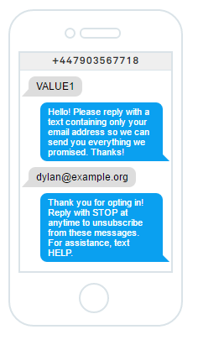
For a copy of the slides:
Text VALUE1 to
0790 356 7718
Q&A
Rob Bryan,
Operations Director
@RobBryanVantage
www.yourvantage.co.uk
© Vantage Business Solutions

