Slide 1
Workshop 1e:
Procuring IT at the heart of service delivery
Speakers: Peter Long (Basildon Borough Council)
Matthew Baxter (echelon Consultancy)
Carol Burton (Basildon Borough Council)
Stephen Holden (Morgan Sindall)
Chaired by: Liz Circuit (M3)
Room: Dorset Room

Slide 2
Strategic Asset Management contract

Slide 3
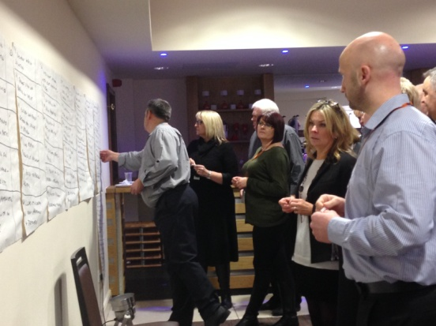
Scoping – why the focus on IT?
Detailed review of existing delivery models
“Lesson Learned” events
Wide stakeholder engagement
Identification of 57 enhancements in future service delivery
3 of top 5 identified IT related
Focus on a strategic asset management approach
Critical that data used to drive decisions
Became clear that CD would enhance final offer

Slide 4
Procurement Process – IT Offer
Approach market with optional Lot structure
One Lot for single SAM provider or broken down into separate Lots
Used “lean” form of Competitive Dialogue
Seven sessions of which two were solely on IT
Enabled bidders to appreciate what Basildon aiming to achieve
Enabled bidders to discuss and then hone their final offers
All bidders scored higher on IT following CD

Slide 5
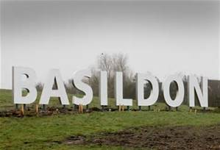
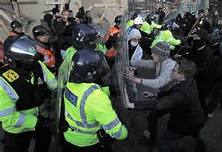
We are famous…

Slide 6
Who are we?
Local Authority
11,500 properties within the borough
50 sheltered housing schemes including 3 leasehold
2,400 leaseholders
5,400 garages
Notes:
ALMO 200? – 2011
Council/ALMO awarded £82 million DH funding – significant investment since 2009/10 £164 million
3807 dwellings non decent

Slide 7
Background
Calls received through a number of different routes
Multiple contracts
Silo working
Contractors based at various locations
Interfaces between several systems both Council and contractors
High number of client pre-inspections
High administration resource
Notes:
63,200 calls taken – CSC, MITIE WIP team and Liberty Gas.

Slide 8
Our Aspirations
Full co-location
Improve the customer experience
Link responsive repairs, gas and planned maintenance
Maximise Social Value
Continuous improvement and innovation
True partnering relationship
Increase Value for Money
Reduce repairs demand using data to focus on high/low demand properties through Complete Property Service

Slide 9
Key Drivers in IT
Demo of contractor system – realised the potential
A single system to deliver one version of the truth
Collaboration of design
Development of MSi into a client facing system
Use of data to inform asset decisions
Notes:
April – June CSC performance
July to date is MSPS performance
CSC service level target is to answer 80% of calls within 40 seconds.
MSPS area represents the calls handled by CSC/Liberty and MITIE.
Focus : channel shift, encouraging calls for non urgent matters at less busy times, reporting repairs via email.

Slide 10
What we delivered
Co-located in existing Council building
Adopted Morgan Sindall’s MSi system
Shared Council telephony with Morgan Sindall to enable them to take all property service calls
PPP/PPG/4* gas
No transactional interfaces
Commercial incentive to drive cost down
Mobile working
Stage 0’s

Slide 11
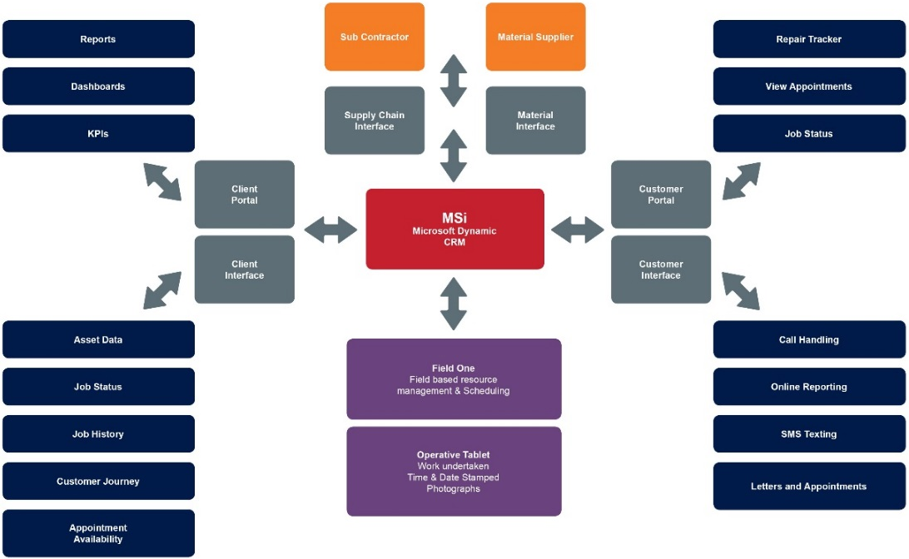
Notes:
MSi is not an IT system.
It is the product of a new vision of Property Services, a tailored set of business processes to support that vision and the technological solutions to implement it. It will allow us to fulfil the requirements of our staff, clients, suppliers and most importantly end customers.
Our business led team defined a set of detailed requirements which helped us determine the most appropriate technologies to support this vision, leading to our decision to selected Microsoft Dynamics CRM as our base platform along with key integrated add-ons from Field One Sky and TK Dialogs and Adx Studio, to provide us with scheduling and mobile data capture, call handling and interactive portals respectively.
A key part of our technical solution was to ensure we did not reinvent the wheel, making use of the best available solutions to provide a cohesive whole

Slide 12
Benefits
Real time
Dashboard snapshots
Customer information all in one place
Transparency of financial information
Reduction in administrative resources BBC and Morgan Sindall
Quality of call handling improved
“Hot Spots” of expenditure to inform SAM approach

Slide 13
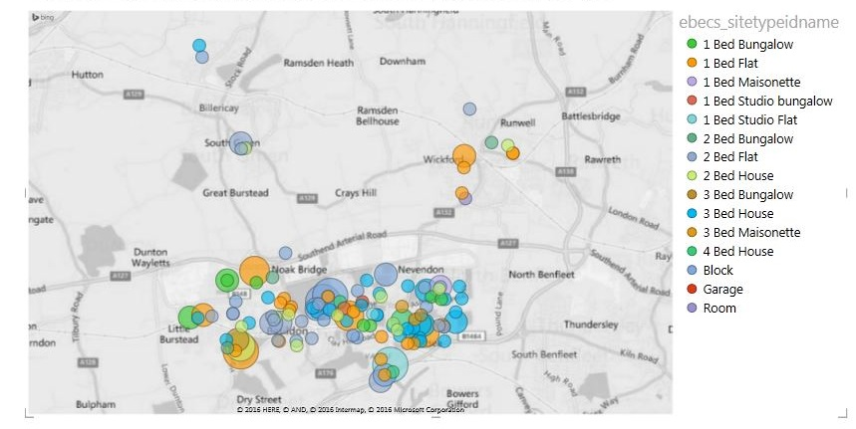
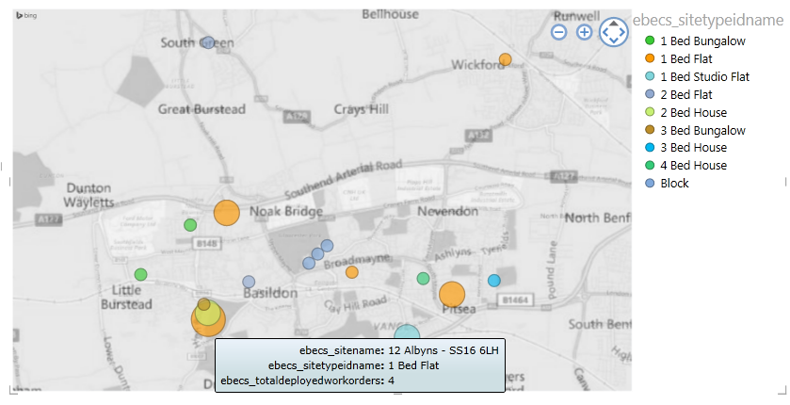
What does this look like?
720 Drain clearance jobs
Holistic approach to maintenance
Targeting preventative repairs through ‘Complete Property Service’
Working together to use Planned and Responsive Repair budgets more efficiently

Slide 14
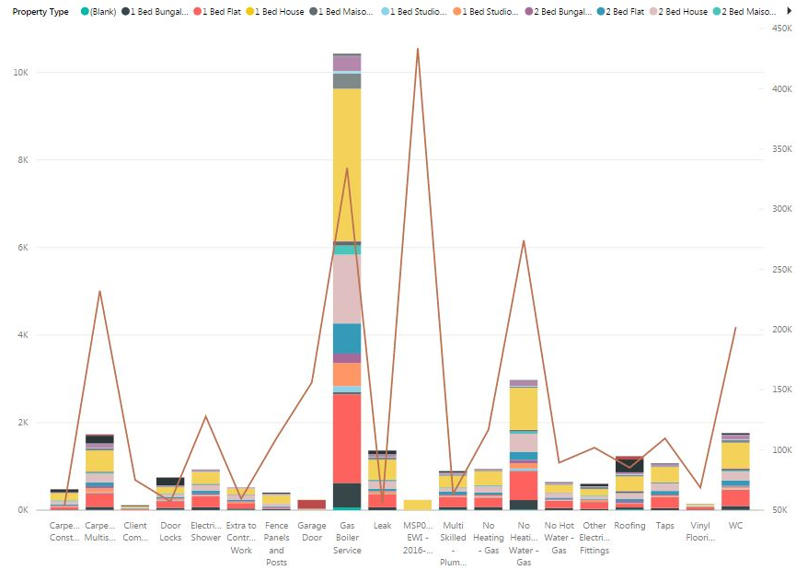

Slide 15
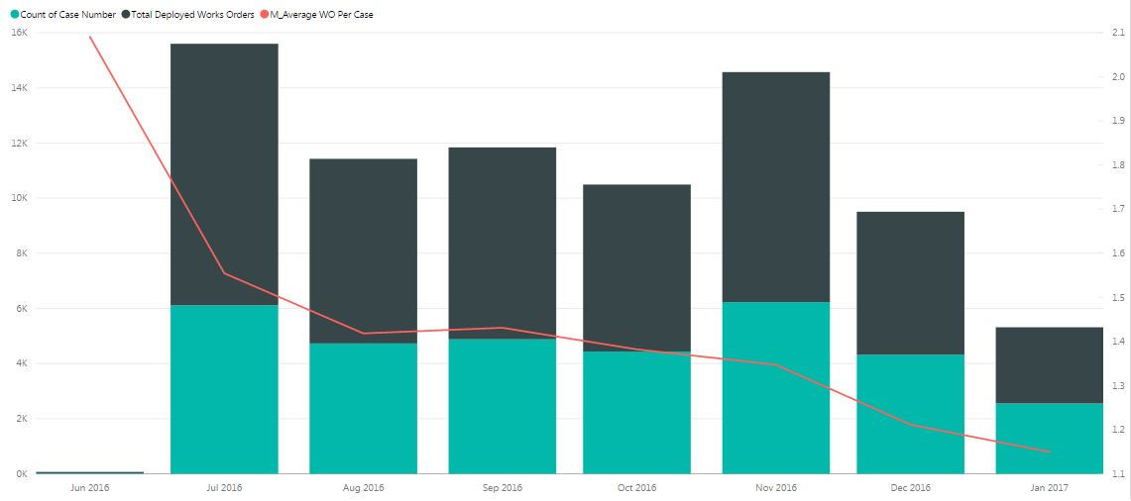

Slide 16
Planned for 2017
Customer App
Price Per Void
Corporate Buildings
Planned Works

Slide 17
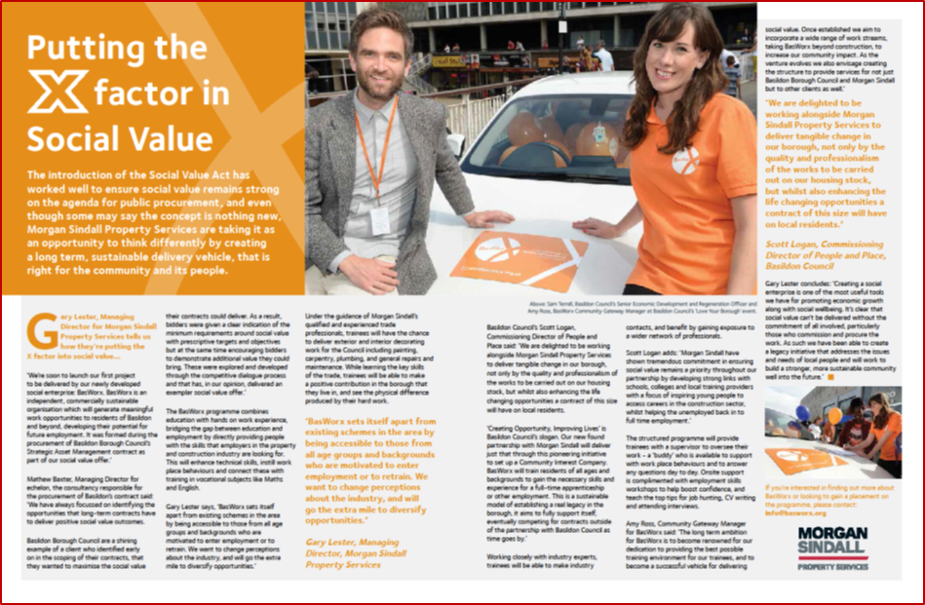
Social Value
BasWorx – social enterprise
Apprenticeships
Skills training
Employment opportunities
Engaging with schools
Supporting unemployed residents
Resident training
Supply chain

Slide 18
BasWorx
Create a social enterprise
Grow BasWorx as a subcontractor in it’s own right, in order to offer a greater number of opportunities on the planned work
Formally advertise BasWorx and promote opportunities locally, online and through social media
Those who complete the BasWorx programme to progress on to apprenticeship / employment opportunities with Morgan Sindall and supply chain

Slide 19
Questions?

Slide 20
Contacts
Carol.Burton@Basildon.gov.uk
Peter.Long@Basildon.gov.uk
Paul.Reader@morgansindall.com
Amy.Ross@morgansindall.com
Mathew@echelonconsultancy.co.uk

