Slide 1
Changes to the Standards covering Fire Detection & Emergency Lighting
Notes:
A note about the FSA.
The Fire and Security Association is a specialist group of the ECA primary focused on those who design, install, commission, maintain and monitor fire detection, emergency and Security systems. All ECA members who are third party assessed in these particular areas of work are eligible to associate themselves with both ECA and FSA membership.

Slide 2
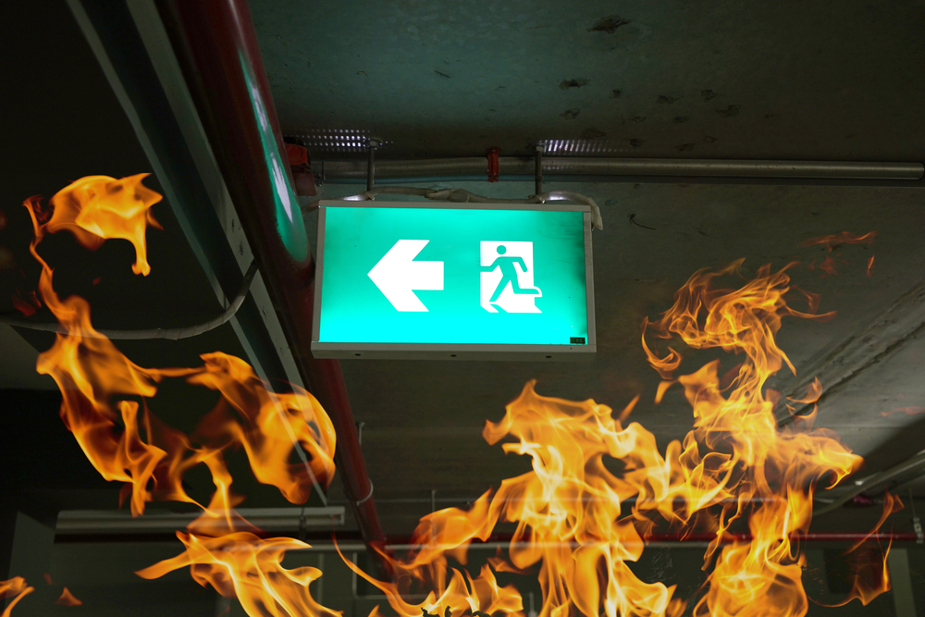
The Electrical Contractor’ Association
Electrical Contractors’ Association.
E: steve.martin@eca.co.uk
T: 020 7313 4807
M: 07866 487593
@ecastevemartin
Shaping our industry
Enabling business growth
Getting members specified
Internet of Things?
Unlocking the potential for electricians..
Central Essex & Colchester Technical Forum.

Slide 3
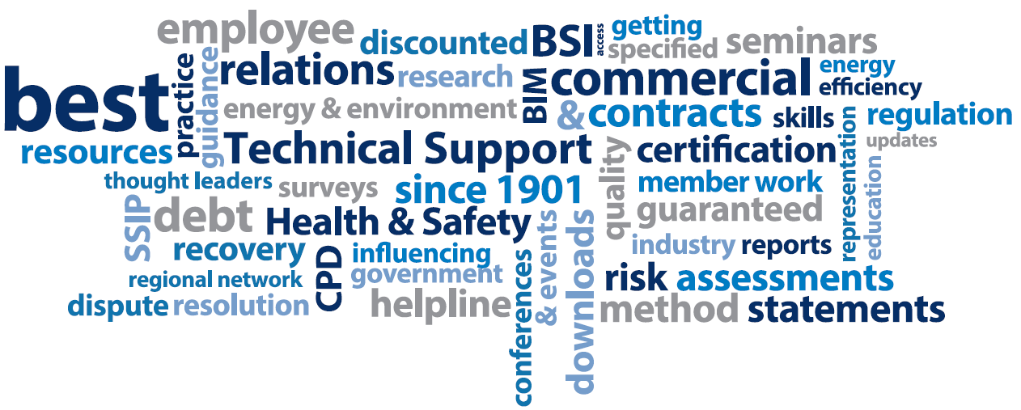
The Electrical Contractors’ Association
Shaping our industry
Enabling business growth
Getting members specified
Notes:
A little about the ECA...

Slide 4
The Electrical Contractors’ Association
Shaping our industry
Enabling business growth
Getting members specified
Notes:
The ECA has been the driving force in the electrical engineering and building service industry since 1901
Creating many organisations which today are involved in improving industry standards
These are the result of ECA’s direct involvement and commitment in Shaping our industry, enabling business growth and getting
members specified..

Slide 5
The Electrical Contractors’ Association
Shaping our industry
Enabling business growth
Getting members specified
Notes:
Representing not just electrical contracting but the whole electrical, electro-technical and building service sectors.

Slide 6
The Electrical Contractors’ Association
Shaping our industry
Enabling business growth
Getting members specified
Notes:
We pride ourselves in being an industry specific resource offering essential information, business support, knowledge and representation to members – more than certification alone..

Slide 7
The Electrical Contractor’ Association
Electrical Contractors’ Association.
Welcome..
New BS 5266-1: 2016 – Emergency Lighting CoP
DPC of BS 5839-1 Fire alarm CoP.
Periodic Electrical Inspections – Expectations and
Frustrations
Shaping our industry
Enabling business growth
Getting members specified
Internet of Things?
Unlocking the potential for electricians..

Slide 8
The Electrical Contractor’ Association
What's new...?
New BS 5266-1: 2016 – Emergency Lighting CoP
Final draft before DPC of BS 5839-1 Fire alarm CoP.
Periodic Electrical Inspections – Expectations and Frustrations
Internet of Things?
Unlocking the potential for electricians..
BS 5266-1:2016 Emergency Lighting

Slide 9
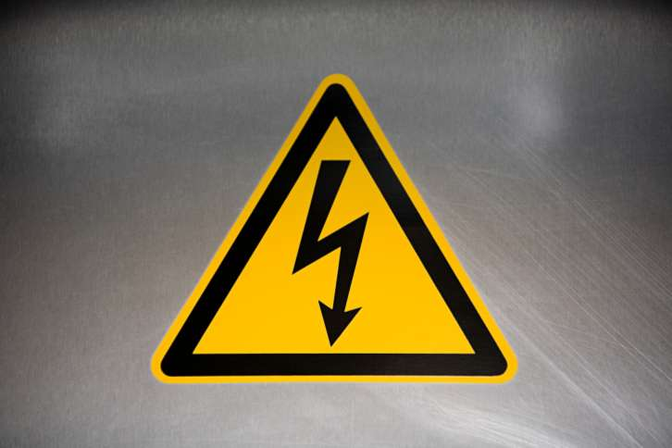
Legislation and Enforcement ...
Any questions..?
UK Regulatory Framework
LAW
The Health & Safety at Work etc Act 1974
Reasonably accepted / deemed to achieve conformity with the LAW
The Electricity at Work Regulations 1989
The Regulatory Reform (Fire) Safety Order 2005
Codes of Practices (BS and BS EN Standards)
BS5839, BS 5266 etc..
Fire and Emergency Lighting Systems (Non domestic)

Slide 10
The Electrical Contractor’ Association
The Electrical Contractors’ Association
...Give guidance on the factors to be considered when designing, installing and wiring emergency lighting..
BS 5266-1 previously concentrated
on getting people out of a building in
the event of mains failure.
Now – considers people who wish to
remain in a building and/or continue
normal operations.
Internet of Things?
Unlocking the potential for electricians..
BS 5266-1:2016 Emergency Lighting

Slide 11
The Electrical Contractor’ Association
Key considerations..
Major change – not just an amendment..
Increased from 44 pages to 73.
Now 13 sections with 13 annexes.
New definitions and considerations.
Came into effect 30th May 2016.
Internet of Things?
Unlocking the potential for electricians..
BS 5266-1:2016 Emergency Lighting

Slide 12
The Electrical Contractor’ Association
Key considerations..
Terms and Definitions (Part 3)...
This has increased from 12 to 18 items - New definitions are:
Borrowed Light – from a reliable source
Competent person – Relevant training, experience and tools
Emergency safety lighting – for those staying in the building
High risk task area lighting – potential dangerous process
Open area lighting – to avoid panic..
Sign height – Geometric shape or height.
Internet of Things?
Unlocking the potential for electricians..
BS 5266-1:2016 Emergency Lighting

Slide 13
The Electrical Contractor’ Association
Key considerations..
Consultation (Part 4)...
Early consultation with clients and relevant stakeholders is
key to define the way in which a system is intended to
operate.
Additional considerations is necessary if a ‘stay put’ strategy
is agreed.
An assessment of risk to the occupants of the building must
be made and a plan of action formed..
Internet of Things?
Unlocking the potential for electricians..
BS 5266-1:2016 Emergency Lighting

Slide 14
The Electrical Contractor’ Association
New areas...
NEW
NEW
Internet of Things?
Unlocking the potential for electricians..
BS 5266-1:2016 Emergency Lighting

Slide 15
High Risk Task Areas...
The Electrical Contractor’ Association
New requirement for High Risk Task Areas...
...If emergency escape lighting is required to provide illumination for the safety of people involved in a potentially dangerous process or situation, and to enable proper shut – down procedures for the safety of the operator and other occupants, the illuminance value should be not less than 10% of the average of the normal lighting at the location of the point of risk...
Internet of Things?
Unlocking the potential for electricians..
BS 5266-1:2016 Emergency Lighting

Slide 16
Escape route / safety signs..
The Electrical Contractor’ Association
Escape route signs should be located and operated in accordance with:
BS 5499-4:2013 – For appropriate direction (Table 1)
BS EN ISO 7010:2012+A5 – Use of E001 and E002
New section regarding the maximum viewing
distance and sign height using BS 5499-4:2013,
Tables 2&3.
Internet of Things?
Unlocking the potential for electricians..
BS 5266-1:2016 Emergency Lighting

Slide 17
Emergency Safety Lighting
The Electrical Contractor’ Association
A new section related to emergency safety lighting:
...The minimum illuminance over the area where people might have to move during a failure of the supply to the normal lighting should be not less than
1 lx on the floor area...
Considerations for:
Rooms where occupants are able to ‘stay put’.
Scenarios where it is impractical to evacuate during a supply
failure (such as hotels) but to ensure 1 hour emergency light
for evacuations is maintained.
Internet of Things?
Unlocking the potential for electricians..
BS 5266-1:2016 Emergency Lighting

Slide 18
The Electrical Contractor’ Association
Other Key Considerations..
If an original completion certificate is not available an inspection of the
installation should take place and if satisfactory a verification certificate
issued.
A new Small Installation Completion Certificate is available
Essential spares and consumables should be kept onsite to reduce
the time taken to repair a system.
Internet of Things?
Unlocking the potential for electricians..
BS 5266-1:2016 Emergency Lighting

Slide 19
The Electrical Contractor’ Association
Routine Inspection & Test.
A new section (12) setting out the requirements for routine inspections and tests:
Requires inspections and testing at regular intervals in
accordance with BS EN 50172.
Functional operation should be checked at least once a
month.
Full rated test should be performed annually.
Visual inspection of each luminaire annually.
Precautions and actions are included when testing with
particular regards to functionality after testing. (Auto Test)
Internet of Things?
Unlocking the potential for electricians..
BS 5266-1:2016 Emergency Lighting

Slide 20
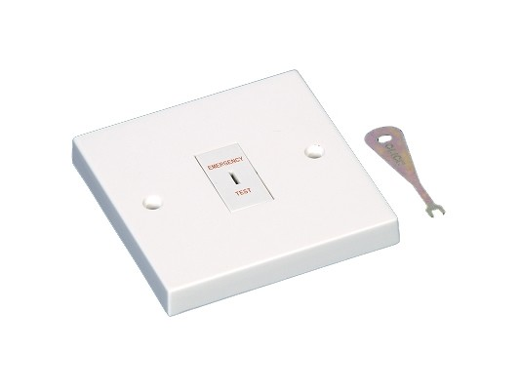
The Electrical Contractor’ Association
Other Key Considerations..
Test facilities:
The test facility should facilitate both
monthly short tests and annual full
duration tests.
The test facility should be protected
from unauthorised operation.
The test device should not interrupt
other electrical equipment that could
cause a hazard.
Internet of Things?
Unlocking the potential for electricians..
BS 5266-1:2016 Emergency Lighting

Slide 21
The Electrical Contractor’ Association
Other Key Considerations..
A new requirement regarding the certification of installations:
If an installation is modified the existing log book and
documentation should be integrated into the revised
documents.
If an original completion certificate is not available an
inspection of the installation should take place and if
satisfactory a verification certificate issued.
Internet of Things?
Unlocking the potential for electricians..
BS 5266-1:2016 Emergency Lighting

Slide 22
The Electrical Contractor’ Association
What's new...?
Service Standard for Fire safety systems & security
systems.
New BS 5266-1: 2016 – Emergency Lighting CoP
Final draft before DPC of BS 5839-1 Fire alarm CoP.
Revision of PD6662 – Scheme for Intruder & hold-up
alarms.
Internet of Things?
Unlocking the potential for electricians..
Final draft before DPC – BS 5839-1

Slide 23
An insight to the proposed changes..
The Electrical Contractor’ Association
Draft for public comment (DPC) – Ends March 2017
New revised standard due July 2017.
Internet of Things?
Unlocking the potential for electricians..
Final draft before DPC – BS 5839-1

Slide 24
An insight to the proposed changes..
The Electrical Contractor’ Association
Scope... BS 5839-1 provides recommendations for the planning, design, installation, commissioning and maintenance of fire detection and fire alarm systems in and around buildings, other than domestic premises.
BS 5839-6 has not changed
Internet of Things?
Unlocking the potential for electricians..
DPC – BS 5839-1

Slide 25
An insight to the proposed changes..
The Electrical Contractor’ Association
A potentially new class of false alarm
Unwanted fire alarm signals
Environmental false alarm
Good Intent
Internet of Things?
Unlocking the potential for electricians..
DPC – BS 5839-1

Slide 26
An insight to the proposed changes..
The Electrical Contractor’ Association
False Alarms – Recording the right details:
Identity and location of the device
Category of false alarm.
Reason fro false alarm
Activity in the area (if the reason for the false alarm is unknown)
Action taken on the cause of the false alarm
Whether the FRS were called
Whether the FRS attended
The person responsible for recording the information
Internet of Things?
Unlocking the potential for electricians..
DPC – BS 5839-1

Slide 27
An insight to the proposed changes..
The Electrical Contractor’ Association
The possible introduction of multi-sensor detectors.
Should be used in smoke detector mode on escape routes
Must comply with EN54-7 standard.
Internet of Things?
Unlocking the potential for electricians..
DPC – BS 5839-1

Slide 28
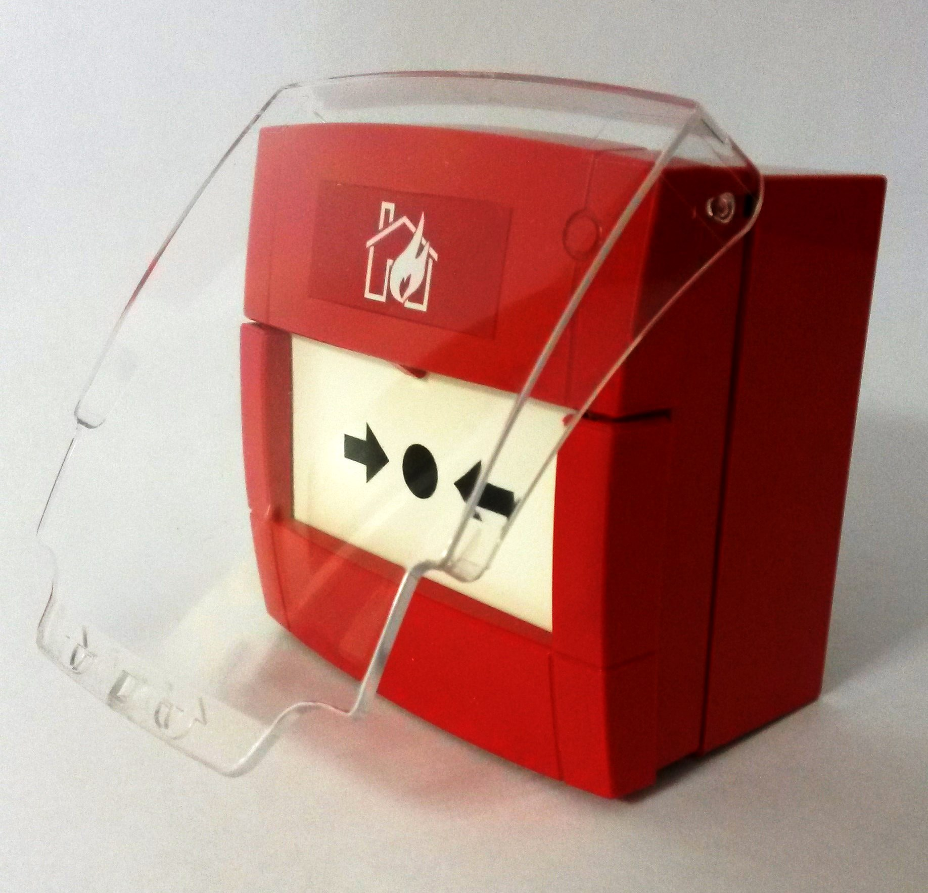
An insight to the proposed changes..
The Electrical Contractor’ Association
Hinged covers over Type A manual call points..
Previously it was a variation
Potentially now written into the standard
Internet of Things?
Unlocking the potential for electricians..
DPC – BS 5839-1

Slide 29
An insight to the proposed changes..
The Electrical Contractor’ Association
Clarification on sighting of Manual Call Points
A final exit must go to a place of ultimate safety.
This includes roller shutter doors or similar exits
Internet of Things?
Unlocking the potential for electricians..
DPC – BS 5839-1

Slide 30
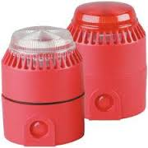
An insight to the proposed changes..
The Electrical Contractor’ Association
Visual Alarm Devices (VADs)
Better practical guidance.
Incorporating CP001 working group with FSA input and
BRE research.
Internet of Things?
Unlocking the potential for electricians..
DPC – BS 5839-1

Slide 31
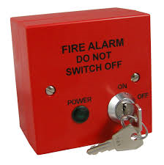
An insight to the proposed changes..
The Electrical Contractor’ Association
Does this need to be double pole..?
No
But you will need to ensure you ensure safe isolation
procedures and tools.
Must be protected by unaithorised persons – key switch.
Internet of Things?
Unlocking the potential for electricians..
DPC – BS 5839-1

Slide 32
The Electrical Contractor’ Association
What's new...?
New BS 5266-1: 2016 – Emergency Lighting CoP
Final draft before DPC of BS 5839-1 Fire alarm CoP.
Periodic Electrical Inspections – Expectations and Frustrations
Periodic Inspections of Electrical Systems.
Internet of Things?
Unlocking the potential for electricians..

Slide 33
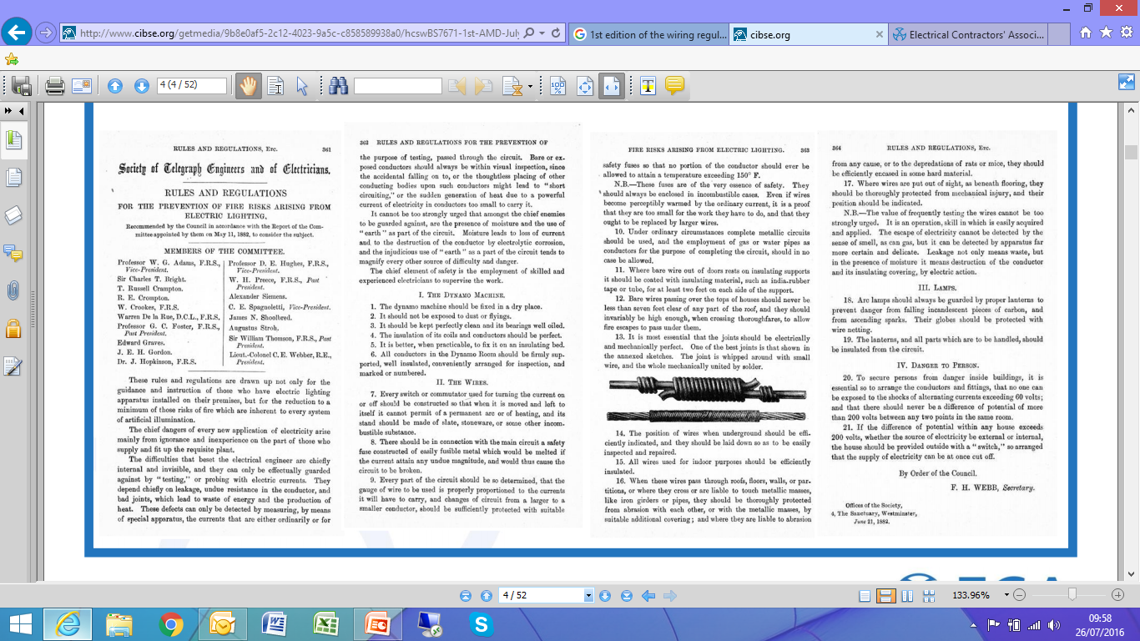
Rules and regulations for the prevention of fire risk arising from electric lighting - 1882
Periodic Inspections of Electrical Systems.

Slide 34
Necessity for periodic inspection & testing.
Any questions..?
Legislation requires that electrical installations are maintained in a safe
condition.
The following bodies may require periodic inspection and testing:
Licensing authorities.
Public bodies.
Insurance companies.
Mortgage lenders.
Periodic Inspections of Electrical Systems.

Slide 35
What does the Legislation say..?
Any questions..?
Electricity at Work Regulation - Regulation 4 (2) requires:
‘All systems shall be maintained so as to prevent, so far as is reasonably practicable, such danger.’
Regulation 16 – Persons to be competent to prevent danger and injury.
‘No person shall be engaged in any work activity where technical knowledge or experience is necessary to prevent danger or injury...unless under such degree of supervision..’
Periodic Inspections of Electrical Systems.

Slide 36
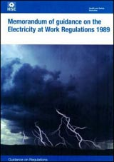
Any questions..?
Legislation.. The Electricity at Work Regulations 1989.
The Memorandum of guidance on the Electricity at Work Regulations 1989. – HSR25.
There is no specific requirement to carry out maintenance activity as such – what is required is that the system be kept in a safe condition..
Periodic Inspections of Electrical Systems.

Slide 37
Any questions..?
What does BS7671 say...?
Remember - BS 7671 is non-statutory – however compliance is generally accepted to satisfy the statutory requirements and may be used in a court of Law. (Refer to 114.1 in BS 7671).
134.2.2 - The designer of the installation shall make a recommendation for the interval to the first periodic inspection and test..
Chapter 34 – An assessment shall be made of the frequency and quality of maintenance the installation can reasonably be expected to receive during its intended life.
Periodic Inspections of Electrical Systems.

Slide 38
Any questions..?
What does BS7671 say...?
In essence.. Periodic Inspection and Testing is a recognised method for demonstrating maintenance, as it involves assessing:
Safety.
Age.
Damage.
Corrosion and external influences.
Overloading.
Wear and tear.
Environment.
Suitability for continued use.
Periodic Inspections of Electrical Systems.

Slide 39
Any questions..?
Guidance Notes 3 – Inspection & Testing
Table 3.2.
Sound engineering judgement should be
applied when deciding upon intervals
between inspecting and testing.
Table 3.2 may be used as a suitable starting
point.
The intervals between future inspections may
be increased or decreased as a result of the
inspection and test (Note 8).
Periodic Inspections of Electrical Systems.

Slide 40
Any questions..?
The reality....
Privately owned dwelling:
Difficult to persuade a homeowner the benefits of periodic
inspection and testing.
It is presumed the occupier will notice any breakages or
excessive wear and arrange for precautions to be taken and
repairs carried out.
Periodic Inspections of Electrical Systems.

Slide 41
Any questions..?
The reality....
Commercial and Industrial Installations:
Compliance is essential with The Electricity at Work
Regulations 1989.
Formal arrangements are required for maintenance, interim
routine checks and periodic inspections.
Frequency of checks and inspections will depend on the
nature of the premises and may increase with age.
Periodic Inspections of Electrical Systems.

Slide 42
Any questions..?
The reality....
Private Rented Sector..
 | Legislation | Requires Electrical checks
England | Landlord and Tenant Act 1985 | No
Wales | Landlord and Tenant Act 1985 (Renting Homes Act 2016) | No (Yes?)
Northern Ireland | Private Tenancies Order (Review – Department for Social Development) | No ?
Scotland | Housing (Scotland) Act 2014 | Yes
Periodic Inspections of Electrical Systems.

Slide 43
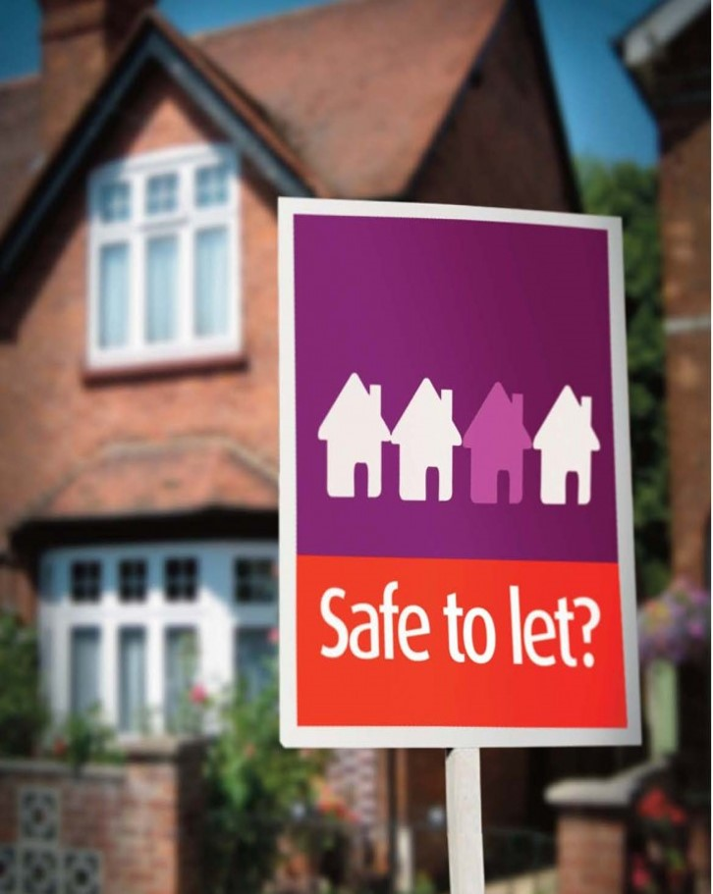
Any questions..?
The reality....
Private Rented Sector (PRS)..
Both the Electricity at Work and the
Landlord and Tenancy Act require electrical
installations to be effectively maintained.
UK Government recently committed to
introducing new powers to set requirements
for electrical safety within the PRS.
Periodic Inspections of Electrical Systems.

Slide 44
Any questions..?
The Private Rented Sector....Recommendations
5 years
Used between change of Tenancy
5 years
Periodic Inspections of Electrical Systems.

Slide 45
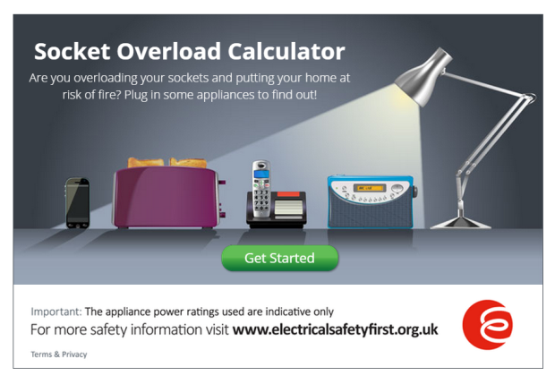
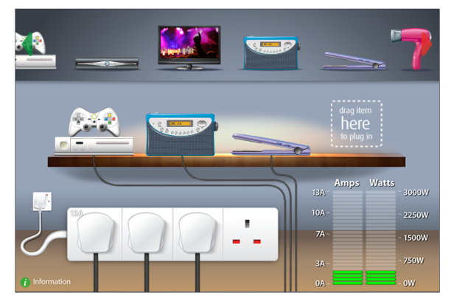
Any questions..?
Advice for Landlords and Tenants...
www.electricalsafetyfirst.org.uk/guides-and-advice

Slide 46
Any questions..?
Houses of Multiple Occupancy (HMO)
The Management of Houses of Multiple Occupation (England) Regulation 2006 requires:
Electrical Installations to be inspected and Tested every 5 years.
A written report (Condition report).
Carried out by a suitably qualified person.
Enforced by licensing procedures.
Periodic Inspections of Electrical Systems.

Slide 47
Any questions..?
Social Housing...
Social Housing – 5 or 10 years?
The ultimate decision is with the competent person – the
inspector.
Apply sound engineering judgment – base the decision on fact.
Maintenance regimes / programmed work may form part of the
decision.
Justification may be sought.
Periodic Inspections of Electrical Systems.

Slide 48
Coding – often the problem..
Any questions..?
These are often the areas where you need help.
One persons C2 is another’s C3!
Its the competent persons judgement call – but it must be
substantiate with fact.
Good practice - assigned with a regulation number against the
coded item.
Anything written down needs to be clear and understood by
the client.
Periodic Inspections of Electrical Systems.

Slide 49
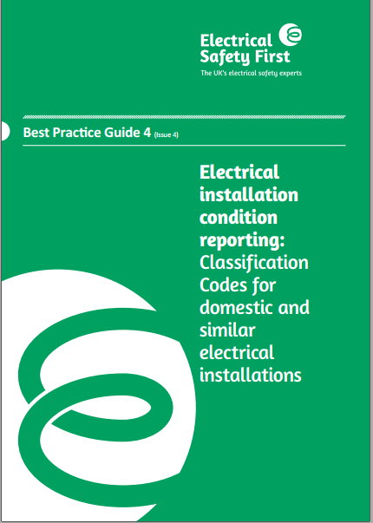
Coding – often the problem..
Any questions..?
Best Practice Guide 4.
Free to download.
Industry agreed guidance.
A good reference if challenged.
Periodic Inspections of Electrical Systems.

Slide 50
Coding – above all..
Any questions..?
Bear in mind, what we tell our members..
Over zealous with coding might lead to later criticism if your
client spent money on unnecessary remedial work.
Being to lenient with coding could have a consequence if later
something goes wrong.
Document as much as you can – keep to the contract.
Periodic Inspections of Electrical Systems.

Slide 51
The Electrical Contractor’ Association
Electrical Contractors’ Association.
E: steve.martin@eca.co.uk
T: 020 7313 4807
M: 07866 487593
@ecastevemartin
Shaping our industry
Enabling business growth
Getting members specified
Internet of Things?
Unlocking the potential for electricians..
Central Essex & Colchester Technical Forum.

