Slide 1
Workshop 2d:
Stock rationalisation and stock swaps
Speaker: Steve Partridge(Savills)
Chaired by: Karl Linder (Viridian Housing)
Room: Norfolk Room

Slide 2
Stock rationalisation – market update
Steve Partridge, Director, Savills Housing Consultancy

Slide 3
Agenda
1
Sales embedding in business plans
7
Evolution of the Regulatory Framework
2
Development – Sales oriented
8
De-regulation
3
Don’t forget – the market moves
9
State of the market
2
Don’t forget – the market moves
4
Drivers for stock sales and swaps
10
Success and pitfalls
5
Market context
6
Future of the SHR
6
Success and pitfalls

Slide 4
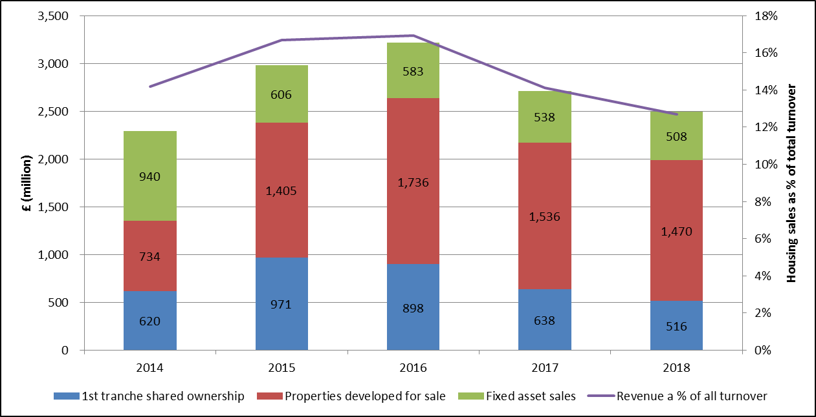
Sales embedding in business plans

Slide 5
Development – Sales oriented
Autumn Statement
£4.1bn pa for shared ownership: -
135,000 shared ownership (doubling the stock/quadrupling output)
£400m for 8,000 specialist homes (to add to the NHP)
£200m for 10,000 Rent to Buy homes
£2.3Bn for 60,000 of 200,000 Starter Homes
Help to Buy Equity Loan - 200,000
Help to Buy ISA
Right to Buy
“£700m grant to be shifted to ownership”

Slide 6
Don’t forget – the market moves
Late cycle price growth stretches affordability
Strong growth as economic recovery gathers pace
Short lived bounce
Slowdown post implementation of MMR
Prices fall 20% post credit crunch
Market stagnation
Notes:
Many moving parts
Associations will need to be very agile and respond to changing markets
Remember 2008!
We are probably close to the next downturn.
Not a reason not to act but be robust and set triggers in the Bis Plan not to commit too much of programme and work closely with the FD to set limits on WIP and put the brakes on if sales aren’t coming through.

Slide 7
Drivers for stock sales and swaps
Footprint disposals for operating efficiency
Churning core stock to release funds for reinvestment
Strong buyers market – social housing is a precious commodity
Proven assets with known liabilities

Slide 8
Market context
Rent cuts
Deregulation
LHA cap
Absorbed – clients back in the market for development and active asset management
Base price impact balanced by strong premiums over EUV-SH
Move from consent to notification
Expect tenant consultation as a regulatory requirement
Ongoing uncertainty for supported housing in particular but also GNeeds
Impact on Development Programmes
Management only arrangements
NHF Rent Consultation

Slide 9
Future of the SHR
SHR becomes an Executive Agency
Separation of investment and regulation
Introduction of fees for regulation
VFM and Efficiency focus

Slide 10
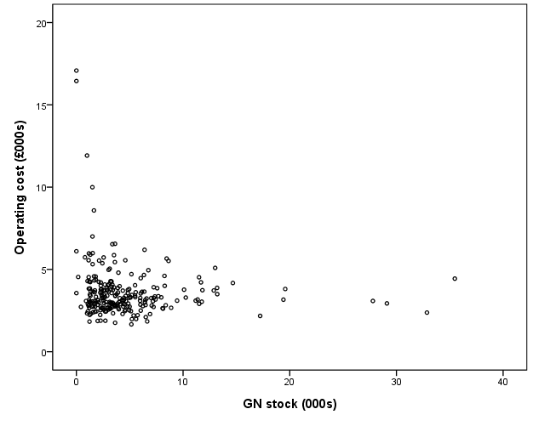
Evolution of the Regulatory Framework
We await guidance to accompany implementation of the Housing & Planning Act
Standards unlikely to change much
Focus on operating efficiency – challenge to the sector to come up with its own measures of vfm
Consumer standards remain. Serious detriment is being pursued. Some pressure to intervene in unresolved ombudsman cases.
Home standard remains but many associations reducing investment to the minimum.

Slide 11
De-regulation
The Dark Side
Sell out your tenanted stock to the private sector
Take a large severance payment and go!
Horse has bolted

Slide 12
De-regulation
The Force Awakens
Sell out poorly performing tenanted stock to the private sector
Secure guarantees for the tenants for the term of their tenancy agreements
Let the private sector convert to market rent or sell
Recycle the receipts into new homes

Slide 13
De-regulation
Conflicted!
Transfer tenanted stock to an unregulated parallel not for profit business.
Avoid RtB, Rent Cuts etc
Is this good governance?

Slide 14
De-regulation
Impact on values
Depends on which side you join!

Slide 15
State of the market
Region | Total Housing units | Total Bids | % EUV-SH | "Net" yield
East Midlands | 1541 | £ 80,293,905 | 133% | 6.1%
East of England | 1696 | £ 100,507,192 | 130% | 8.8%
London | 2974 | £ 268,220,833 | 144% | 6.9%
Midlands | 42 | £ 2,610,000 | 150% | 6.0%
North East | 118 | £ 6,100,100 | 113% | 7.7%
North West | 3555 | £ 116,587,714 | 138% | 13.6%
South East | 3431 | £ 231,338,514 | 161% | 8.3%
South West | 3591 | £ 201,569,500 | 137% | 9.4%
Wales | 98 | £ 4,500,200 | 149% | 8.1%
West Midlands | 1216 | £ 81,232,001 | 180% | 7.5%
York/Hmber | 571 | £ 26,809,225 | 119% | 8.9%
Grand Total | 18833 | £ 1,119,769,184 | 144% | 8.6%

Slide 16
Success and pitfalls
Robust data
Stock condition
Identify risk areas before marketing
Clear communications about timescales and expectations
Early comms with affected staff and stakeholders – Las
Maintain momentum and competitive environment
Communication!
Delegated authority of decision making
Dedicated project manager/team

Slide 17
Questions

