Slide 1
Workshop 4a:
The risks and pitfalls associated with the appointment of a principal designer
Speaker: Tony Mitchell (HSE),
Tim Clark (Kendall Kingscott),
Richard Parry (Ian Williams Ltd)
Chaired by: Stephen Chalmers (Kingsdale Group)
Room: Arden Room

Slide 2
The Evolving Principal Designer Role
Tony Mitchell
Principal Inspector
Construction, West Midlands

Slide 3
The PD – Child of CDM 2015
Born out of necessity
CDM-C role was not working
The PD Should
  Strengthen design risk management and co-operation
  Mirror the PC role in achieving co-ordination
  Simplify Health and Safety in the pre construction phase

Slide 4
CDM 2015
Pre construction phase
Liaison phase
Construction Phase
Principal Designer
Principal Contractor
CDM
Information
Pre construction information
Construction Phase Plan
H&S File
BIM Common Data Environment
Concept Stage
Options
Models show mass
Site evaluation
Risk analysis
Design
3D Models
Methods of construction
Liaison with contractors
Site logistics
Define end user needs
Detailed design
Clash detection
4D Models
Constructability
Using models to communicate
Risk mitigation
Construction
Information on risk informs CPP
Visual method statements
Handover
H&S File
Maintenance info
Information to inform ongoing risk assessment

Slide 5
PD Appointment – 5(1)(a)
Required where there is more than one, or reasonably foreseeable to be more than one, contractor
Must be appointed in writing
Must be in control of pre-construction phase
Must be a designer
  “designer” means any person (including a client, contractor or other person referred to in these Regulations) who in the course or furtherance of a business—
    prepares or modifies a design; or
    arranges for, or instructs, any person under their control to do so,
    relating to a structure, or to a product or mechanical or electrical system intended for a particular structure, and a person is deemed to prepare a design where a design is prepared by a person under their control

Slide 6
PD requirements
8(1) - A designer (including a principal designer) ….. appointed to work on a project must have the skills, knowledge and experience, and, if they are an organisation, the organisational capability, necessary to fulfil the role that they are appointed to undertake, in a manner that secures the health and safety of any person affected by the project.
8(2) - A designer …must not accept an appointment to a project unless they fulfil the conditions in paragraph (1).

Slide 7
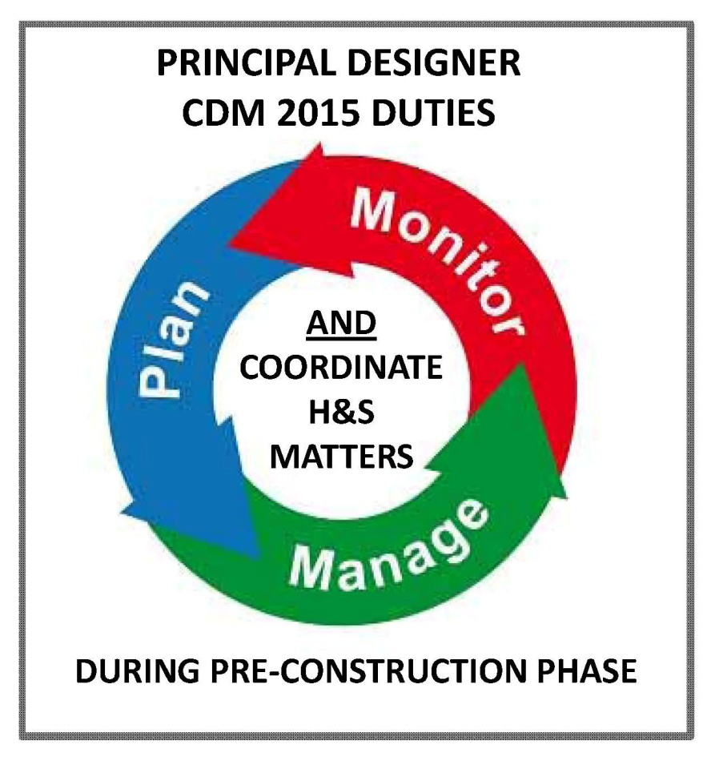
PD – main duties – regs 11 (1 to 7)
Role is to plan, manage and monitor the pre-construction phase
  To co-ordinate the health and safety
  Pre-construction is defined as any period which design or preparatory work is carried out
PD must:
  assist the Client in identifying, obtaining and collating the pre-construction information
  provide pre-construction information to Designers, the Principal Contractor and Contractors
  ensure that Designers comply with their duties and co-operate with each other
  liaise with the Principal Contractor for the duration of the appointment
  prepare the Health and Safety file (possible handover)

Slide 8
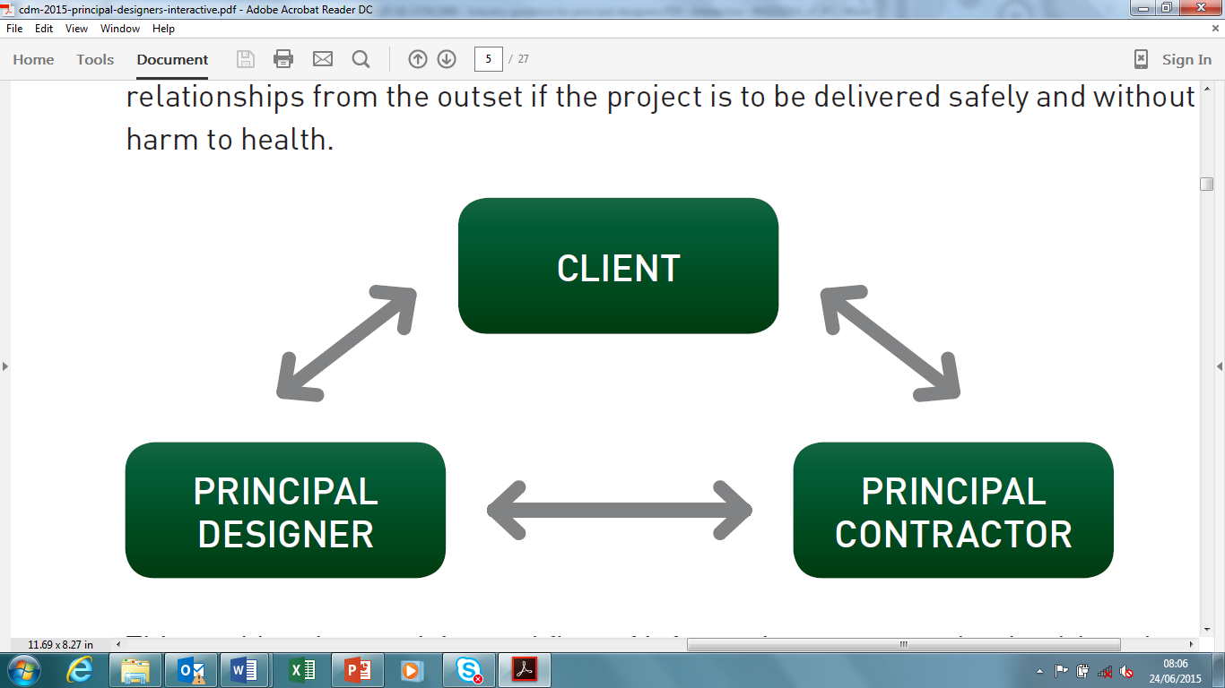
PD role – what is industry trying to achieve?
Designers taking responsibility during pre-construction
  Mirror role to the Principal Contractor (PC)
  Ability to influence the Client and PC
  More strategic approach on a project
Designers taking responsibility for health and safety
  Health & Safety part of their design (not at the end)
  Needs to be an integral part of design – not separate / part of the thought process
Added value
  Reduce no of dutyholders
Change accountability and behaviours
  Perception of delegating H&S to consultant
  Remove the Notifiable / Non-Notifiable behaviours

Slide 9
what we expect of the PD and the professional design institutions in support for developing the role.
Encourage & Build Confidence
Skills, Knowledge & Training
Know CDM2015
Know the Principles of Prevention
Know how to influence the Client
Know how to manage the design risk process
Experience in benefitting from BIM tools
Confidence to influence the supply chain
Training started i.e. Consultants Forum, RIBA, ICE

Slide 10
PD is in control of process of risk management - but Client is key
Input
Standards / Codes
Assumptions
Design
Changes identified
Output
Check (errors) & Review (requirements)
Client brief
Risks
Existing Information
Assumptions
Risks
Appropriate competency
Drawings
Calculations
Risk information created
Client resources PD
Client instructs PD
…….but Client is entitled to look to PD for leadership in Health and Safety

Slide 11
Principal Designer Risks & Pitfalls
A Practitioner’s View & Experience
Tim Clark
Kendall Kingscott Limited
January 2017

Slide 12
Principal Designer Risks & Pitfalls
A Practitioner’s View & Experience
Will be looking at:
Complying with Duties and ‘Tools’ available
Late Appointment, and Types of Appointment
Typical Technical Issues
Design Changes
Not being ‘Kept in the Loop’
Security/ASB Issues
Conclusions

Slide 13
Complying with Duties
Principal Designer duties – as Regulation 11, include…
Must plan, manage, monitor pre-construction phase
Must identify, eliminate or control, SFARP, foreseeable risks
Must take into account General Principles of Prevention
More emphasis than the old CDMc role – previously had to ‘ensure’ arrangements were in place

Slide 14
Complying with Duties
Designer Duties under Regulation 9 of CDM 2015, include…
Eliminate, reduce and control risk
Take into account General Principles of Prevention
Designer duties have not significantly changed from CDM 2007 – but Principal Designer MUST ensure that they carry them out
Therefore – risk to the PD from poor Designer performance

Slide 15
Tools for Compliance –
General Principles of Prevention
These come from the Management of Health & Safety at Work Regulations 1999, Schedule 1
Annex D of CDM 2015 “Industry Guidance for Designers” lists them and gives examples of applying them

Slide 16
Tools for Compliance –
Red, Amber & Green Lists
Annex E of CDM 2015 “Industry Guidance for Designers” includes the HSE Red, Amber, Green lists

Slide 17
Tools for Compliance - ERIC
Get to know ERIC
Eliminate risks where possible
Reduce to an acceptable level risks that cannot be eliminated
Inform those who need to know of the residual risk i.e. PD, PC, C etc.
Control of residual risks, could be by the PC, C and end users, future maintenance contractors

Slide 18
Other Tools for Compliance
Designer Risk Assessments
Hazard Reduction and Risk Reduction Checklists
CDM Risk Registers
Attendance/Minutes of Design Team Meetings
Other notes/discussions
Reference to HSE Guidance, e.g. HSG 264 Asbestos Survey Guide
All help demonstrate that the PD role has been properly executed

Slide 19
Late Appointment of PD
PD should be appointed as early as possible in the design process (as per Regulations guidance)
If not, it could be too late to be effective in reducing design risk
APS have letter which refers to ‘modified’ PD role
What if you don’t like what you see?
Who has been PD up to that point (whether they knew it or not), and what have they done?
Being named as PD on the F10 form when most of the design was completed without your involvement – not very appealing?

Slide 20
Types of Appointment – Principal Designer
i) Principal Designer
For projects where also appointed as designer
ii) Principal Designer
For projects where not appointed as designer – has been clarified as acceptable by APS that a Designer rather than the Designer can fulfil the role (initially we thought this was not the case)

Slide 21
Types of Appointment – Adviser
iii) CDM Consultant/Adviser
For projects where not acting as designers, and those involved do not have sufficient knowledge, experience or ability to undertake the role without assistance
Not a dutyholder under CDM 2015
May be of use in larger /complex schemes, M&E design lead schemes, and design and build
Prior to APS clarification, we thought this was the only alternative where we were not already the designer for the project

Slide 22
Typical Issues - Asbestos
Correct type of survey - to HSG 264 by competent person
Refurbishment Demolition Survey required for works, not a Management survey
Rather that telling the qualified asbestos surveyor what to do, give them the details of the scheme and let them advise what is necessary for providing a targeted/localised R&D Survey suitable for the proposed works
Place responsibility with the competent person, otherwise who is responsible for the scope of the survey?
Watch out for caveats - read surveys carefully!
Occupied premises/contractor design works – two stage process?
Archetypes/cloning – again, take advice (refer to HSG 264)

Slide 23
Typical Issues – Work At Height
Edge Protection
Sufficient height for duration of works? Think about when insulation is laid
Can edge details be formed with kickboards in place? Are alternative provisions required, e.g. exclusion zones at ground level?
Fragile Surfaces
How to temporarily protect – barriers, deck below?
Can activities continue beneath?
Avoid specifying – see R/A/G lists

Slide 24
Typical Issues – Work At Height
Fall Restraint versus Fall Arrest
Fall arrest stops a fall that has already happened, whereas..
Fall restraint stops a fall from occurring by restricting movement
Therefore, where possible always go for fall restraint
Prevention, rather than (a potentially very dangerous) cure
Maintenance Works
When are ladders appropriate? – short term, e.g. less than 30 minutes

Slide 25
Typical Issues – Work At Height
HSE WAIT Toolkit suggests methods other than ladders for a light task, despite equipment moves less than 30 minutes apart
Food for thought….....
WAIT - Work at Height Access Information Toolkit

Slide 26
Typical Issues - Security/Anti-Social Behaviour Matters
Vacant premises
Squatters
Syringes
VIP properties, ‘Visit In Pairs’
Need to consider how to protect the workforce, whilst paying due regard to data protection issues
.

Slide 27
Design Changes
Construction phase design changes need to be considered to the same extent as pre commencement design
This is to eliminate the introduction of unintended risks into the project
Process for dealing with these if PD appointment ended at commencement? Still need to have availability of competent person to advise in this regard

Slide 28
PD not being ‘Kept in the Loop’
Need to be wary of PD ‘box having been ticked’, and then being isolated from the design process – remember your duties
Be wary if communications dry up

Slide 29
Conclusions
The Principal Designer role is a significant responsibility with legal duties
Need to have the relevant skills, knowledge, training and experience to fulfill the role
In order to adequately discharge the duties, close liaison is required with the Designer(s), Client, and Principal Contractor
Demonstrative involvement required in the role of PD – more than the CDM Co-ordinator
It remains to be seen whether Designers will embrace the Principal Designer role or whether ‘specialists’ will be required to provide support indefinitely

Slide 30
Impact on Service Providers
Richard Parry
Ian Williams

Slide 31
The Contractors Conundrum
The responsible contractor carries an obligation
Can a contractor be a designer?
Principal Contractor also the Principal Designer? Good or bad idea?
Simply acquiesce? – The responsible contractor will not want to simply agree where they know it is wrong to do so
A contractor may only accept the PC or the PD role where they can demonstrate a sufficient mix of skill, knowledge and experience that is relevant to the project for each role
  Inevitably many contractors will aim to avoid PD duties in all but the most simplistic of construction projects
  Mission creep?

Slide 32
Doing the right thing?
Housing Association client awards work packages to three separate contractors
Multiple but similar projects over 7 areas
Three separate contractors all given written letters of appointment as PD
No indication in bid documentation of PD requirement
3 x PD inputs = inconsistency
Contractor options?

Slide 33
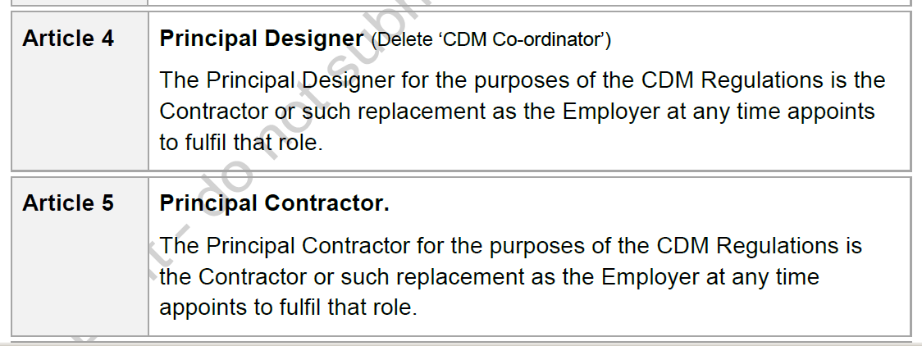
Supplementary conditions to an invitation to bid
(extract)

Slide 34
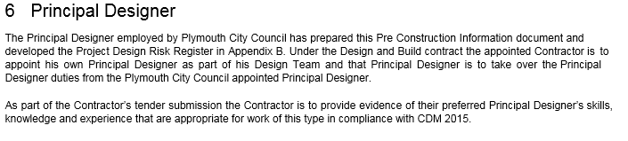
Doing the right thing
Extract – Design and build

Slide 35
A dual role – desirable?
It is a client duty to appoint a PD not the principal contractor’s
The client must appoint a PD in writing (reg.5 CDM 2015)
The majority of the PD role occurs pre-construction phase. Appointment therefore must be as early as possible, ideally at the concept stage
Adoption of role during life of the project
Failure in timely appointment could result in additional cost and cause delay
Failure to appoint results in client adoption of these roles

Slide 36
Doing the right thing?
Conception of the project / Outline specification
If foreseeable that more than one contractor will be involved a Principal Designer (PD) to be appointed
PD advises the client on the content and adequacy of the PCI
PCI and project put out to tender
PD assists in selection of a Principal Contractor (PC)
Appointment of a Principal Contractor
Project start
PC and PD liaison during the construction phase
PD liaison and influence on any ongoing design changes
PD completes the H&S file

Slide 37
The way it (sometimes) appears
Conception of the project / Outline specification
Client fails to recognise the implications of more than one contractors involvement
Client draws up a tender document / model contract without the assistance of a PD
Tender document issued for contractor bid ignoring the need for PD & PC appointment
Client recognises the implications of more than one contractors involvement
Client draws up a tender document / model contract without the assistance of a PD
Tender document issued for contractor bid by seeking to discharge PD duty by contract through the PC
Consequences
Failure to comply with CDM?
Delay where PCI info falls short of that required
Client by default adopts the roles of both the PD & PC
Client may well retain the roles of both the PD & PC
Civil (contract) law v Statute Law
Notes:
PD advises the client on the content and adequacy of the PCI
PD advises the client on the adequacy of the C Phase plan
PC and PD liaison during the construction phase
PD completes the H&S file

Slide 38
Timely PD involvement
PD
PC
PC
Pre construction phase | Liaison phase | Construction phase
PD
PD
Principal Designer
Principal Contractor
CDM Info
Pre construction information
H&S File
Construction phase plan
Notes:
Make suitable arrangements for managing a project to include the allocation of sufficient time and other resources.
Provide pre construction information.
The information must:
be relevant to the particular project;
have an appropriate level of detail; and
be proportionate to the risks involved.

Slide 39
Areas of concern
A contractual clause in tender docs requiring the contractor to fulfil PD role as a contractual condition for award may not be wise
Any appointment of a PD in the liaison or construction phase, then the client must ‘brief’ the incoming PD on any design risks or considerations that arise from design activity in the pre-construction phase
A potential for conflict?
Where a contractor has to discharge by the involvement of a competent third party. Appointment ought to be subject to client agreement bearing in mind their legal obligation
Notes:
The PD can be an organisation or an individual that has:
the technical knowledge of the construction industry relevant to the project;
the SKE to understand, manage and coordinate the pre-construction phase, including any design work carried out after construction begins.
If an organisation it must have the organisational capability.

Slide 40
The contractors take on it
The PD manages health and safety, mainly in the pre-construction phase of a project
The PD role extends to the construction phase through the PD duty to liaise with the PC and designers for ongoing design work
The PC manages the construction phase of a project
The PC has to liaise with the client and the PD throughout the project to include the pre-construction phase once appointed

Slide 41
Skill, knowledge and experience
Client should check all duty holders have ...
Principal Designers shouldn’t accept unless they have ...
Principal Contractors shouldn’t accept unless they have ...
And the PC should not appoint (sub) contractors unless they have checked that they have ...
Regulation 8 CDM 2015
Notes:
All duty holders must have the skills, knowledge and experience to fulfil their role. If an organisation they must have the capacity to fulfil.
Must not accept a role unless above is fulfilled.
Person appointing is to check.
Co-operate
Report to person in control of a project anything that endangers.
Provide information or instruction (must be comprehensible)
Applicable to all working on a project.

Slide 42

Questions?
Speakers: Tony Mitchell, HSE
Tim Clark, Kendall Kingscott
Richard Parry, Ian Williams

