Slide 1
Workshop 4e:
Using IT to support excellent customer services
Speaker: Anna O’Halloran (Just Housing Group)
Chaired by: Jon Cross (Essenjay Associates)
Room: Dorset Room

Slide 2
Anna O’Halloran
Managing Director
NHMF 2017

Slide 3
Today
What proportion of reports can be expected online?
Will this deliver savings to the service?
Are there technical barriers to overcome?
So, let’s start by thinking about technology in connection with channel shift, specifically getting tenants to report repairs online.
Can technology provide the best customer experience for repair reporting?
Notes:
3

Slide 4
Are we doing all we can?
Actually if you build, market and sell it really well they will come……
Remember this?
Notes:
4

Slide 5
Factors influencing channel usage
Access
Awareness
Trust
Motivation
Ability
Trigger
Experience
The relevance of each factor will vary from organisation to organisation, with each having its own profile of priorities.
Do you know which is the biggest issue for your organisation?
Notes:
5

Slide 6
Behavioural Influences
ACCESS – is the channel available to the tenant?
AWARENESS – is the tenant aware of the channel?
TRUST – does the tenant trust the channel and the organisation?
MOTIVATION – what benefits will the tenant get from using the channel?
ABILITY – does the tenant have the required skills / equipment?
TRIGGER – what can we do to nudge the tenant into trying the channel?
EXPERIENCE - does the channel offer a superior customer experience?
Notes:
6

Slide 7
Access
I don’t have a computer
Even if I had one, I wouldn't know how to use it
I’m not confident on a PC
I don't always have phone credit
Potential solution:
An Access barrier to using phone (no credit) could be turned in to a Motivation incentive (email / web is free).
For tenants who ‘dip into’ an alternative channel in this way, it is essential that they receive a superior customer Experience if they are continue to use that channel.
Notes:
7

Slide 8
Awareness
None that I know of
It’s common sense [that X channels are available]
I can't remember where I heard about it
Might have been a leaflet [where I heard about it]
I don’t know where I heard about it—I guessed.
What could you do to make sure that your tenants are aware of the new channel?
Notes:
8

Slide 9
Trust in the landlord
I trust them in the sense that they gave me a home, but I don’t trust them to fix things. I had to wait 18 months for a repair
They send nice glossy brochures, but…
I think they’ve got a hidden agenda. They’ve got that nice new office building, but…
Potential solution:
A ‘paper trail’
A lack of trust in certain cases was manifest when respondents were probed about the benefits of each channel.
In relation to email communication, a notable number of tenants stated ‘paper trail’ (unprompted) as the key benefit.
Email allows a tenant to keep a record of the correspondence should it be needed for proof at a later stage.
Whilst this is a negative in relation to trust, it could be turned into a positive incentive when it comes to motivating tenants to use email communication.
Notes:
9

Slide 10
Trust in the channel
Best to call if I need something done, they might not get email
If I use the phone I know that it has been dealt with, if I speak to someone
If I do it online you don’t know if it has gone through
What does this mean?
Suspicion that digital communication does not arrive is a key barrier
This relates directly to the desire for personal contact
More specifically it relates to a need for confirmation, feedback and acknowledgement
Notes:
10

Slide 11
Trust & personal contact
Communication through personal contact is deeply embedded in human interaction and represents a largely unconscious preference.
In turn, this will make incentivising shift through rational appeals difficult.
Whilst over time many have learned to accept letters and telephone calls as a proxy for true face-to-face personal contact, digital interaction is perceived as more fundamentally impersonal to many.
Notes:
11

Slide 12
Motivation
This is linked to habit & routine in most instances:
Its automatic for me to pick the phone up
It’s the easiest way and I’ve always done it
For many, use of the existing preferred channel is simply a matter of habit. However, as with ‘Personal Contact’, habitual behaviours are often deeply ingrained, unconsciously executed and therefore difficult to change through rational appeal.
Could SPEED help?
Speed of service is a key driver of channel choice.
However, ‘speed’ must be understood in relation to both the submission of the request and response to the request:
Submission relates to how long it takes the tenant to log the request
Response relates to how long it takes the organisation to action/respond/acknowledge.
Notes:
12

Slide 13
Access
If I tried it once, I think I’d be ok
I’m computer-phobic
I find new technology hard to use
As with Access the causal factor here may be an underlying attitudinal set that accounts for the reluctance to learn/try, rather than the absence of skills per se.
For others, who are already using digital technology for some tasks (Facebook), there is a perception that using it for landlord-related interactions would be too complex/difficult.
Notes:
13

Slide 14
Trigger
We need to design ‘triggers’, to address the other issues:
Access
Awareness
Trust
Motivation
Ability
Experience
Notes:
14

Slide 15
Experience
I tried email but it doesn’t work well when reporting repairs
I do use email for other things but not with [landlord]. I have wait too long for reply
I thought it was easy to use, straightforward etc, but I don’t think I’ll use it again as [my repair] didn't get logged
Once triggered to try a new channel, the tenant must receive a positive service experience in order to continue using it.
In order to counterbalance significant disincentives such as force of habit and need for personal contact, it is likely that this experience will need to offer significant advantages over the tenant’s existing preferred channel.
A sub-standard customer experience in this context is likely to further reinforce existing barriers and make subsequent channel shift with that tenant even more challenging.
Notes:
15

Slide 16
Experience & acknowledgement
As human beings, if we are not acknowledged, we feel ignored. Lack of acknowledgement also leads to uncertainty, a well-documented source of psychological tension that leads to frustration in the process and lack of confidence in the outcome.
In the absence of clear, timely acknowledgement, the user is likely to pick up the phone to check that the interaction has been logged.
Notes:
16

Slide 17
Important!
Acknowledgement
Make it personal
First impressions count
‘What’s in it for me’
Habits must be broken
Speed
Steps (how complicated is it?)
The new normal
Notes:
17

Slide 18
Solutions anyone?
Notes:
18

Slide 19
A different way?
Homo Economicus?
Homer Economicus?
Notes:
19

Slide 20
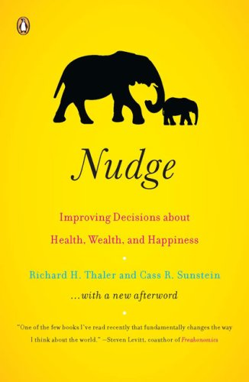
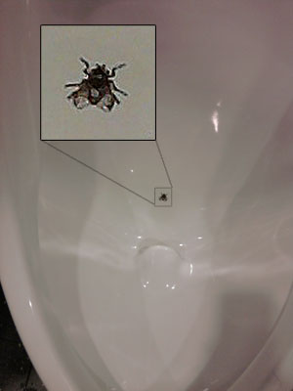
Nudge
The classic Nudge
Small changes to context can have powerful impacts on behaviour.
Notes:
20

Slide 21
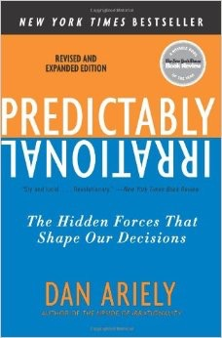
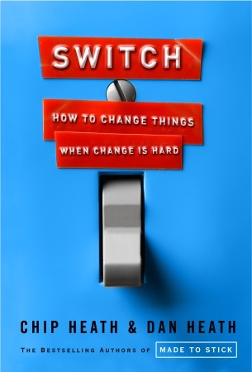
Behavioural insights
Widely used in UK / US government policy development.

Slide 22
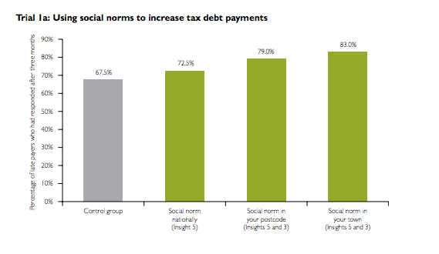
Norms
When citizens were told that most people pay their tax on time, payment rates significantly increased.
£210m of revenue brought forward in 2012/13 alone.

Slide 23
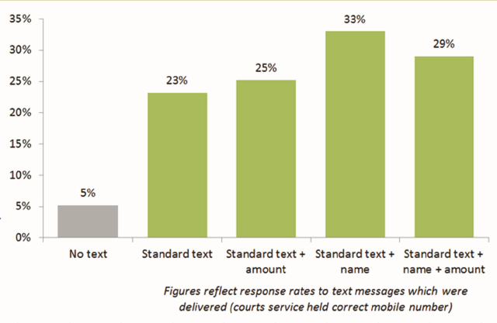
Messenger / Saliance
When people who were late with court fine received reminder text messages, payments when up by 28%
£30m per year in saved revenue
150,000 bailiff interventions

Slide 24
Behavioural insights
72%***
71%***

Slide 25
Behavioural insights
56%**
Reframing Letter 1 led to a 12% increase in payments.

Slide 26
Behavioural insights
71%*
Thanking tenants for keeping up repayment agreements resulted in 71% of them further increasing the amount they paid to reduce their debt

Slide 27
MINDSPACE
Messenger
Incentives
Norms
Defaults
Salience
Priming
Affect
Commitments
Ego
We are heavily influenced by who communicates information.
Our responses to incentives are shaped by mental shortcuts
We tend to do what those around us are already doing.
We ‘go with the flow’ of pre-set options.
Our attention is drawn to what is novel and relevant to us.
Our acts are often influenced by sub-conscious cues.
Emotional associations can powerfully shape our actions.
We seek to be consistent with our public promises
We act in ways that make us feel better about ourselves.
Notes:
27

Slide 28
Have a go
Taking one of the problems below, use MINDSPACE to trigger behaviour change
Lack of awareness of the new channel
Lack of trust in the new channel
Lack of ability to use the new channel
Notes:
28

Slide 29
Other things to think about
The cost of the new channel – have you assessed the ‘true’ costs? For example, does your new channel create an outbound call to arrange an appointment?
The unintended consequences of tenants actually using the new channel? For example, we’ve found that tenants who already report repairs on line report MORE repairs than those who report by other means. Do you want this?
Notes:
29

Slide 30
To find out more
anna.ohalloran@justhousinggroup.co.uk
www.justhousinggroup.co.uk
07912110078

