Slide 1
Workshop 4F:
Building skills for the future
Speakers: Rebecca Hart (Nottingham City Homes)
Chaired by: Billy Park (Guinness Property)
Room: Queens Room

Slide 2
Overview
My Journey
NCH WiC
Culture
Recruitment
Retention

Slide 3
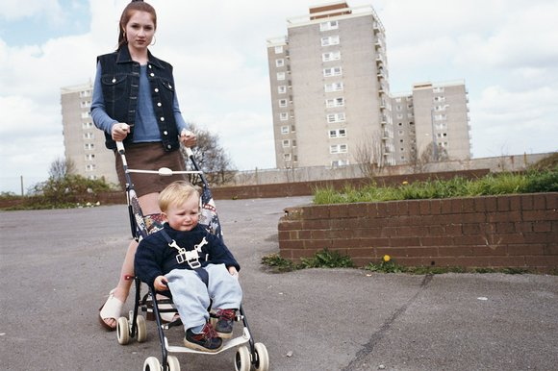

Slide 4
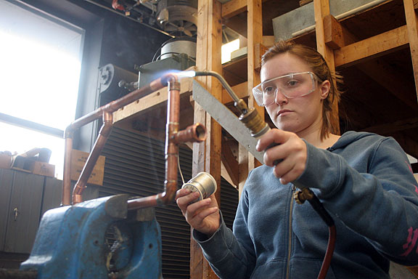
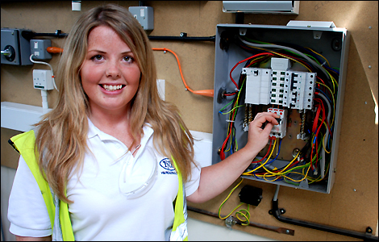
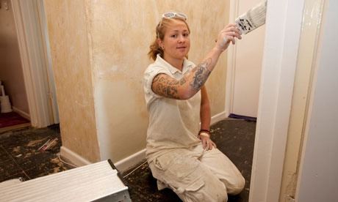
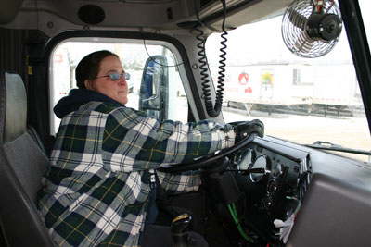
NWTS

Slide 5
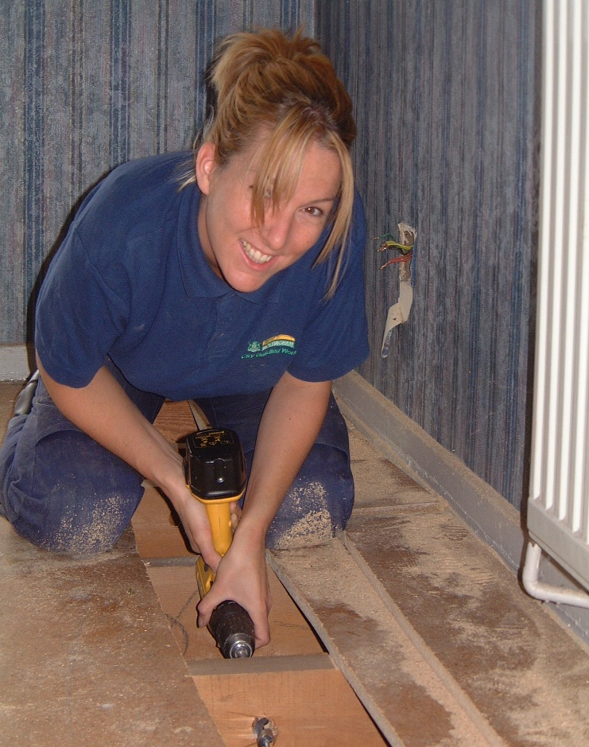
Life Long Skills
Job Satisfaction
Good Salary

Slide 6
The NCH Approach
External initiative
Targeted recruitment
Involve WiC members with outreach work
Build sustainable relationships
Internal initiative
Explore the barriers
Nurturing existing talent
Focus on retention

Slide 9
“Its not a man’s job, it’s a persons job and anyone can do it”
Leonora 2014
Notes:
The women led workshops have allowed visitors to learn new skills, gain advice on employment, and most importantly the confidence to take the next step.

Slide 10
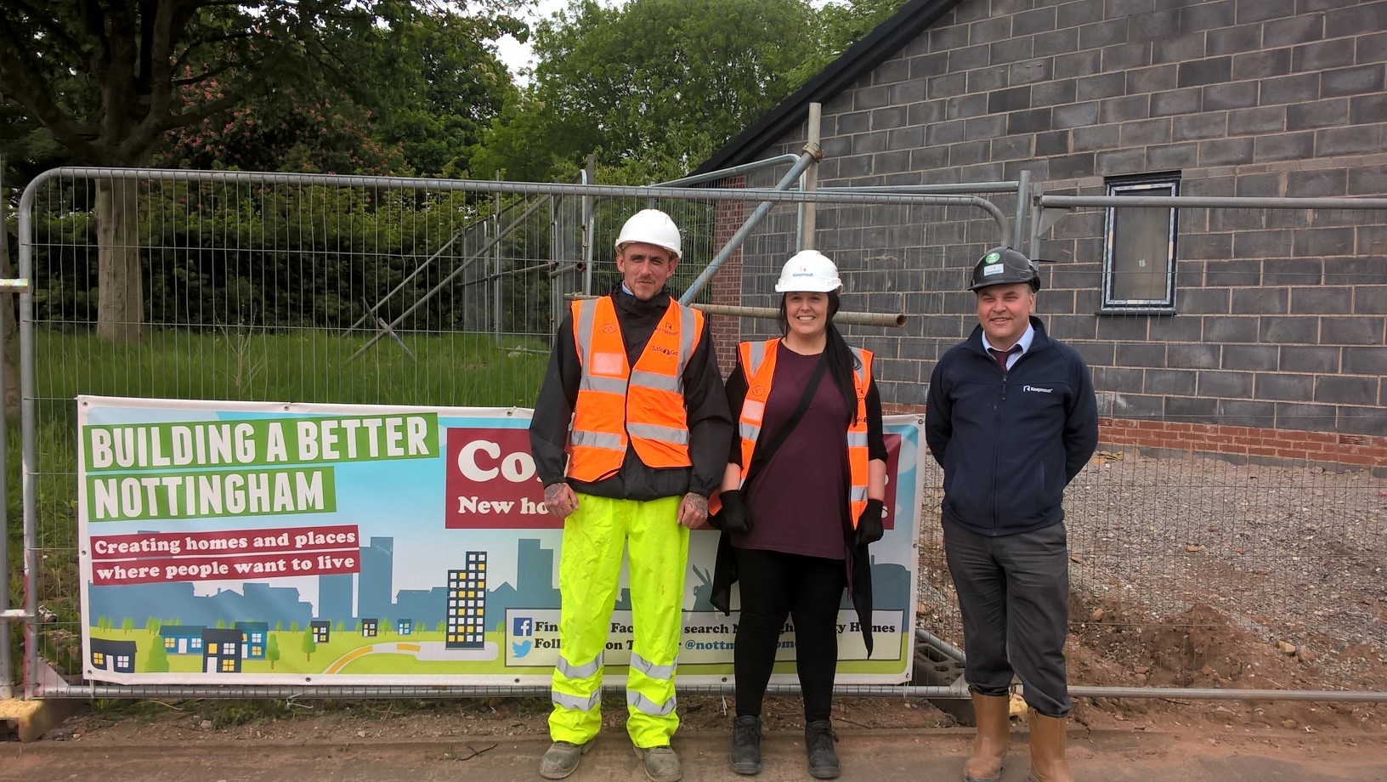
Notes:
The women led workshops have allowed visitors to learn new skills, gain advice on employment, and most importantly the confidence to take the next step.
We work closely with our partner contactors to increase opportunities and work together to reach common goals – Both Keepmoat and Robert Woodhead have supported women on placements which provides valuable experience so the women can make informed decisions about career paths
Increase of applications for trades increased from 0.5% to 16% over two years proving it’s a total misconception that ‘women don’t want to work in construction’
Both Hayleigh and Genna have done work experience with NCH which spurred them on to apply and secure plumbing apprenticeships

Slide 11
Barriers
entrenched attitudes
pay scheme
ourselves
Notes:
Engagement with women & men - WiC Presentations to DLO increasing the visibility of women whilst giving men & women the opportunity to gain mutual understanding and support.
Right first time means women who work to bonus scheme on average earn 5-7% less than men-reasonable adjustment etc
Monthly network meetings were the start to women sharing experiencing and sharing perceived barriers
Our own lack of self belief – lack of resilience/setting yourself up to fail – women less likely to apply for progression opps’ 10% V’s 80% rule
lead into ALS overview Reg Revans concept in 1940’s

Slide 12
Action Learning Sets
Introduction – issue bringer summarises issue
Exploration – SET listens, questions and probes to get clarity
Definition – get clarification from issue bring – could go around the room
Consultation – SET members generate ideas/options (discussion/post it) – stories of own experience
Action – Back to issue bringer to commit to 1-2 actions for next meeting.

Slide 13
WiC development Programme
Notes:
Peas Above Sticks, programme overview;
raising the aspirations and confidence of women currently working in Repairs and Maintenance and Asset Management to progress within the division
inspiring women through positive role models to take personal responsibility for their career development
making sure that everyone taking part has a realistic personal development plan and recognises the opportunities available to them
First workshop explores unconcious bias and how to address it both as an organisation and as an individual

Slide 14
Nurturing Talent
Aspire to Manage
Future Leaders
WiC development Programme

Slide 15
Aims
raise aspirations and confidence
inspire women through positive role models
ensure that everyone taking part recognises the opportunities available to them
Notes:
of women currently working in Repairs and Maintenance and Asset Management to progress within the division
to take personal responsibility for their career development
- making sure that everyone taking part has a realistic personal development plan and recognises the opportunities available to them

Slide 16
Success’s
30% trade apprentices are women
Increase in applications
Raised aspirations
Improved culture
Recognition!

Slide 17
Thank You!

