Slide 1
“We have fixed your house now don’t Break it”
Mark Burnett
NHMF Conference
January 2017

Slide 2
Some Background: Who are Riverside?
A charitable RP: established nearly 90 years ago
Operating at scale: over 50,000 homes and nearly 100,000 customers.
Over a range of housing markets: +160 local authority areas in some of the nation’s most challenged communities.
With a diverse offer: affordable homes for rent /care and support/ affordable homes for sale for shared owners and leaseholders/ market homes for sale to generate profits for the charity (through commercial companies)
Extra services to help sustain tenancies: money advice, employment support, affordable warmth

Slide 3

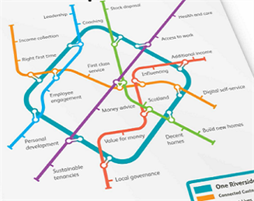
Riverside Journey

Slide 4
Think Homes Strategy
Proactive MOT
Repairs
Improved Asset
Data
Continuous Planned Works
Enable
Evolve
Expansion
Customer
Notes:
Starting with the customer First and undertaking MOT we can fix the home before its broken and through SIS understand the need
The main benefit of this proactive approach is to reduce the volumes of activity as (reverse Pareto principle)
85% of the activity (low value ) = 15% of the spend and 85% of the spend = 15% of the activity (high value)
So if we can reduce volumes we can focus on seeing the costs and avoid/mitigate these as well.
We use the data and improve our systems to know what we have what we need and keep us safe and informed
Keep flow of the work continual to maximize productivity and savings and cashflow benefits
Controlled expansion of Evolve which will with the DLO be covering @80-85% of our Homes by 2016

Slide 5
The Think Homes Benefit Experience
Appointment made to ‘fix the repair,’ not just ‘assess the repair’
Reduced visits / follow up
Proactive repairs service through MOT’s
Customer
Riverside
Business
Facilities Services (Evolve)
Guaranteed ‘pipeline’ of work
Improved management of workforce
Ability to reduce unit costs
Smarter Management of Suppliers
Improved Forward planning
Improved Data / Management Information (MI)
Reduced Costs (VAT, materials, labour)
Notes:
Start with the customer experience first , then the business , then service provider mainly Evolve
Benefits in the main categorized in one of 4 categories
Increased Revenues
Cost reduction
Improved Productivity
Risk Mitigation
But at the Heart of all this its about increasing Customer satisfaction with repairs which is currently 73% up to 82% (9% increase versus 6% quoted in plan)

Slide 6
Savings in 2015-16 Business Plan
Evolve Facilities Management
Property MOTs
£1,020,000
£ 909,000
Systems / Data
£836,000
Notes:
The upfront financial investment needed for Think Homes pays back within 2 years both financially and in terms of customer experience as well as increased satisfaction we are looking to significantly reduce complaints and chasers etc.
The slide here shows the £2.7M worth of savings that were incorporated within the Business plan this financial year delivered by each project.
Both MOT’s and Evolve projects will be increasing savings contributions over next 2 years to £2.9 and £2.8 M but Asset Data is at its maximum as the majority of that was derived by the Exit of our Value Works contract.

Slide 7
Project Alignment to Benefits
Customer
Evolve Facilities Management
Responsive Repairs require less visits
Property MOTs
Proactive Repairs every 4 years
Fix before breaking
Reduced failure rate
Improved communications
Do the repair rather than just assess it
Empowered operatives
Seamless integration
Reduced Failure calls
Alleviate disrepair
Improved stock (EPCs/Stock Condition/Repairs data)
Improved communication
Consistent delivery
Transparency re: programme information
Improved Information aligned to customer needs / expectations
Systems / Data
Notes:
Diagram here shows how each project contributes to a better experience for the Customer
Fix it before its broke approach
Also new software ensuring if we do need to go right operative with the right skills with right time and right materials to do it first time
The upfront financial investment pays back within 2-3 years both financially and in terms of customer experience as well as increased satisfaction we are looking to significantly reduce complaints and chasers etc.

Slide 8
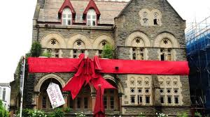
The “Red Ribbon” concept

Slide 9
What is a Riverside MOT?
Property
1)Selection based on both high historic repairs demand & current repair demand (include low demand properties)
2)High repair demand neighbourhoods
3)High repair demand property types
People
1)Client team all on message
2)Surveyors fully trained and consistent in approach Contractor supportive of approach & fully mobilised
3)Tenants informed about new approach and the reason for adopting it,influencing behavioural change
4)CSC briefed and advised on what they need to do

Slide 10
What is a Riverside MOT? (cont).
Process
1)Define access & no access communications
2)Scope and define end to end MOT model
3)Pre MOT repairs monitoring & action model “Heatmap”.
4)Post MOT repairs monitoring and action model
Price
1)Analyse and model data to define cost saving model

Slide 11
What is the purpose of the MOT?
Reduce responsive demand
Be proactive for our residents (repairs is a failure demand driven industry)
Maximise our productivity (batching repairs by street / neighbourhood)
Get to know our assets (aiming for 100% SCD information)
Deal with Section 11 and Section 82 issues
Get to know our residents (pick up on vulnerability/ sustain tenancies)
Culture change

Slide 12
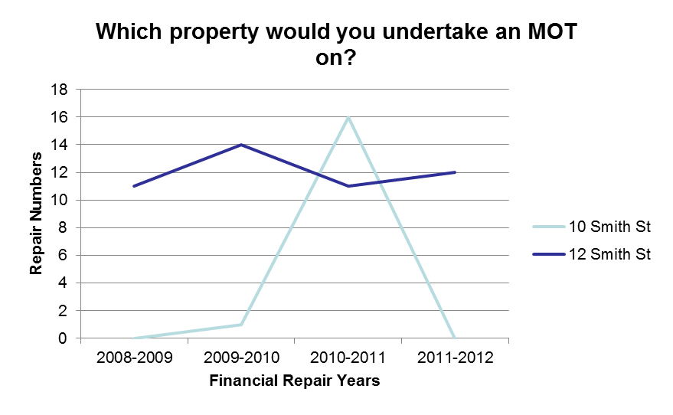
E.g.; upon reviewing the repair history for the past 4 years for 2 properties, the following is highlighted;
12 Smith Street has a constant stream of repairs each year;
10 Smith Street has a high number of repairs one year and minimal/zero repairs for the remainder.

Slide 13
The “Recidivist” and “Somnambulist”
– sound familiar?
March
2012
July
PLS CHECK ELECS IN KITCHEN
34.43
March
2012
October
MULTI ELECTRICS
37.53
March
2012
October
LOCATE FAULT ON INTERNAL DOOR
34.92
March
2012
December
LEAK FROM WALK IN SHOWER LIFTING THE WET ROOM FLOOR COVERING
10.52
March
2012
March
TAPS LEAKING: KITCHEN SINK
48.02
March
2012
August
KITCHEN SINK: WASTE PIPE:LOCATE FAULT/RECTIFY
33.87
March
2012
October
LOCK: PROBLEMS TURNING WITH KEY
62.41
March
2012
October
POWER:SOCKET OUTLET-GRND FLR.
26.23
March
2012
June
LIGHT: RENEW LAMPHOLDER/BATTEN HOLDER
48.34
March
2012
October
GUTTER: REMAKE JOINT
11.97
March
2012
December
BURST/LEAK: REPAIR LEAKING/BURST PIPE
34.71
March
2012
December
POST/GATE: RENEW/REPAIR ANY FITTING
42.72
February
2012
March
TAP LOOSE/LEAKING
39.5
February
2012
April
TAP:RENEW PAIR BATH PILLAR TAPS. FOW TO 310457072
106.67
February
2012
November
OUT OF HOURS:TOILET LEAKING
42.74
February
2012
December
ELECTRICS NOT WORKING
42.74
February
2012
November
NOSING: REFIX NON-SLIP TO STEP
8.83
February
2012
November
GARAGE DR:RENEW SPIND/ROLLER/CABLE.
66.31
February
2012
November
SEALANT:APPLY TO WORKTOP/WALL.
13.12
February
2012
November
GUTTER:RENEW N.E 112MM PVC COMPL
431.24
February
2012
June
SLATE MISSING FROM REAR ROOF
17.1
February
2012
June
FAN:OVERHAUL DOMESTIC EXTRACT ON LANDING CEILING
14.46
February
2012
August
DRAIN COVER MISSING NEAR BACK GATE
449.7
February
2012
October
LIGHT HAS GONE VERY DULL IN BATHROOM
51.49
April
2012
June
CISTERN:RENEW BALLVALVE. FOW TO 320411017
33.87
April
2012
October
LIGHTING: LOCATE FAULT/RECTIFY
34.43
April
2012
November
BACK DOOR IS L;EAKING AND DIFFICULT TO OPEN AND CLOSE
155.89
April
2012
November
COOKER: REMOVE/REPAIR/REFIX/RENEW
29.2
March
2012
June
REPAIR KITCHEN DRAWER.
21.12
March
2012
November
HEAT DETECTOR ABOVE COOKER BEEPING
93.34
March
2012
November
UNIT:RENEW DRAWER COMPLETE
104.09
March
2012
November
WASTE:RENEW 40MM PIPE/TRAP-SINK.
43.94
September
2011
December
WATER HEATER:SERVICE/OVERHAUL ANY TYPE.
20.17
September
2011
October
FAN:PLEASE SURVEY FOR EXTRACTOR FAN IN BATHROOM
14.46
September
2011
October
POSSIBLE DAMP IN BEDROOM - UNSURE OF SOURCE
24.94
September
2011
October
DOWNPIPE:RENEW PVC - NE 2 STOREY FOW 320429428
98.7
February
2012
April
BURST/LEAK: REPAIR LEAKING/BURST PIPE
34.71
February
2012
April
WATER PENETRATION: REPAIR/TEST
66.49
February
2012
April
BURST/LEAK: REPAIR LEAKING/BURST PIPE
34.71
February
2012
December
GATE:REPAIR/EASE/ADJUST GATE. - METAL GATE -
11.39
April
2012
July
TILE/SLATES:RENEW/REFIX HANGING ANY TYPE.
3.33
April
2012
July
STEP:RESTORE DAMAGED CONCRETE.
8.45
April
2012
October
GUTTER:RENEW N.E 112MM PVC COMPL FOW 320424349 FAO LINSEY M
330.74
April
2012
December
LAMP:RENEW 28 WATT 2.D.LAMP.
65.4
April
2012
October
CISTERN: REFIX WC CISTERN
33.87
April
2012
October
OOH MAKE SAFE ELECTRICS
42.74
April
2012
October
RECTIFY FAULT ON SHOWER
79.12
April
2012
October
S/DET:INSTALL MAINS OPTICAL TYPE FOW 32043006
91.05
July
2012
July
TAP: OVERHAUL ANY TYPE OF TAP
37.89
July
2012
October
MANHOLE:REBED/RELAY COVER/FRAME
142.29
July
2012
December
OUT OF HOURS ELECTRICS TRIPPING
42.74
July
2012
December
POWER:LOCATE FAULT/RECTIFY FOW 320437204
53.25

Slide 14

“Colour Chaos” and the Repair Heat Map
Noted that numerous properties had reported high repairs for several years, often with the same trade operatives attending
Each property was tracked to show the chaotic repair activity and listed in a repair ‘heat map’ based on activity
A way of monitoring and targeting the heaviest repairs consumers
Aims to reduce annual repair figures and average repair costs
A shift from a reactive to a proactive service
Grouped high repair activity by neighbourhood, targeting full areas in one approach

Slide 15
MOT / Stock Condition Survey
- Carried out by local divisional MOT Officers
Delivered on a rolling 4 year cycle to target repairs and pick up detailed stock condition data
70% of each years programme targets a planned neighbourhood approach with the remaining 30% of visits based on the heat map
Captures all actual and prospective repairs
Re-inforce the tenant responsibilities and our repair obligations
Records data on property attributes and component data allowing for accurate property data and investment forecasting

Slide 16
LOL SLIDES

Slide 18
LOL SLIDES

