Slide 1
Leadership’s True Colours
Plenary 3
Speaker: Graham Cook, The Colour Works
Chaired by: Mike Turner (Ian Williams)
Room: Main Hall
Sponsored by

Slide 2
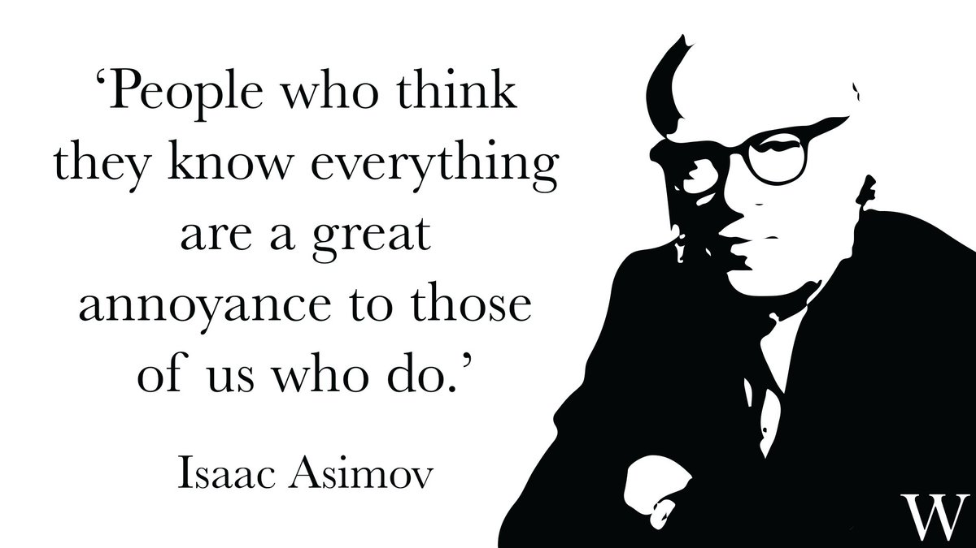

Slide 4
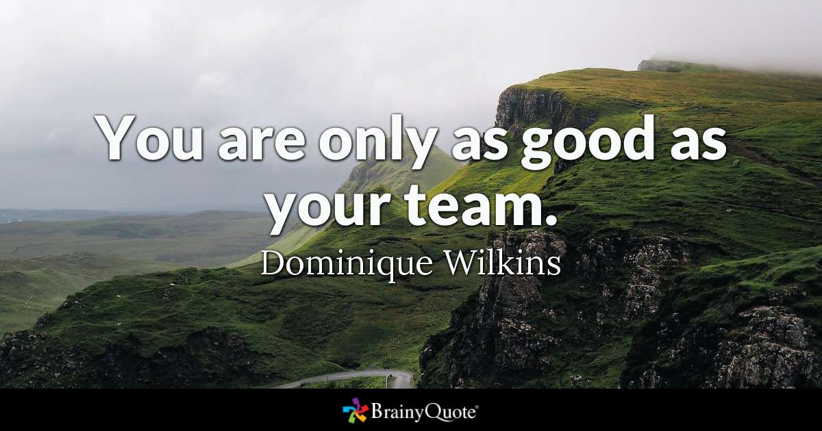

Slide 5
Leadership’s True Colours
How a simple but powerful colour model of human behaviour, can improve team and individual performance… and shape and develop Leadership practices in your organisation and improve Talent Retention…

Slide 6
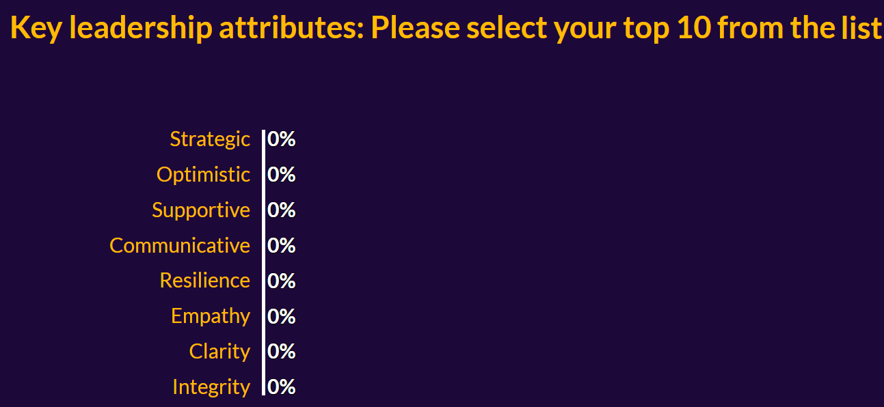
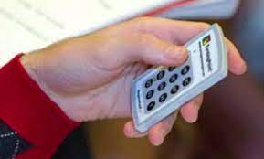
How do we see Leadership?
Using your controller, select what you see as the key attributes of leadership
Key Attributes: https://io-eur.cvent.com/polling/v1/api/polls/sp-w6kg8h

Slide 7
So, what can be done to support Leadership in your business?

Slide 8
Brought to life over 20 years ago by Co-Founders (and father and son) Andi and Andy Lothian, we help people understand themselves better as individuals and leaders. Over 6 million people worldwide have colour profiles.
The largest independent Insights distributor in the UK and with our own global presence, we've helped people across a variety of sectors to build, grow and empower their teams.

Slide 9
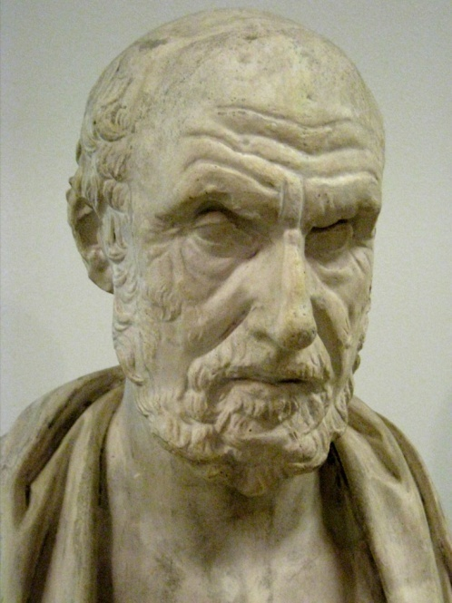
The Four Humours
Melancholic
conscientious
orderly
pessimistic
mood changes
Choleric
appear as natural leaders
tough-minded
impatient
Phlegmatic
observe from
the sidelines
tolerant
fit in with others
Sanguine
outgoing
optimistic
fun-loving
sociable

Slide 10
The Four Insights Colour Energies
Cool Blue
Shows no bias, Objective, Detached, Analytical
Earth Green
Still, Tranquil,
Calming, Soothing
Sunshine Yellow
Cheerful, Uplifting,
Spirited, Buoyant
Fiery Red
Positive, Affirmative,
Bold, Assertive

Slide 11
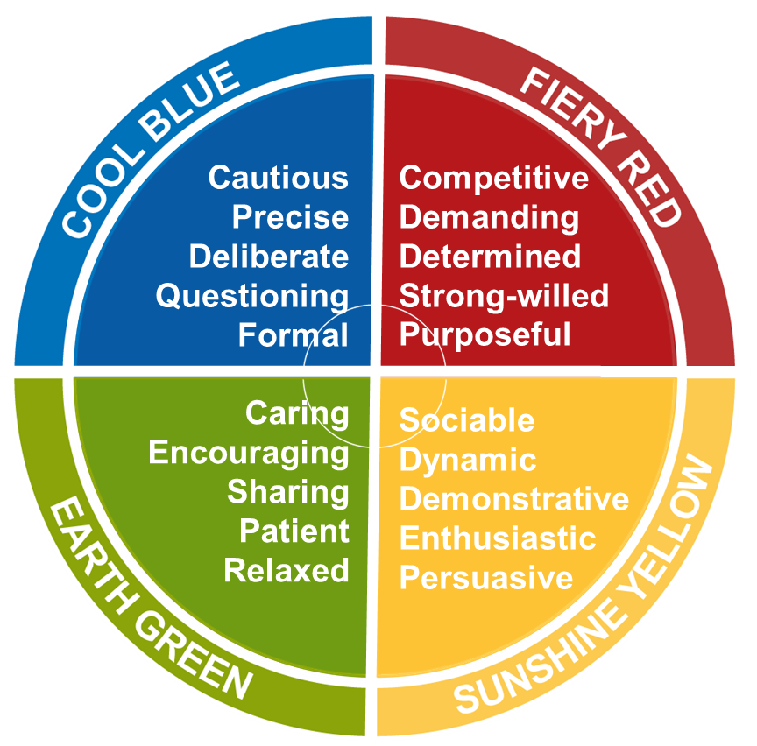
The Insights Colour Energies

Slide 12
The Colour Energies Exercise – Where do you fit?
Using your keypad, pick your Leading Colour and the order of the remaining three
Leading Colours: https://io-eur.cvent.com/polling/v1/api/polls/sp-15nbwf

Slide 13
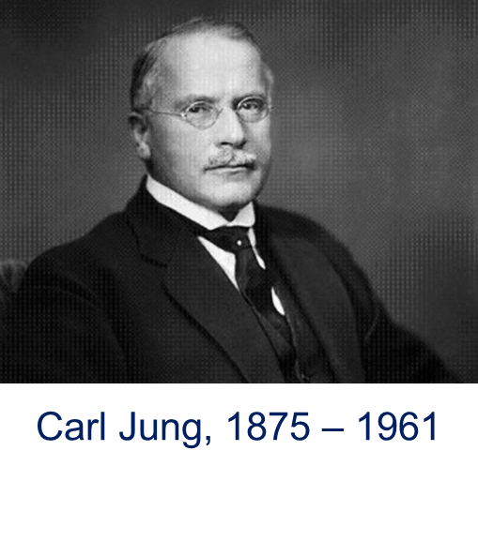
Psychological Preferences
Jung talked about pairs of preferences:
The way we react to outer and inner experiences
Introverted Attitudes and Extraverted Attitudes
How we make decisions
Thinking Functions and Feeling Functions

Slide 14
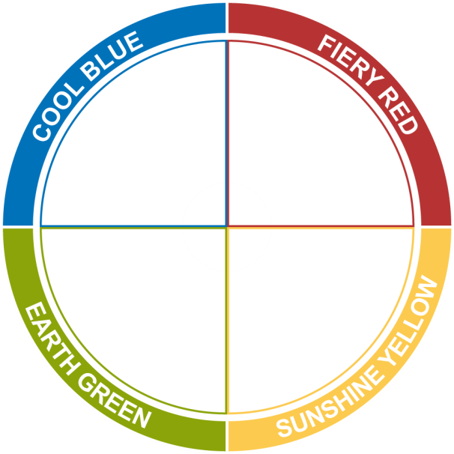
Introversion and Extraversion How do you react to stimuli?
Inward Focus
Quiet
Observant
Reflective
Thoughtful
Cautious
Passive
Depth of knowledge
Outward Focus
Talkative
Involved
Outspoken
Action Oriented
Bold
Active
Breadth of knowledge
INTROVERSION
EXTRAVERSION

Slide 15
Thinking and Feeling How do you make decisions?
Task-oriented
Analytical • Impersonal • Detached • Objective
THINKING
FEELING
Considerate • Accommodating • Personal • Harmonious
Relationships-oriented

Slide 16
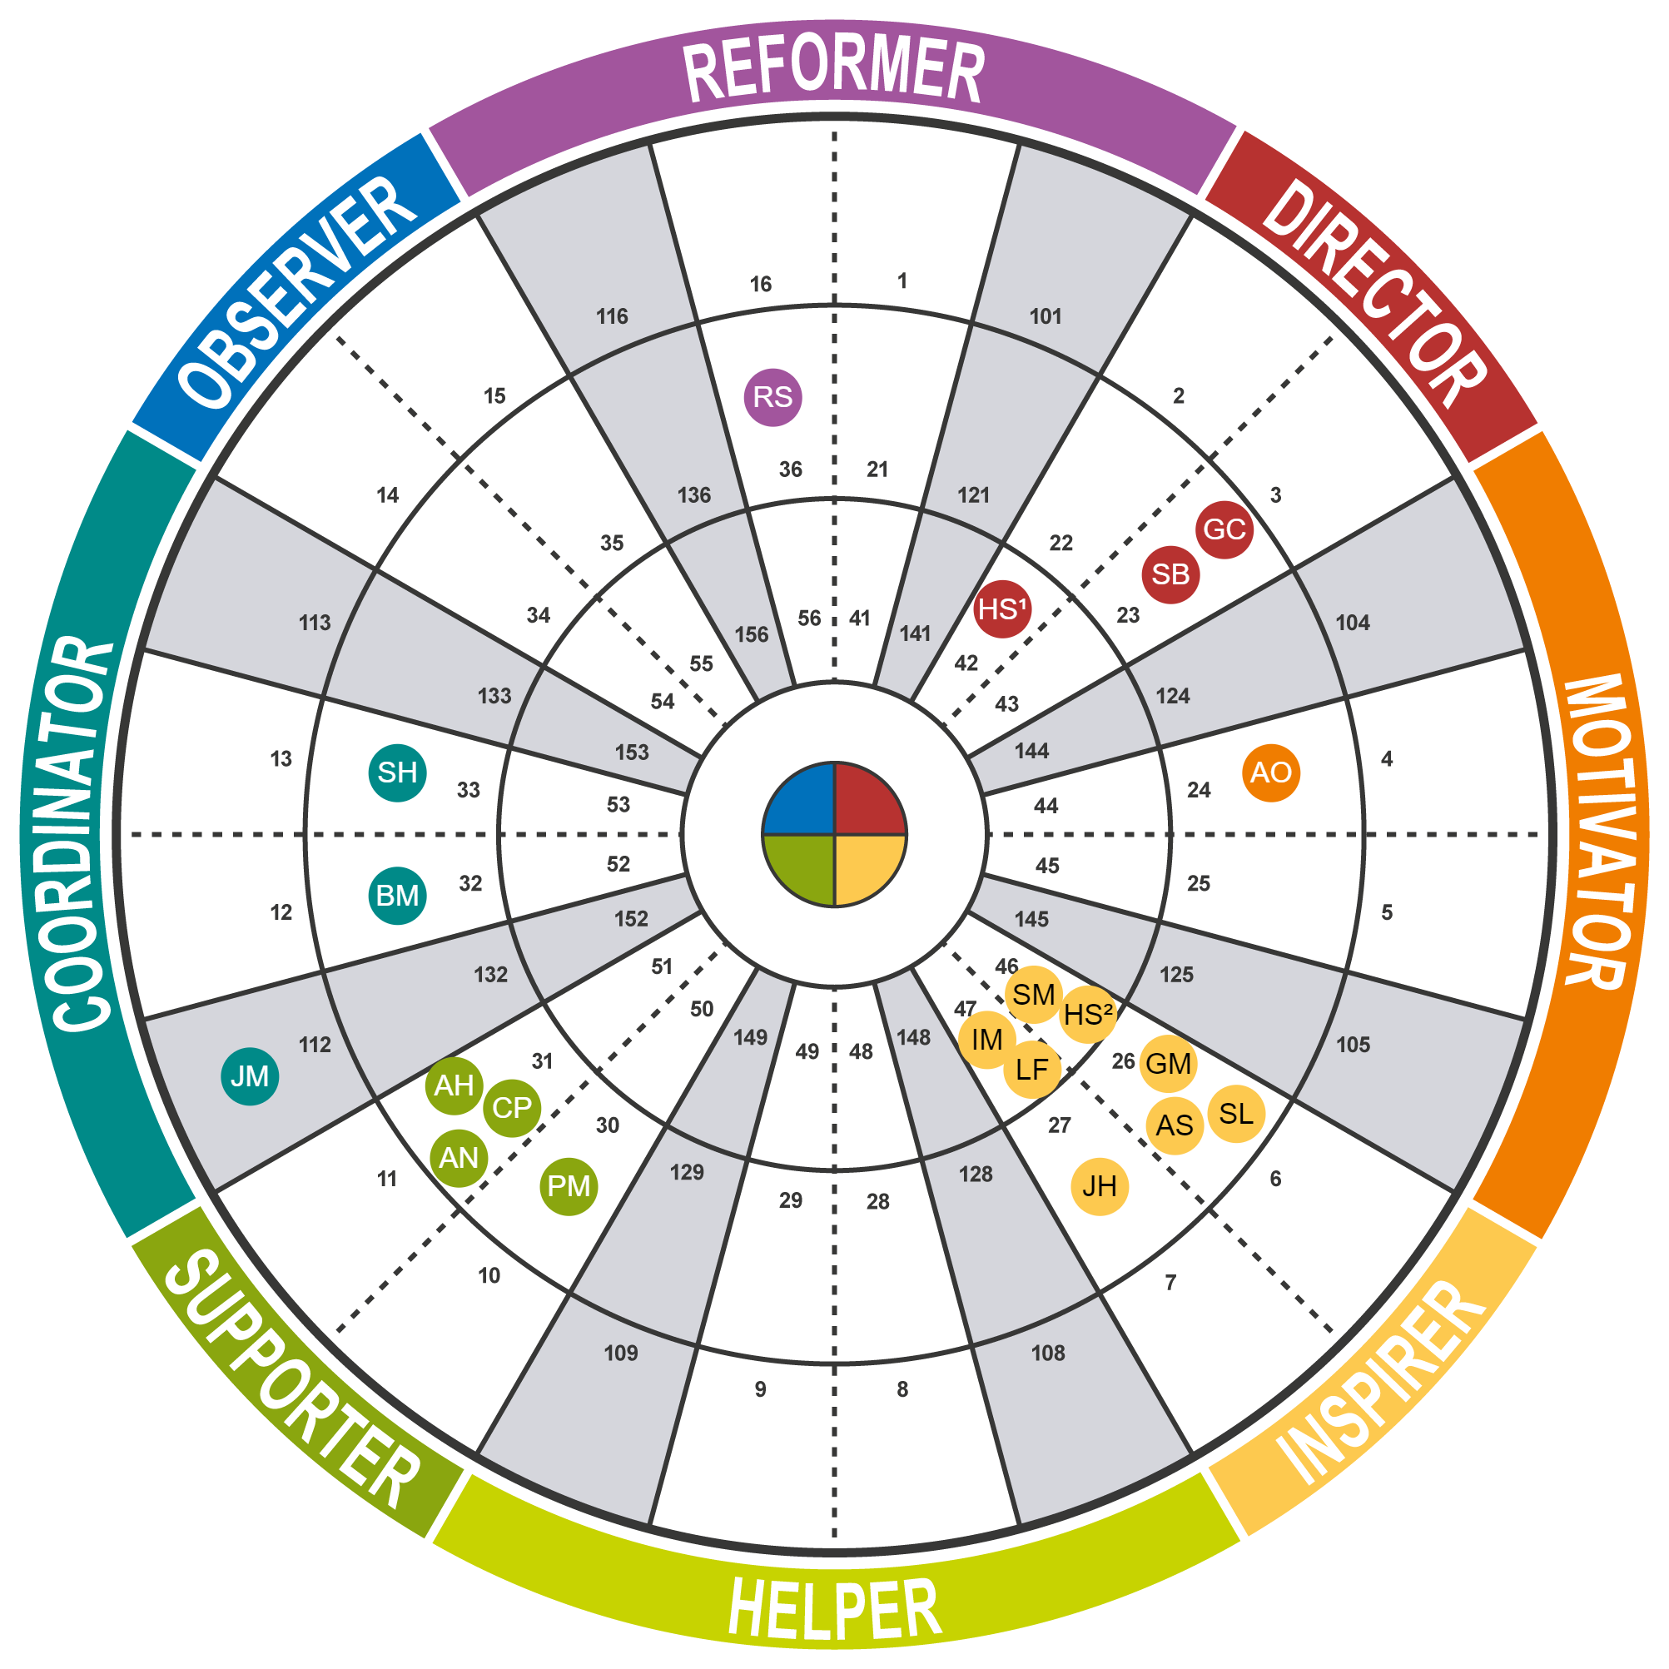
Insights Discovery
How does this affect Team Performance, Leadership and Retention?
Notes:
Bring in Plenary responses from Leadership responses

Slide 17
How can you use this to make you more successful?
Recruitment
Understand the preferences of the candidate
How do the preferences of the candidate fit the role?
How does the new recruit complement the team?

Slide 18
How can you use this to make you more successful?
On-boarding and Retention
What do you need to do to get the best out of the new starter?
What is their ideal environment?
How do we / they need to adapt to each other to be most effective?
Understanding and appreciating other perspectives supports Diversity and Inclusion and the general feel of being understood and connected
Sets the bar in terms of encouraging and nurturing positive behaviours and engagement

Slide 19
How can you use this to make you more successful?
Creating High Performing Teams / Leaders
Understanding our preferences, and especially those of others, helps us communicate more effectively with each other
Adapting to others improves levels of engagement, buy-in and understanding
Applies at any / all levels of seniority and between seniority levels

Slide 20
For more information
The foundational program with The Colour Works is called Personal Impact
Tailorable but typically ranges from 2-4 hours and conducted in groups of 8-20
Supplementary workshops include Leadership and Cultural workshops
Coaching and Feedback, Emerging and Established Leaders, Outstanding Leaders and 360
Creating a Vibrant Workplace Culture

Slide 21
Leadership’s True Colours
How a simple but powerful colour model of human behaviour, can improve team and individual performance… and shape and develop Leadership practices in your organisation and improve Talent Retention…

Slide 22
Thank you.
See you at the next conference!
For more information contact
graham@thecolourworks.com

