Slide 2
What are Spotlight Investigations?
Learning from complaints
Deeper investigations into systemic and thematic issues
How we gather our data
Recommendations for action
Ongoing monitoring

Slide 3
Change in culture needed
Reactive
Proactive
Inferring blame
Taking responsibility
Resident focused
Fabric focused
Zero tolerance
Fatalism

Slide 4
Key recommendations
Proactive communication strategy
Take responsibility
Empower staff
Use the complaints process
Focus on the fabric
Record keeping
Proactive
Find your silence
Treat people fairly
Know your residents
Check net zero plans
Know your stock
Damp and mould strategy
Zero tolerance culture

Slide 5
Following up on our report
35% now have a damp and mould policy
12% were in the process of implementing a damp and mould policy
19% have self assessed against the recommendations
59% who have done so stated they have made changes

Slide 6
Damp and mould prevention
Resident app
Surveyors' equipment
Modelling mold growth
AI model

Slide 7
Areas of concern
Use of language
Advice alone is sufficient
Wording in guidance
Lack of engagement

Slide 8
Priority areas for action
‘Hiding behind’ legal proceedings
Dignity, respect and fairness
Good governance, and knowledge and information management

Slide 9
What is still being seen?

Slide 10
Difficult situations
Signpost
Offer support
Keep in touch
Maintain records

Slide 11
Vulnerabilities Case Study

Slide 12
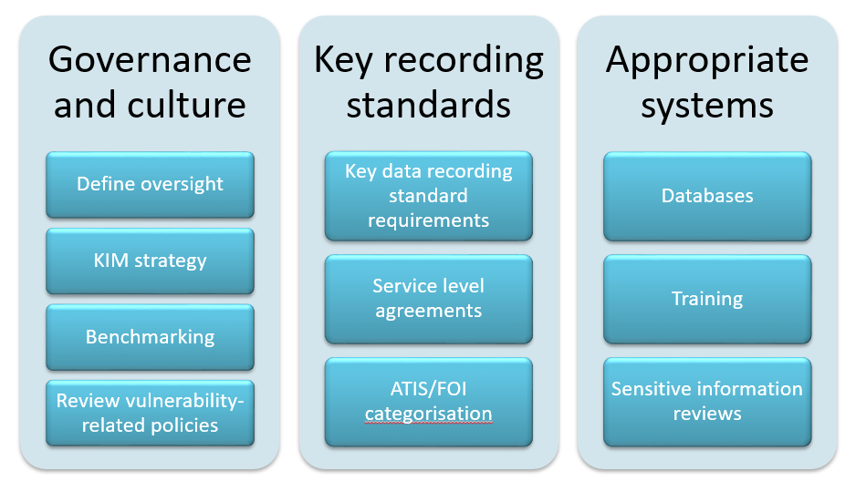
Knowledge & Information Management

Slide 13
Extended Powers

Slide 15
Centre for Learning
e-learning
FAQs
Drop-in sessions
Guidance notes
Requirements Documents
Reports
Case studies
Videos
Podcasts
Virtual Workshops
Webinars
Networking Forums

